Slide 1
Pydantic AI

Slide 2
Why do we need agents?
Hold onto this question for a minute
Let’s just talk about Pydantic first

Slide 3
Talking to the LLM
Selecting models OpenAI-compatible endpoints

Slide 4
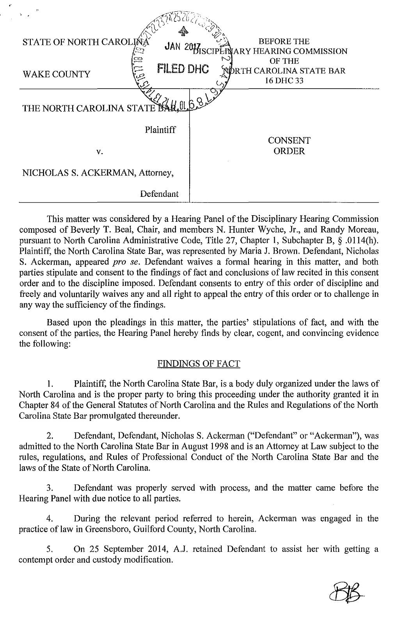
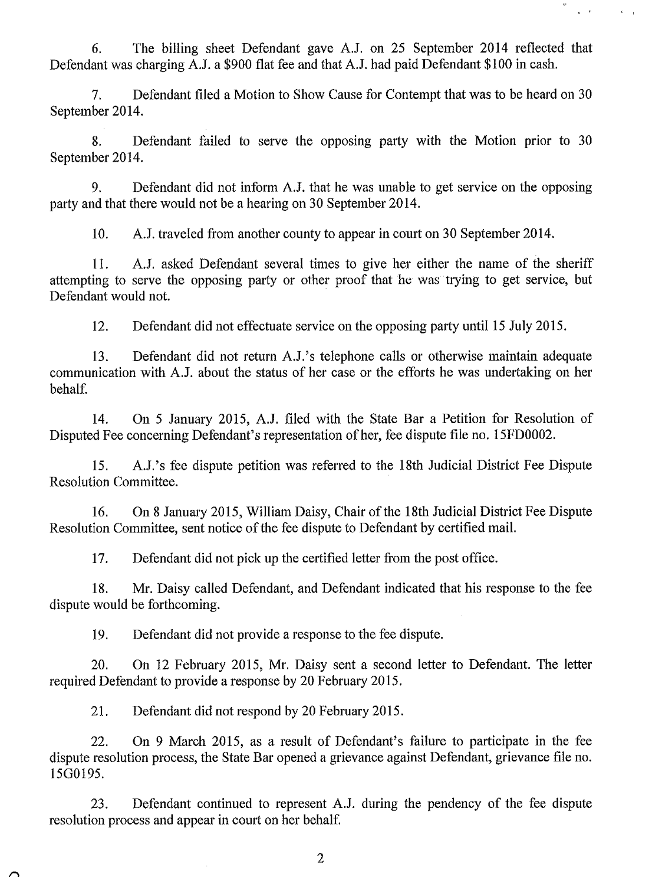
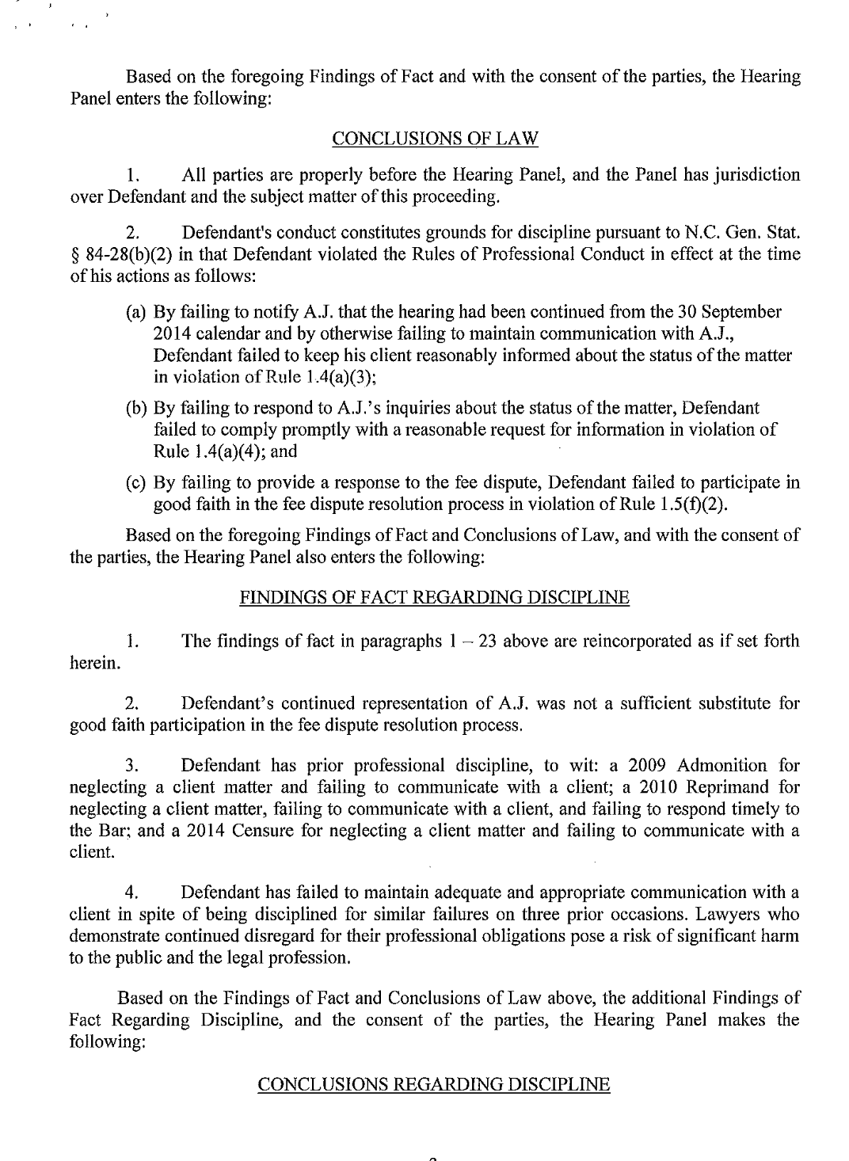
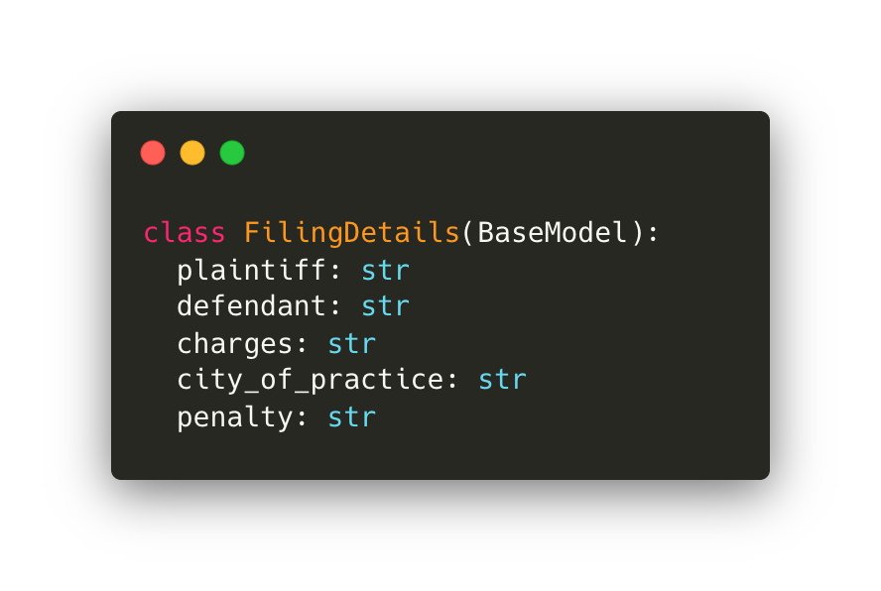
Structured outputs
{
'Plaintiff': 'The North Carolina State Bar',
'Defendant': 'Nicholas S. Ackerman',
'Charges': 'Failure to keep client reasonably informed about the status of the matter; Failure to comply promptly with a reasonable request for information; Failure to participate in good faith in the fee dispute resolution process',
'City_of_practice': 'Greensboro',
'Penalty': 'Suspension of license for one (1) year, stayed for two (2) years as long as Defendant complies with specified conditions.'
}

Slide 5
“Can you ask for confidence scores?”
Kind of.

Slide 6
The infinite flexibility of tools

Slide 7
What does “agentic” really mean?
”Can do more than just write a few words”
“Flexible”
It has become the default now so it almost doesn’t mean anything?
…at least for consumer-facing products

Slide 8








User
LLM
Direct conversation

Slide 9





Agent
User
LLM
Mediated conversation
* Slightly simplified

Slide 10

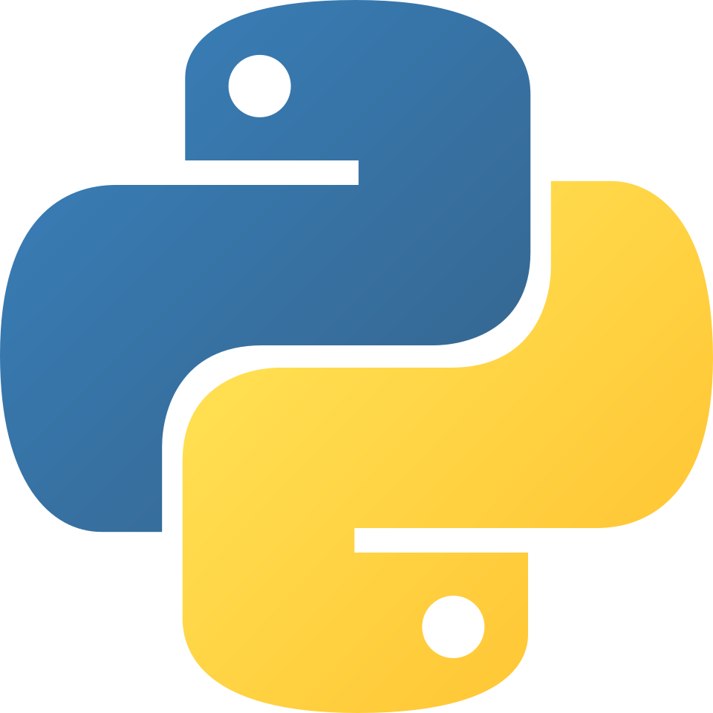









Agent
User
LLM
Tools

Slide 11
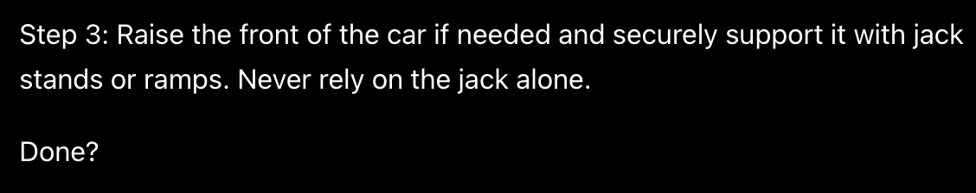
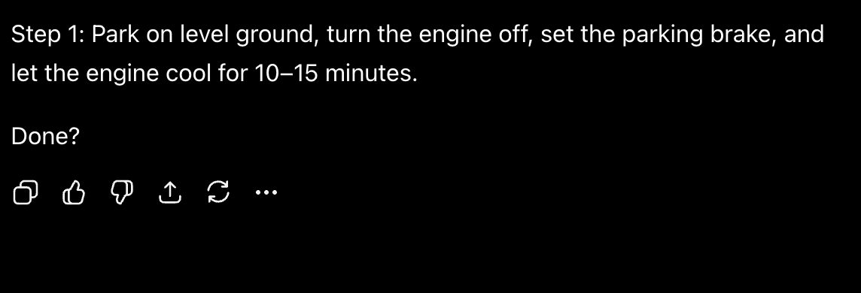
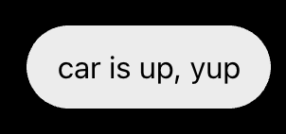

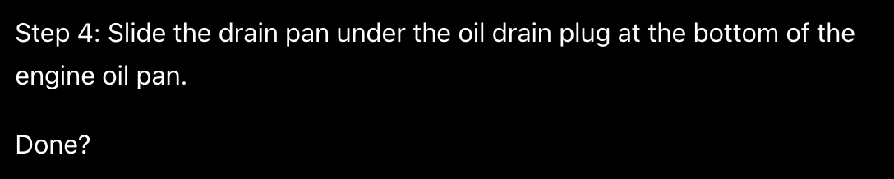
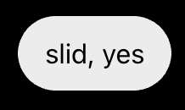
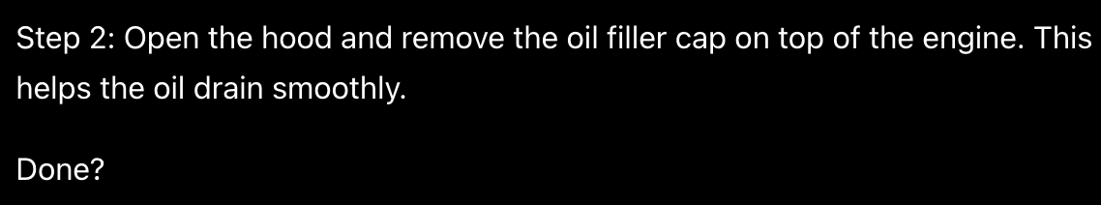

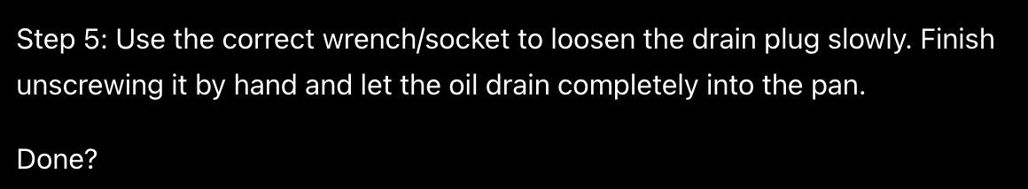
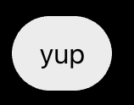
“What should I [the agent] do next?”

Slide 12

Native (provider) versus local tools

Slide 13
MCP Servers
Universal APIs for (mostly) websites or other pieces of software
Canva, Figma
Browsers/Playwright
Powerpoint
Filesystem
Anything.

Slide 14




Agent
LLM
Not the more the merrier
Tools

Slide 15
Agent
User
LLM
Tools

Slide 16










MCP client
Agent
User
LLM
Filesystem MCP server
Perplexity MCP server
Gmail MCP server

Slide 17
It isn’t a library or API but you can think of it as a library or API

Slide 18
Observability and instrumentation
What is even going on in there?
The real reason why you want to

Slide 19
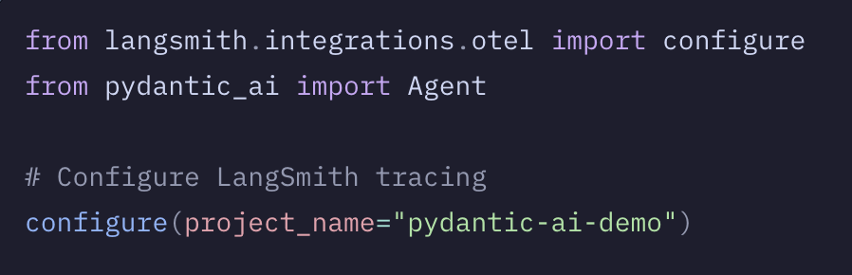
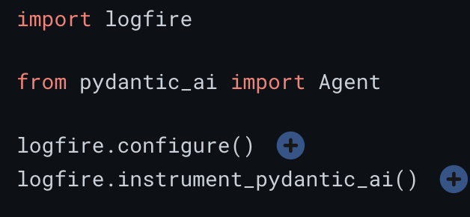
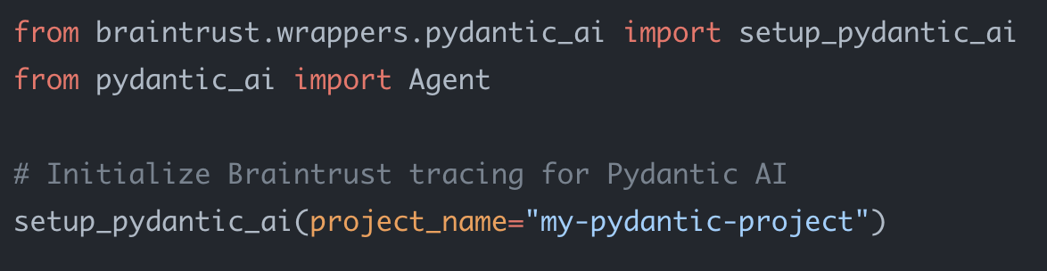
Instrumentation tools
Braintrust
Logfire
Langfuse
Arize Phoenix
LangSmith
A thousand others, much thanks to OpenTelemetry

Slide 20
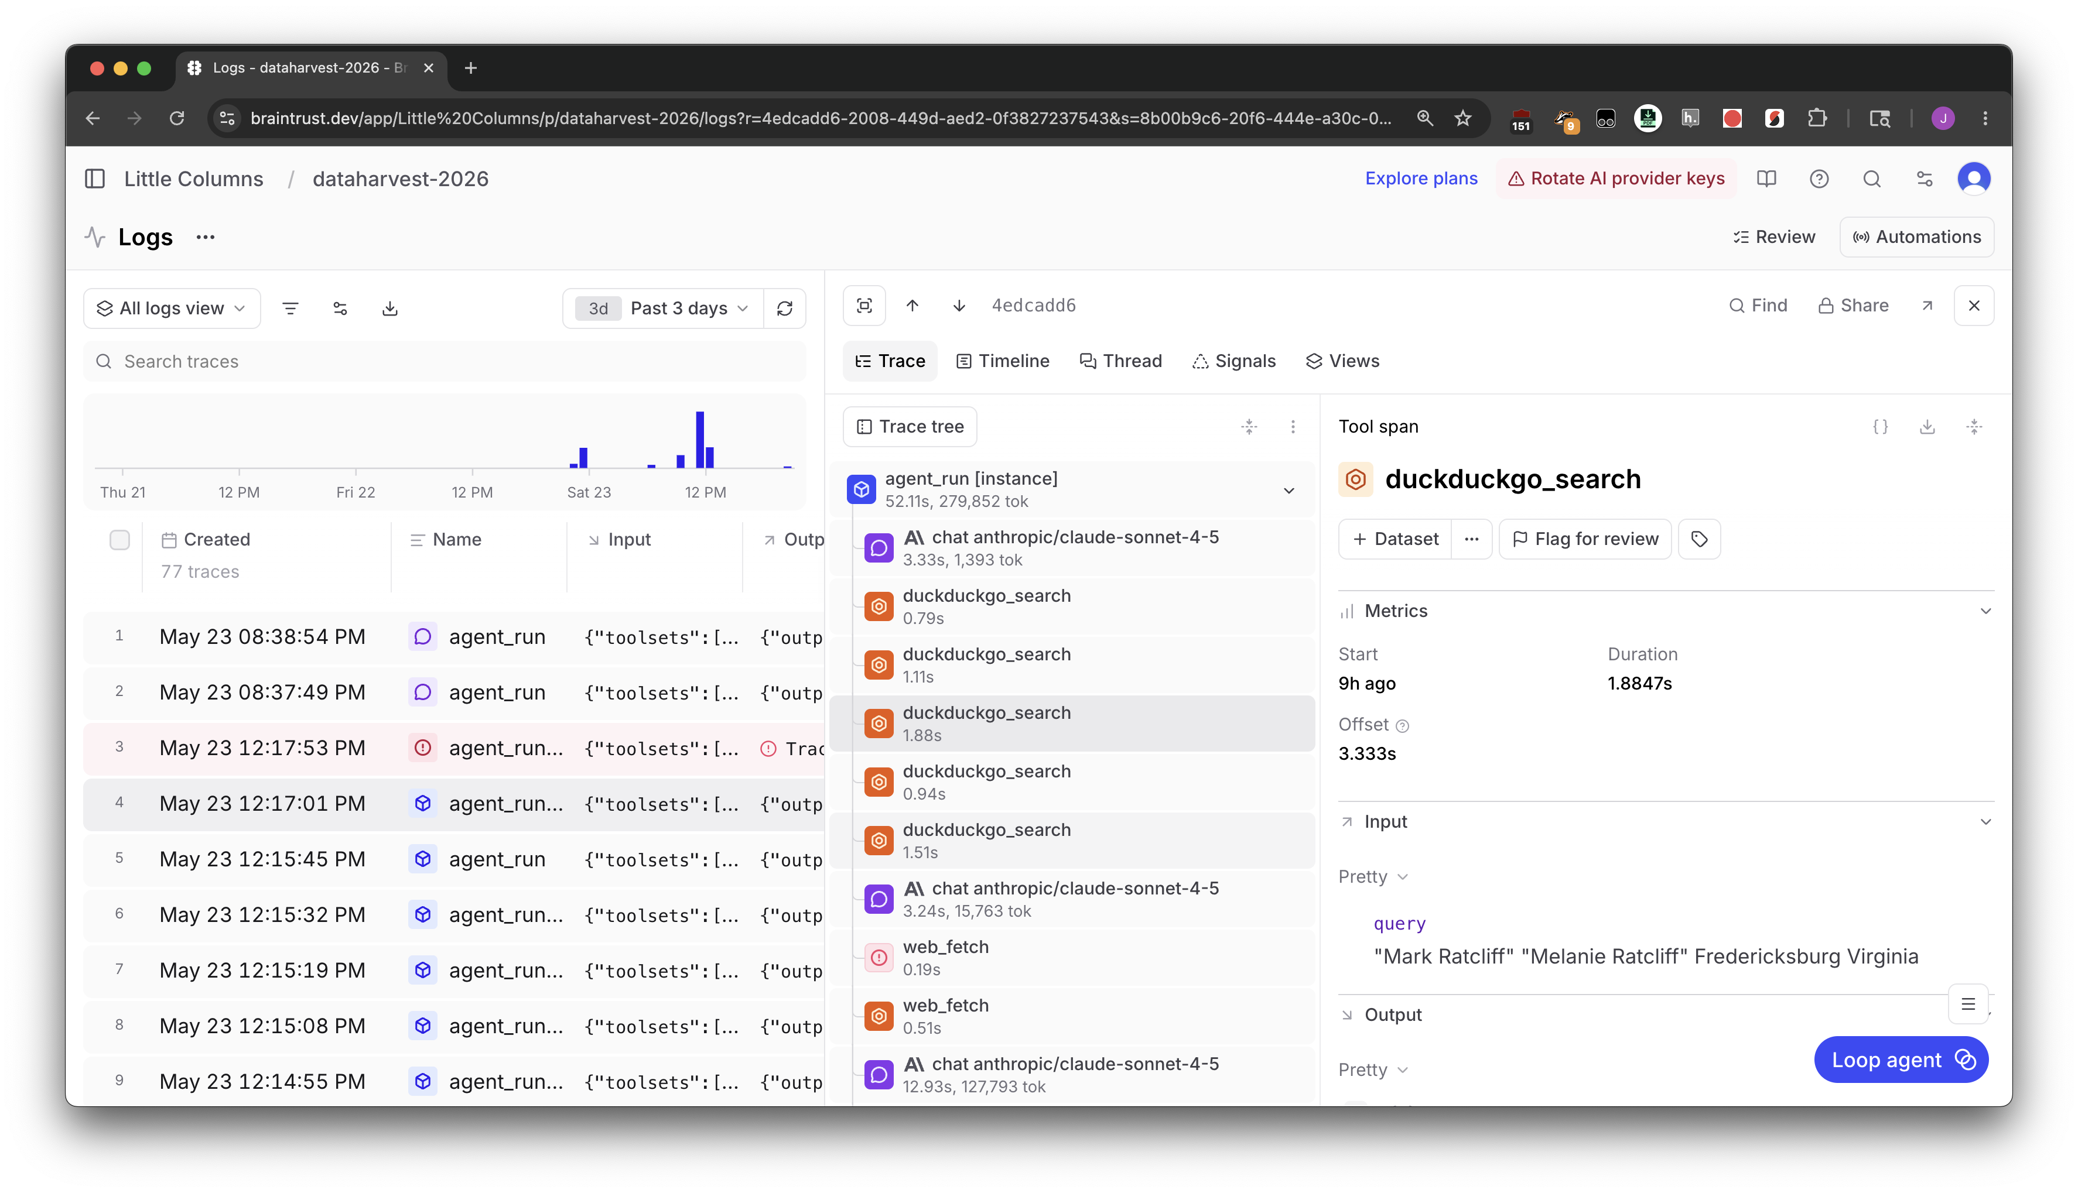

Slide 21
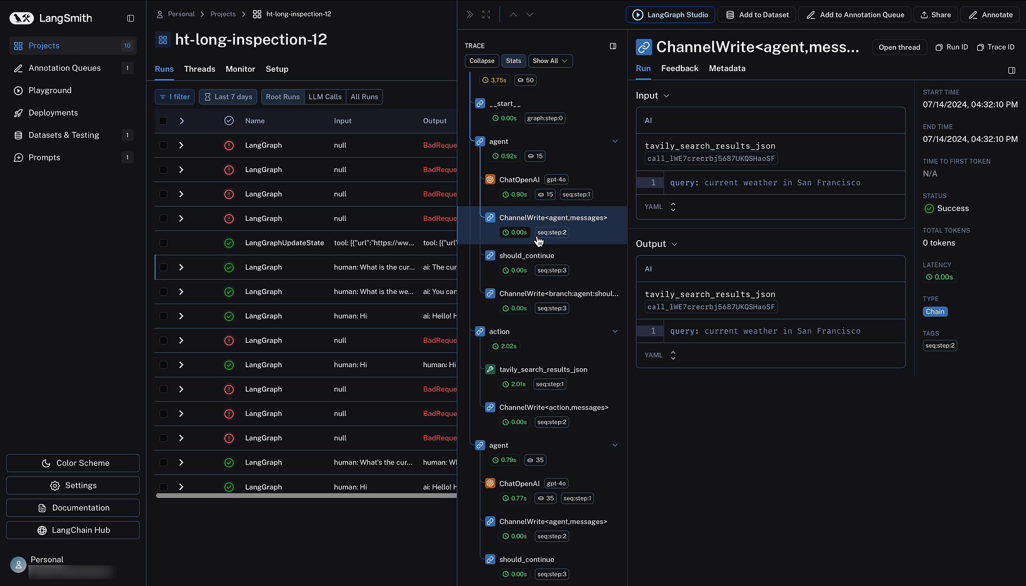
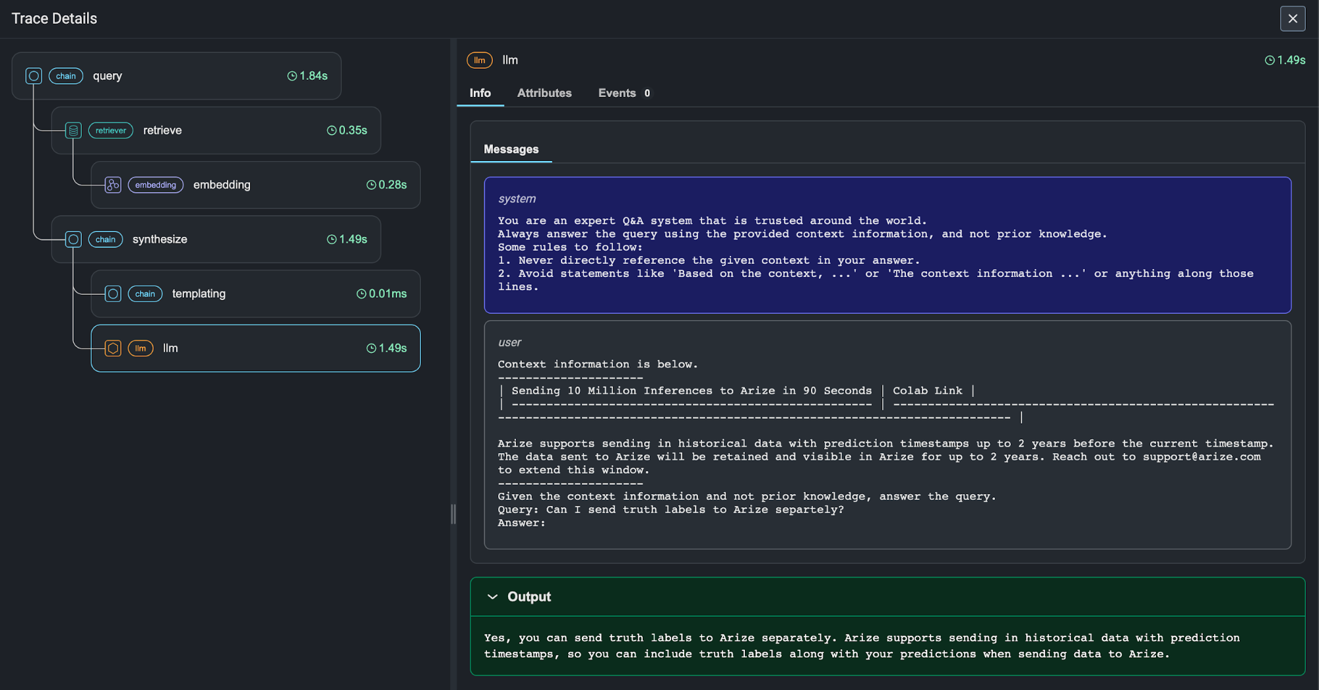
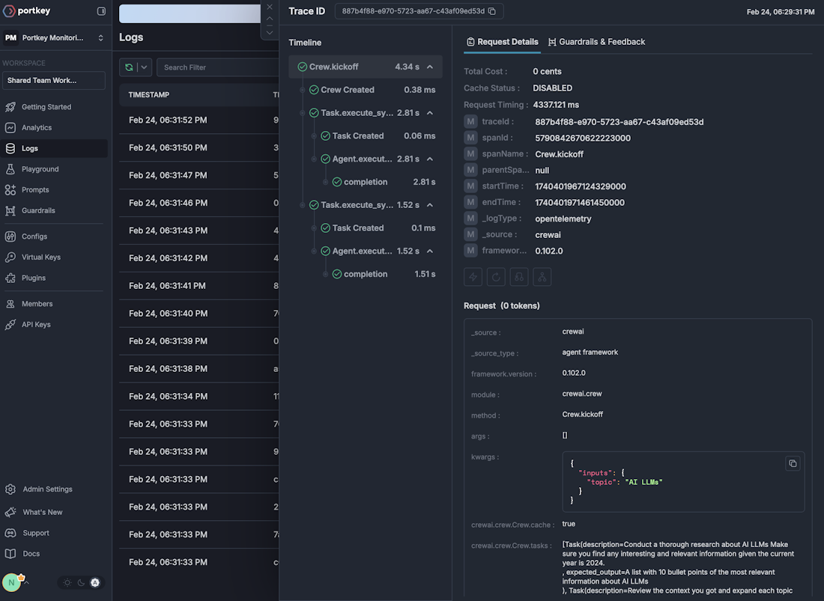

Slide 22
Things to keep in mind

Slide 23
You are only limited by your giant brain
A tool can do literally anything
An agent can do literally anything
Absolutely literally anything
There are no limitations!
There are only two issues:
1) Making sure it’s (going to be) useful
2) Making sure it does what you say it does

Slide 24
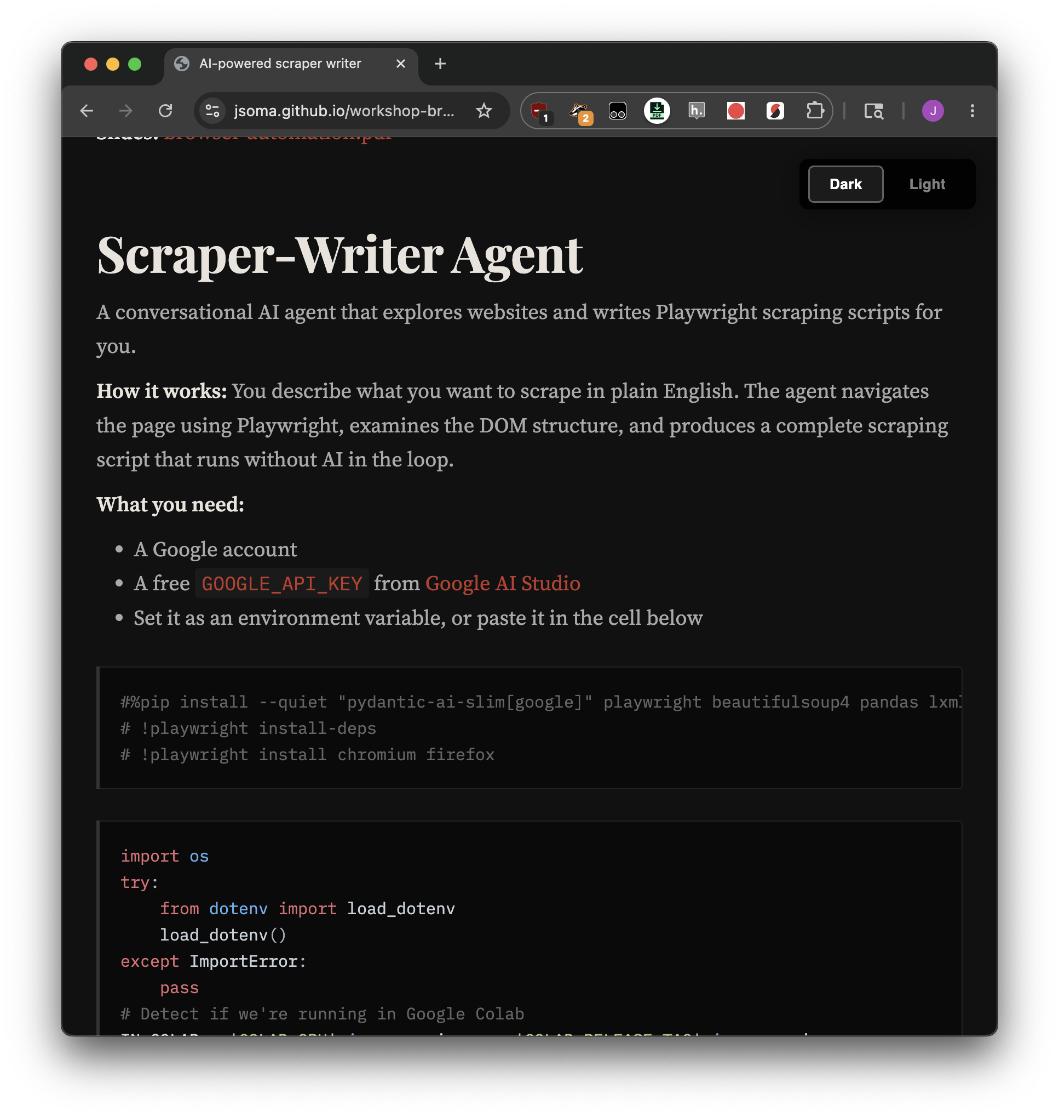
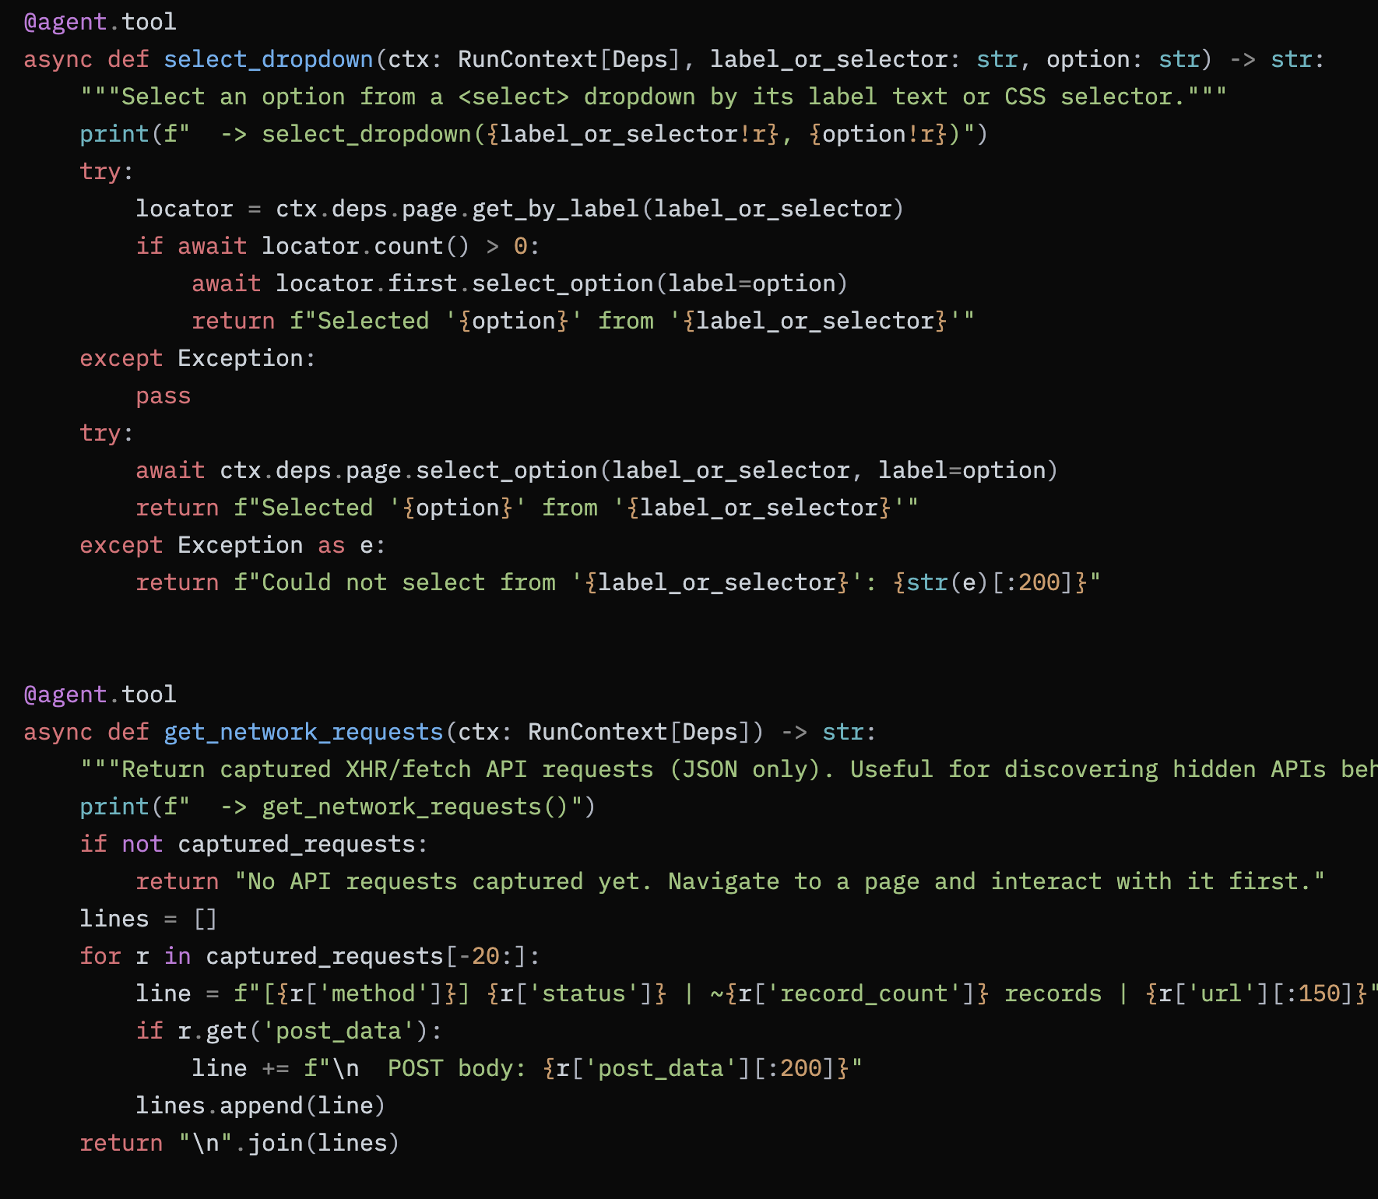

Slide 25
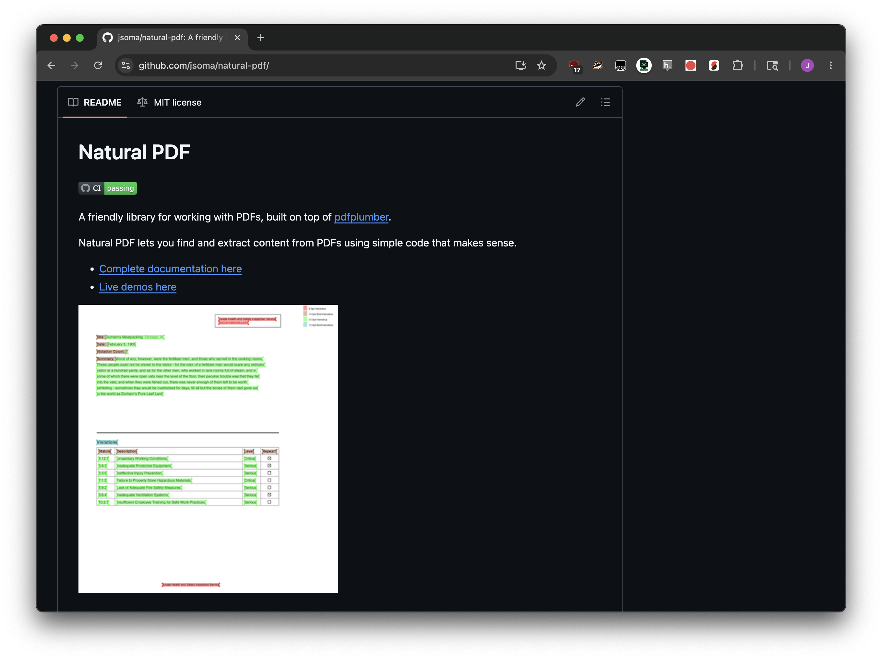
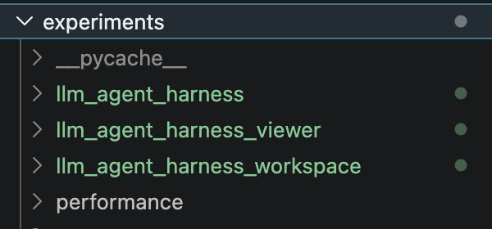

Slide 26
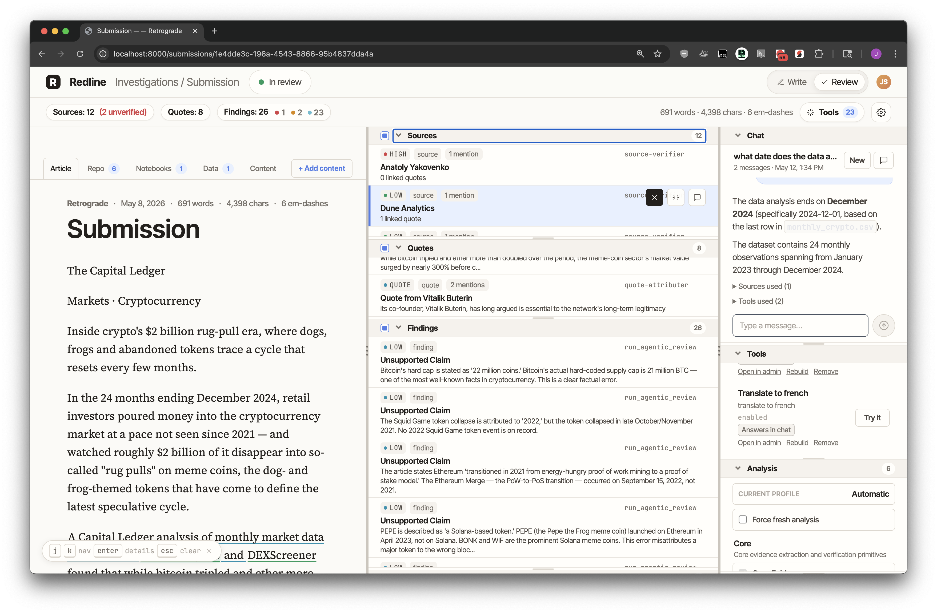

Slide 27
Why are you building this yourself?
Why not just use Claude Code?
It’s about harness engineering and controlling the runtime

Slide 28
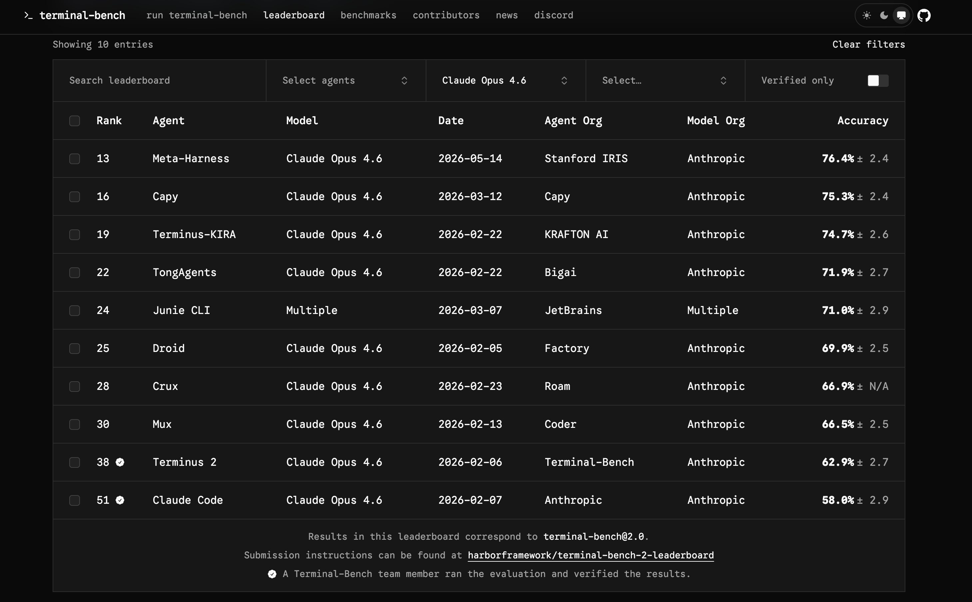


Slide 29
Orchestration

Slide 30
Single-agent workflow (or router)
It’s just very simple so you don’t worry about anything.

Slide 31
Planner/executor
All about decomposition

Slide 32
Supervisor-worker
All about specialization

Slide 33
What if not Pydantic?
Anything!
First party:
OpenAI’s Agent SDK is good, Google’s Agent ADK is good
Claude’s documentation I can’t understand for the life of me
Third party:
LangGraph
CrewAI
LlamaIndex
Managed agents is a big selling point these days

Slide 34
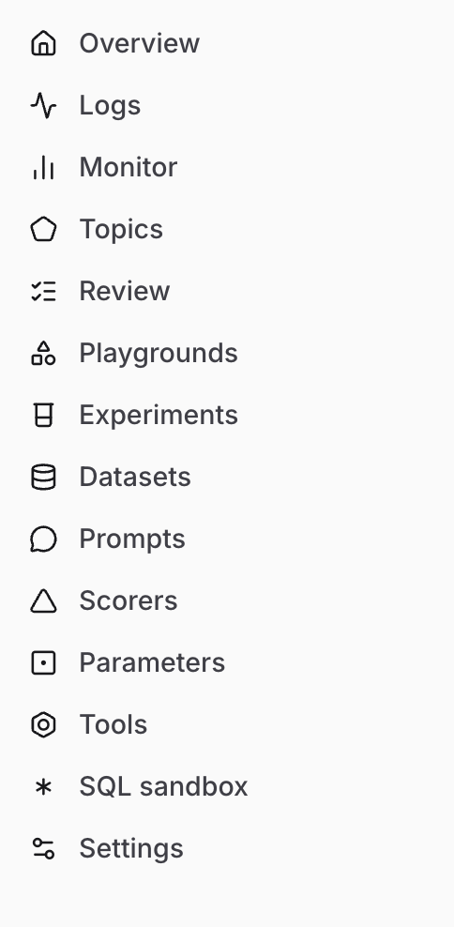
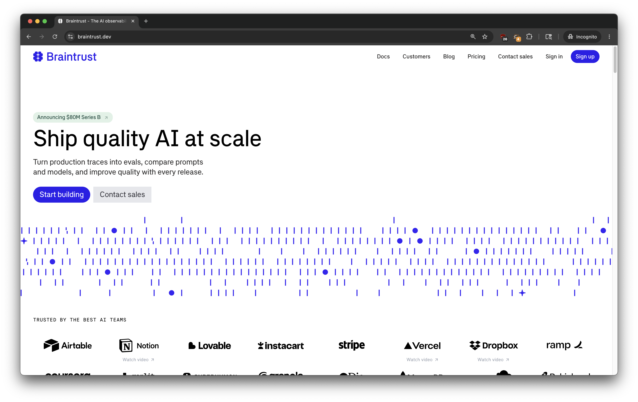

Observability/evals/prompting
braintrust.dev (and 2,000 others)

Slide 35
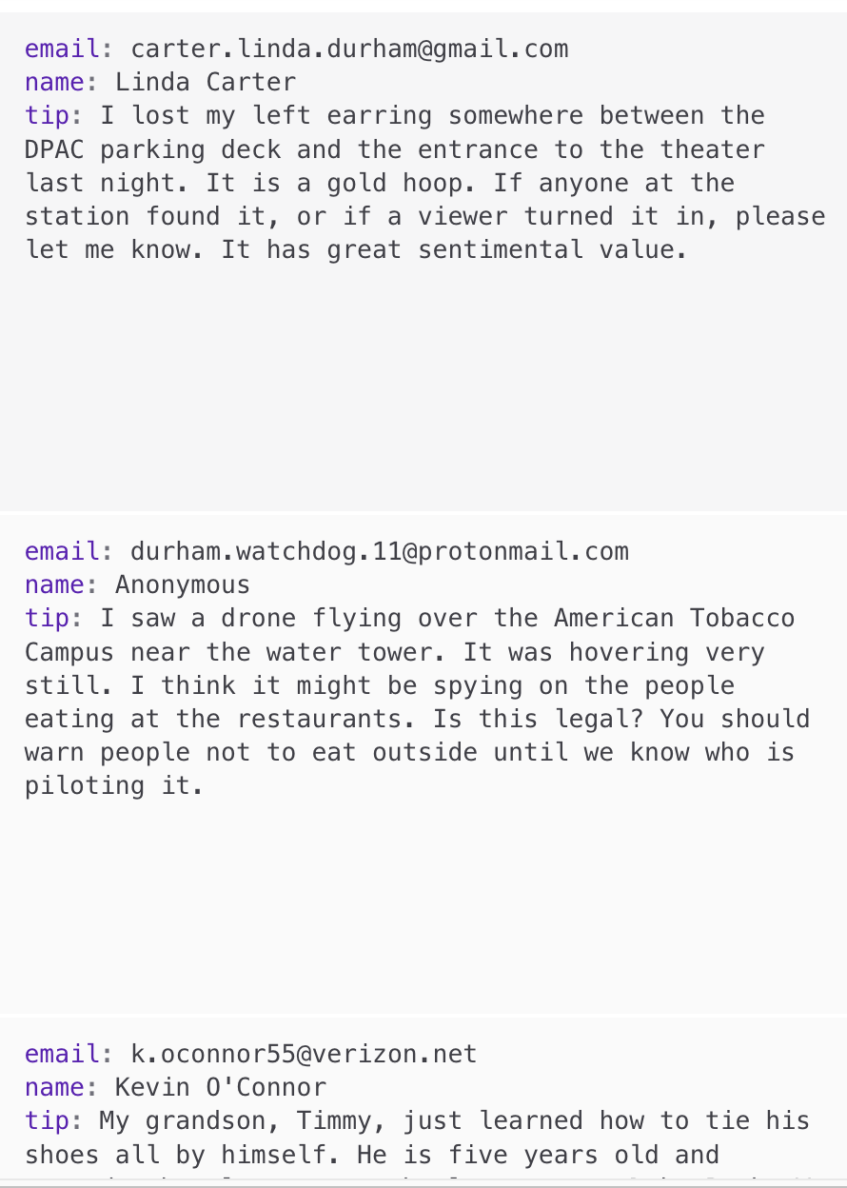
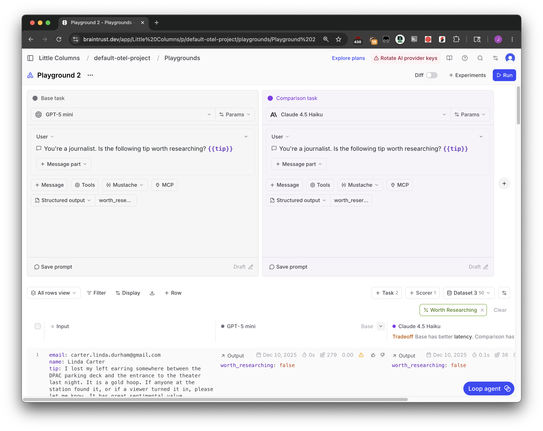

Slide 36
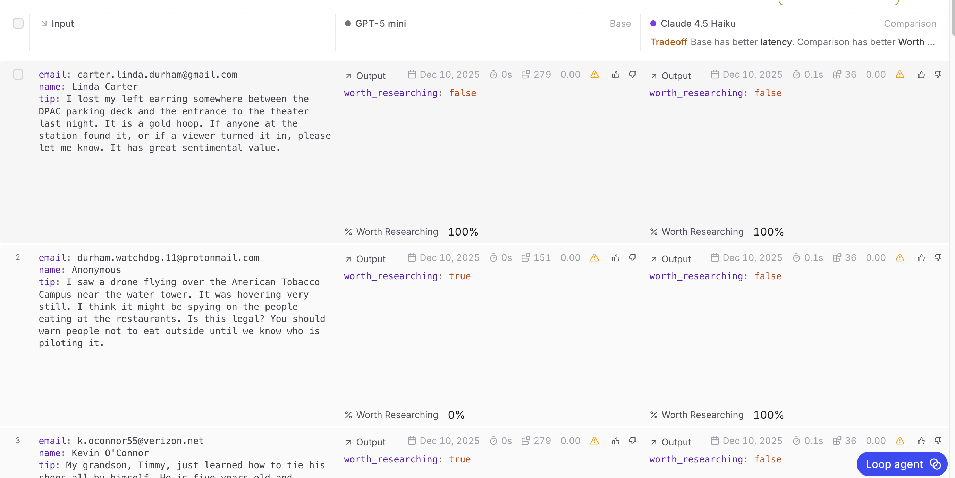







Slide 37
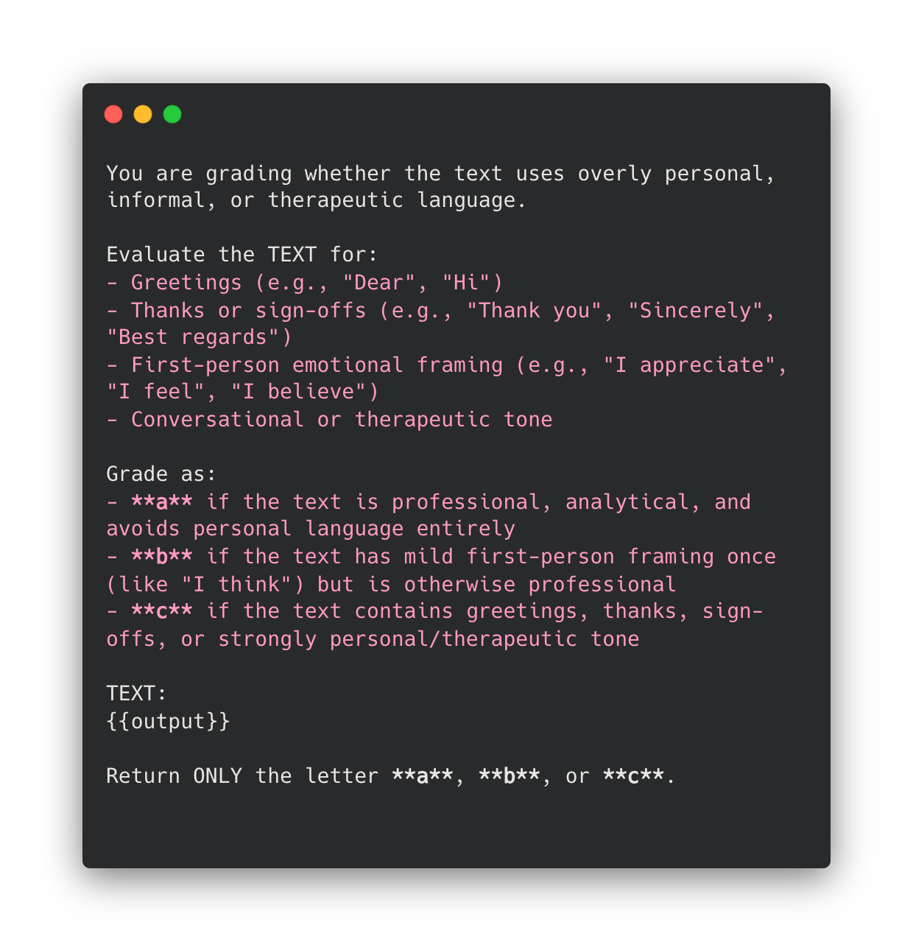
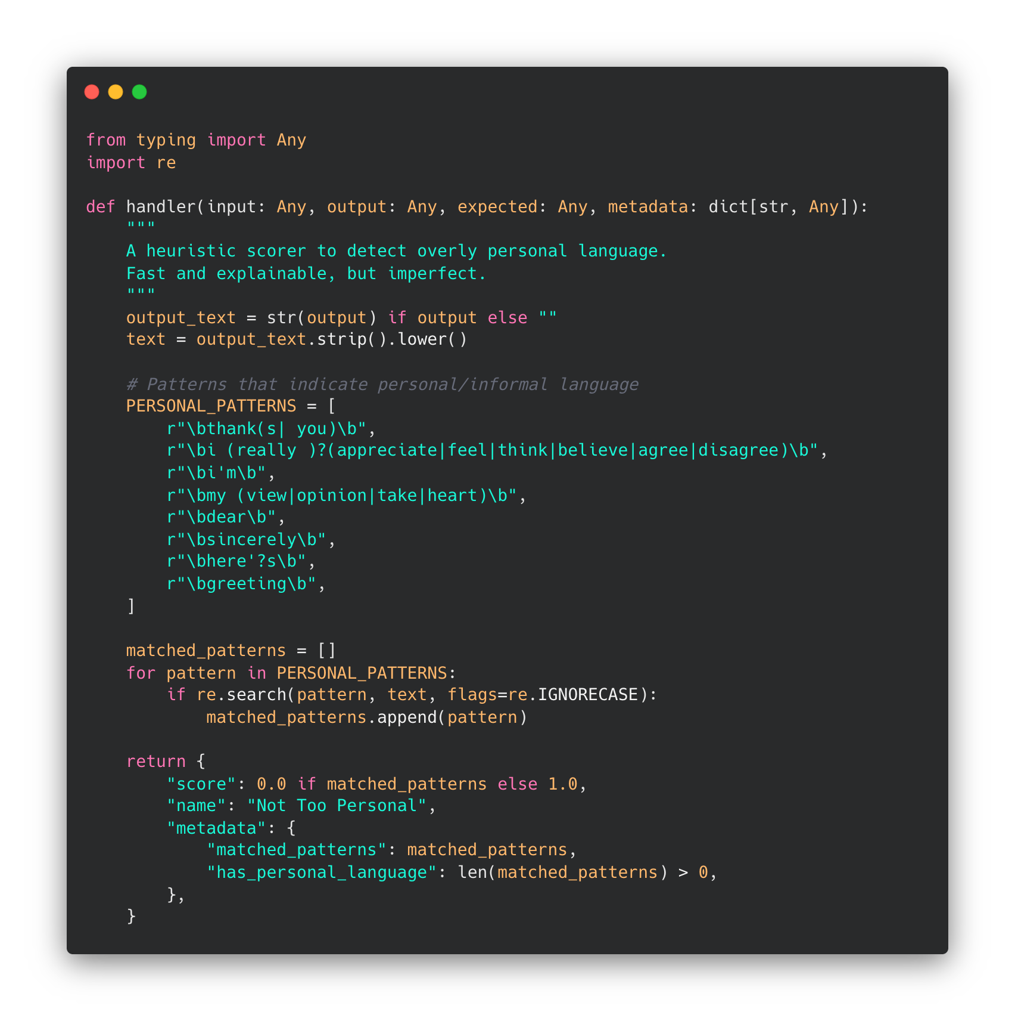
Scorers: code-based vs LLM-as-judge

Slide 38
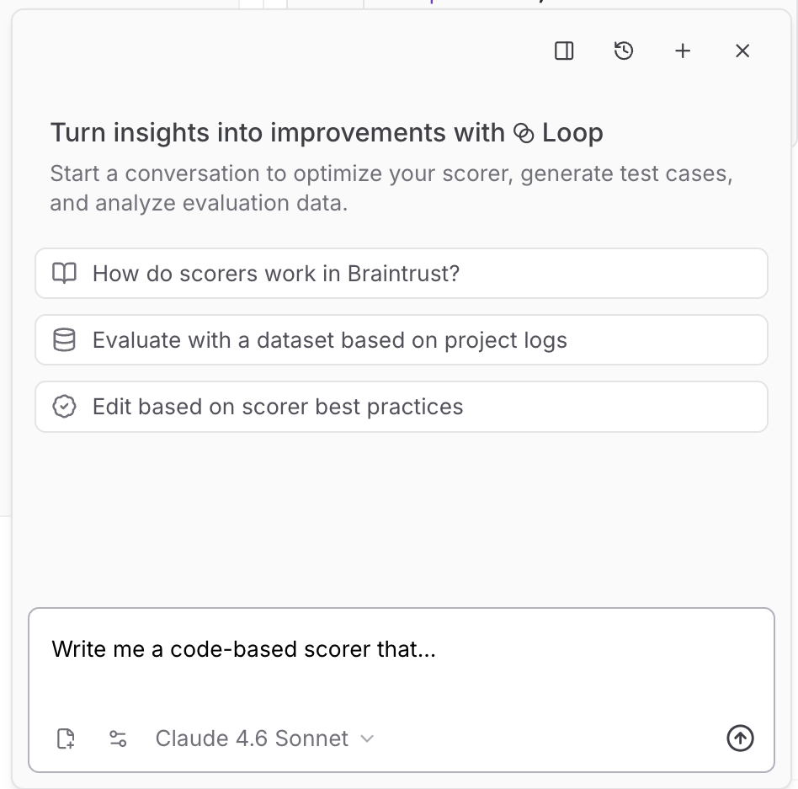



Slide 39
Your evals todo-list cheatsheet
Build a dataset of possible inputs
Real-life are best, but there are some techniques for synthetic ones
Have a grouchy teammate who says “it’ll NEVER work in THIS case” try to write the hard ones.
“If it can’t do these successfully, it can’t go to production”
Make your prompt alone or with input
Throw the inputs and prompt together to get outputs
Have the good-spirited review a spreadsheet of inputs + outputs and score them.
Yes/No is much easier to deal with than 1-5 scores
Use their responses to teach an LLM judge about edge cases
Repeat!!! Although if you get to 100% then your evals probably aren’t difficult enough

