Slide 1
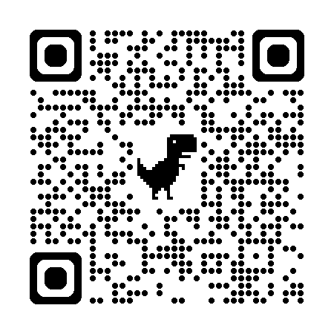
Tampermonkey 101
Hack your CMS (and the rest of the web)
Jonathan Soma
js4571@columbia.edu • dangerscarf
Columbia University
bit.ly/dh-tampermonkey

Slide 2
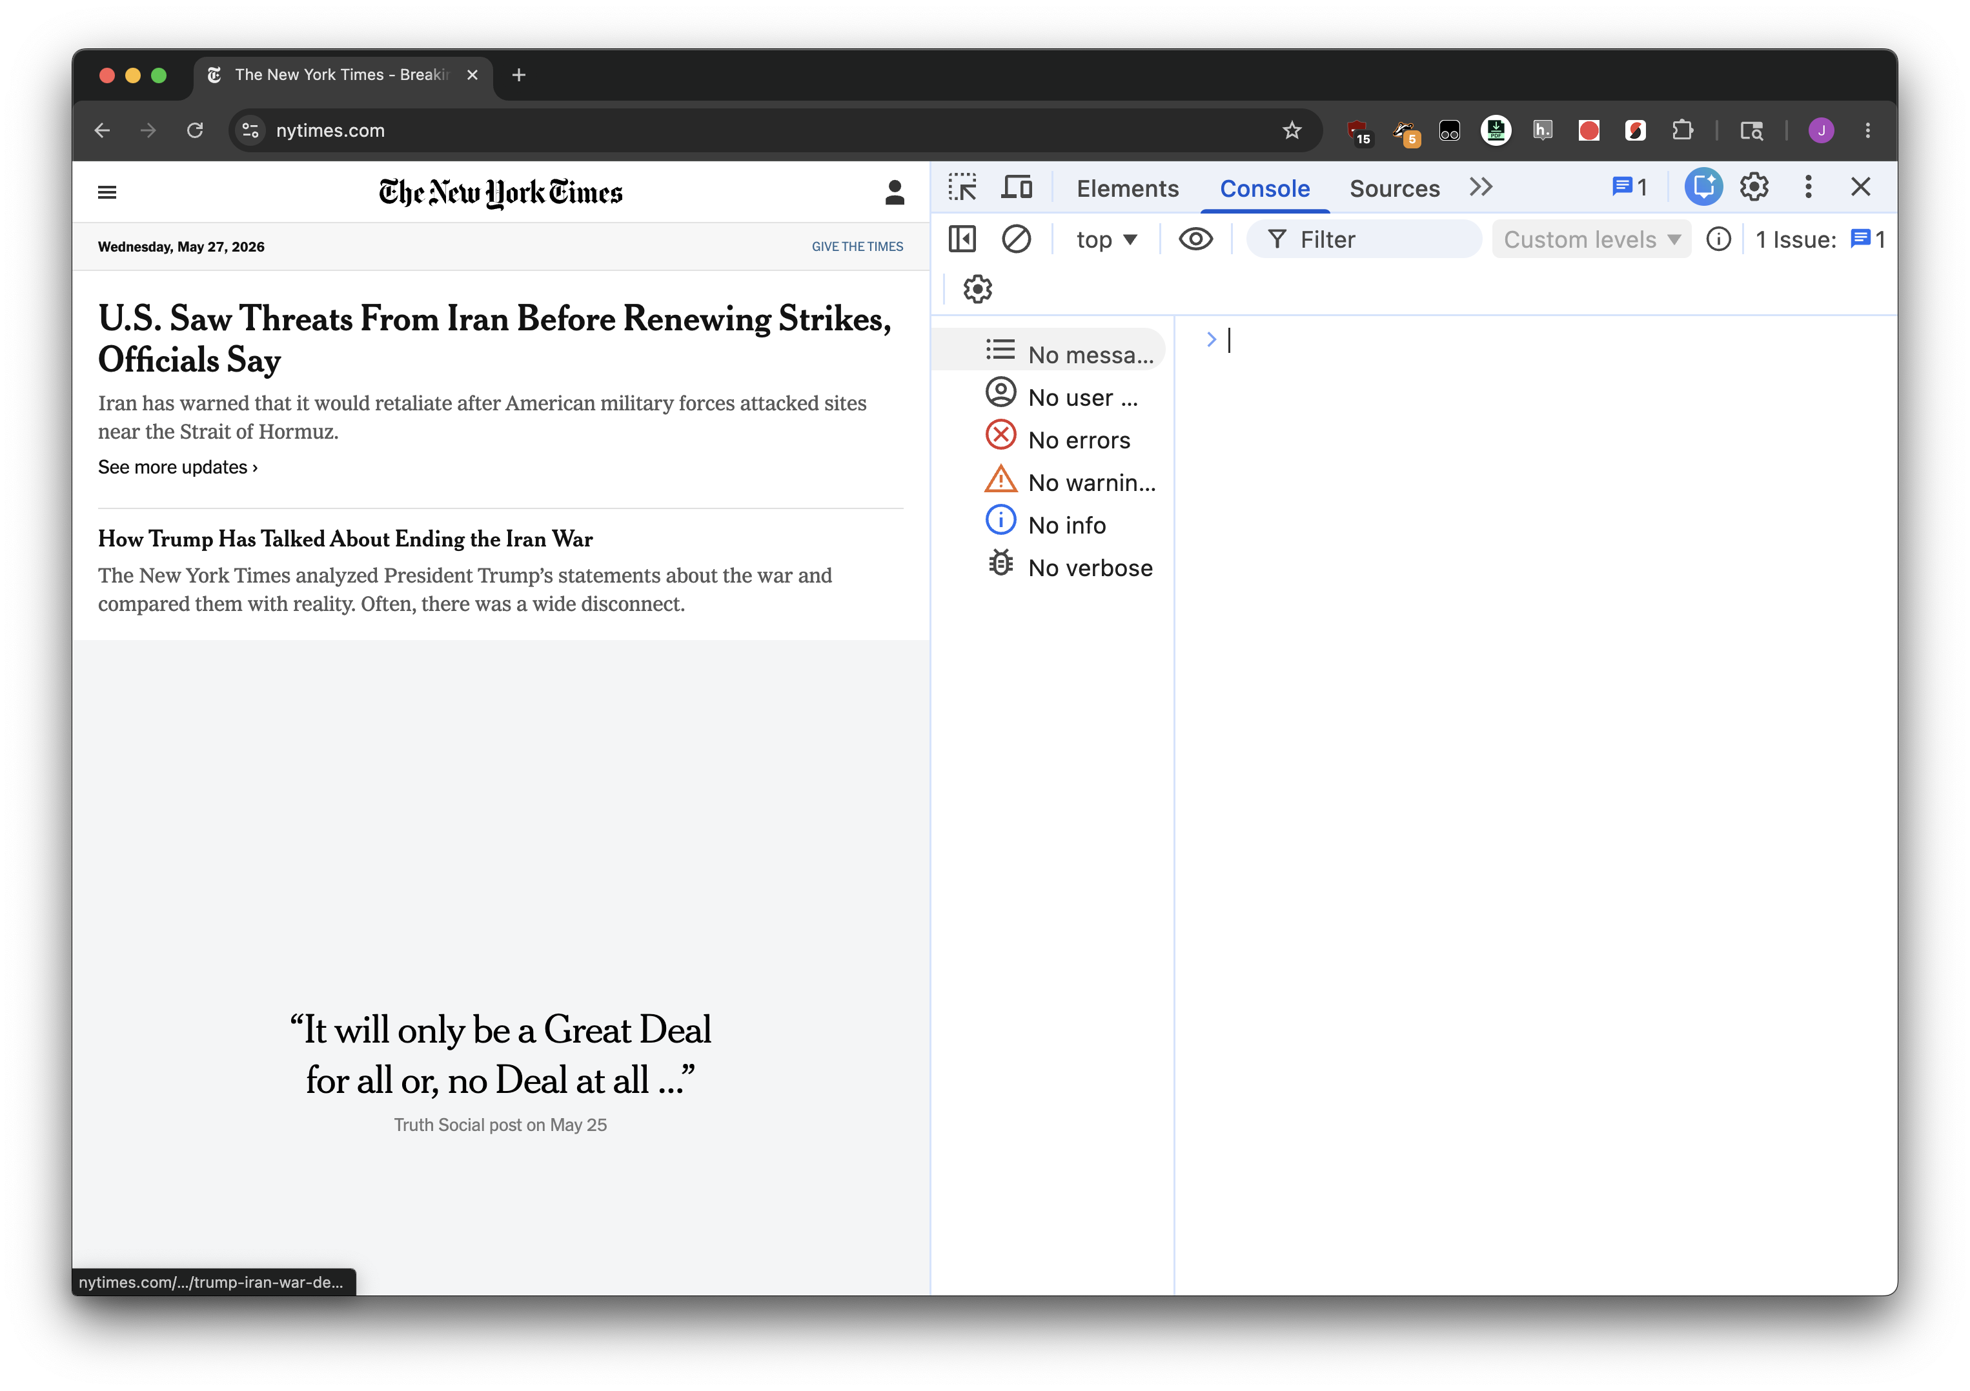
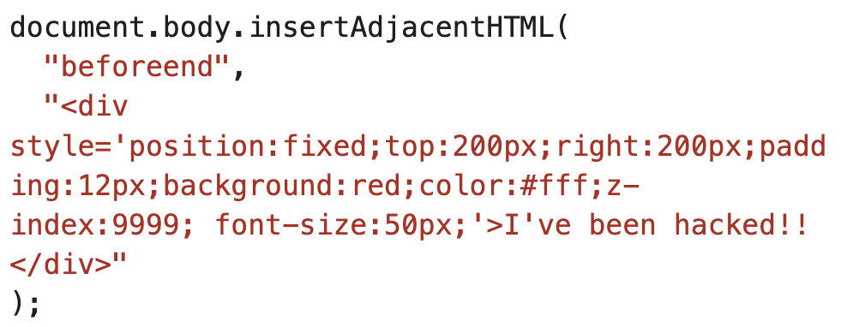


Slide 3
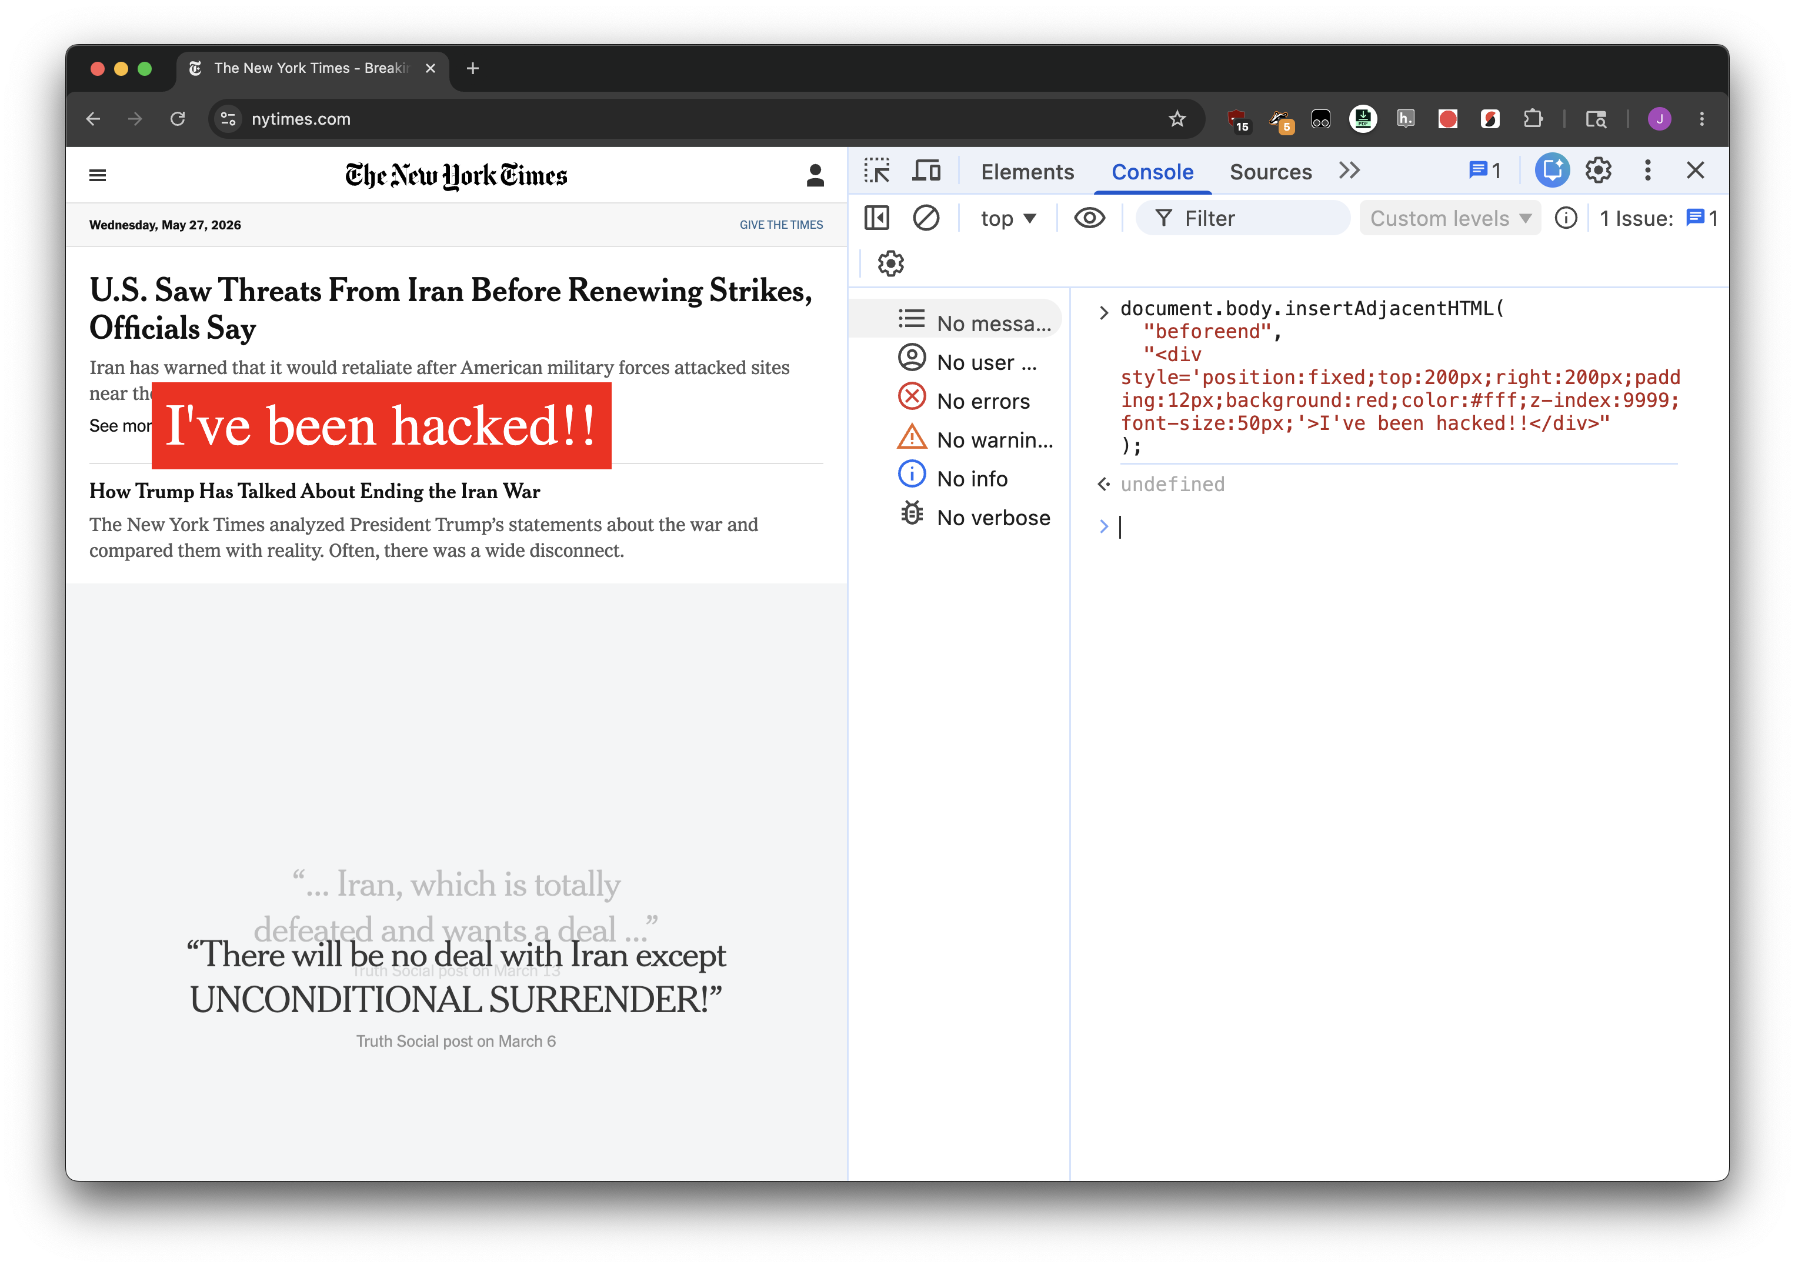

Slide 4
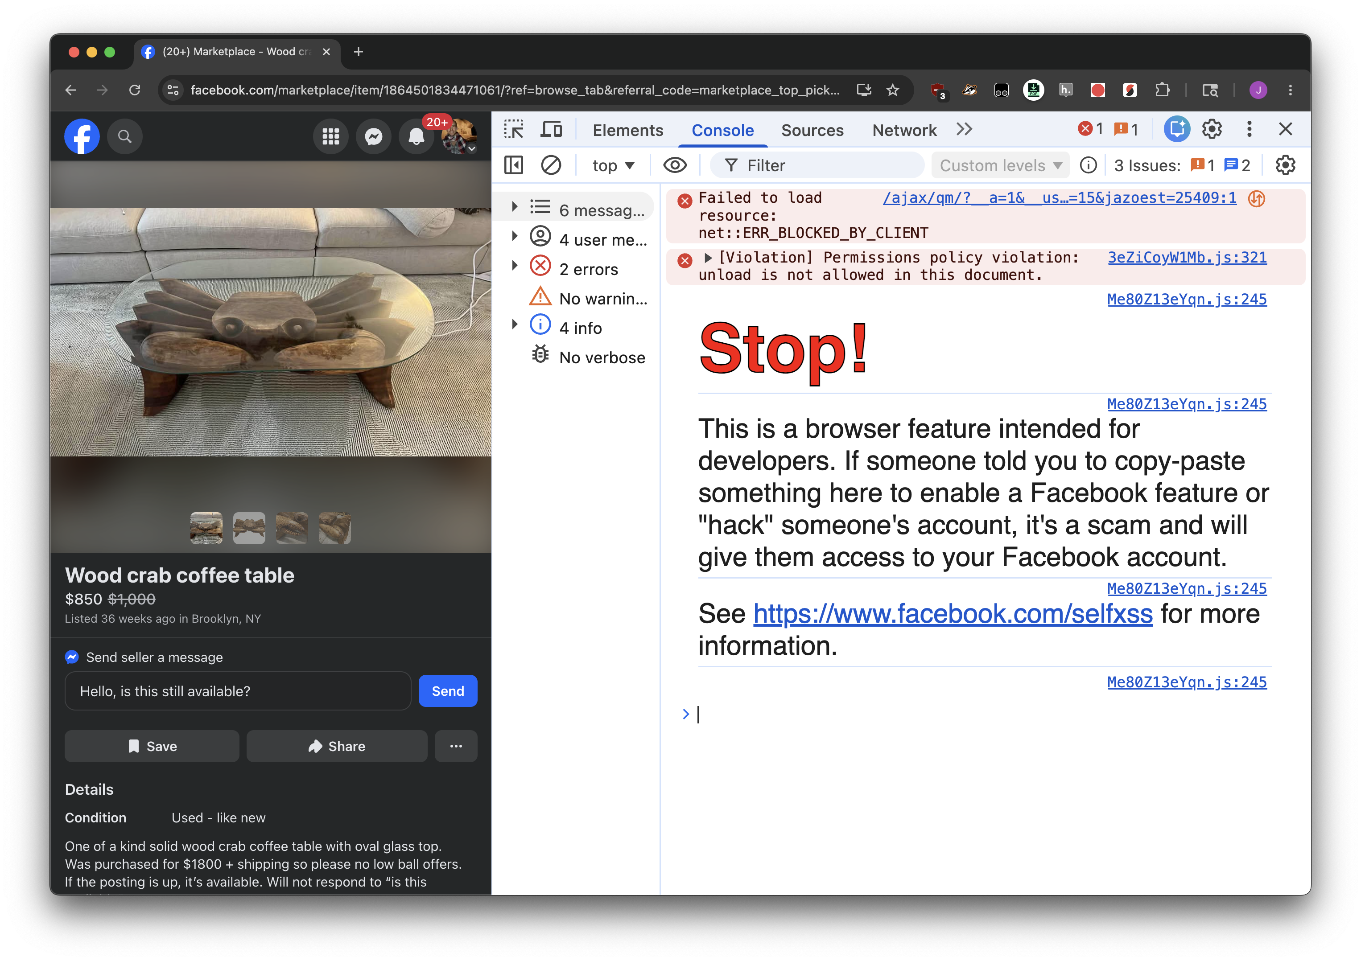

Slide 5
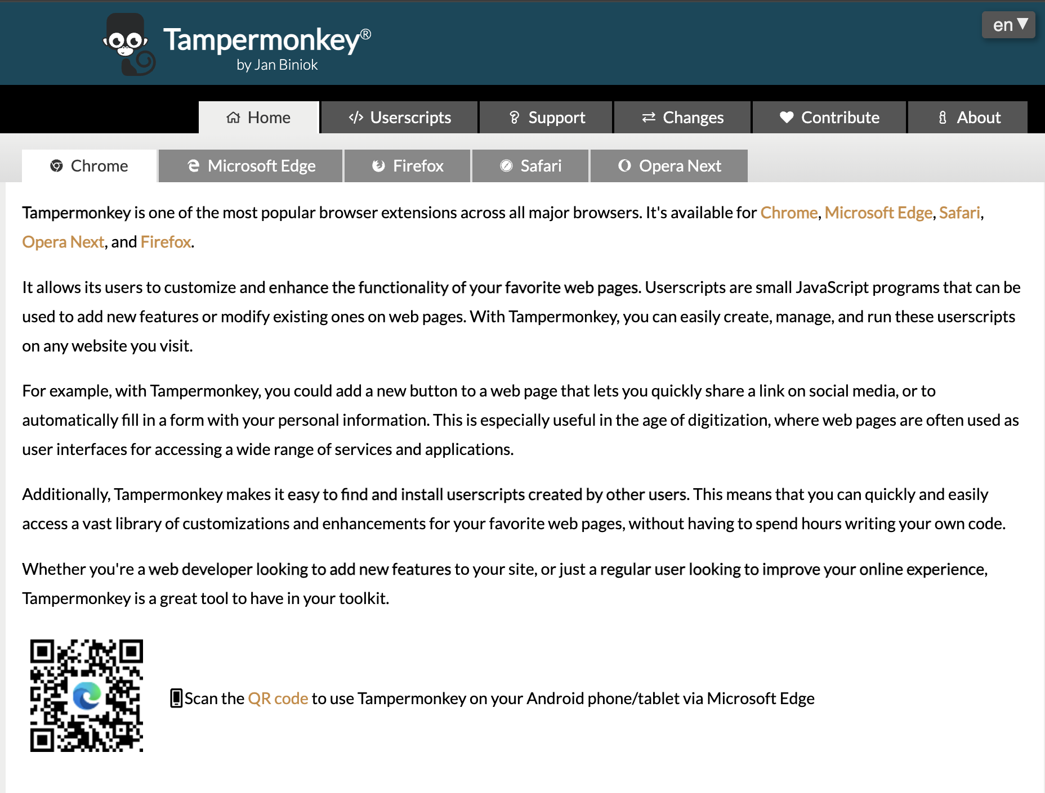

Slide 6
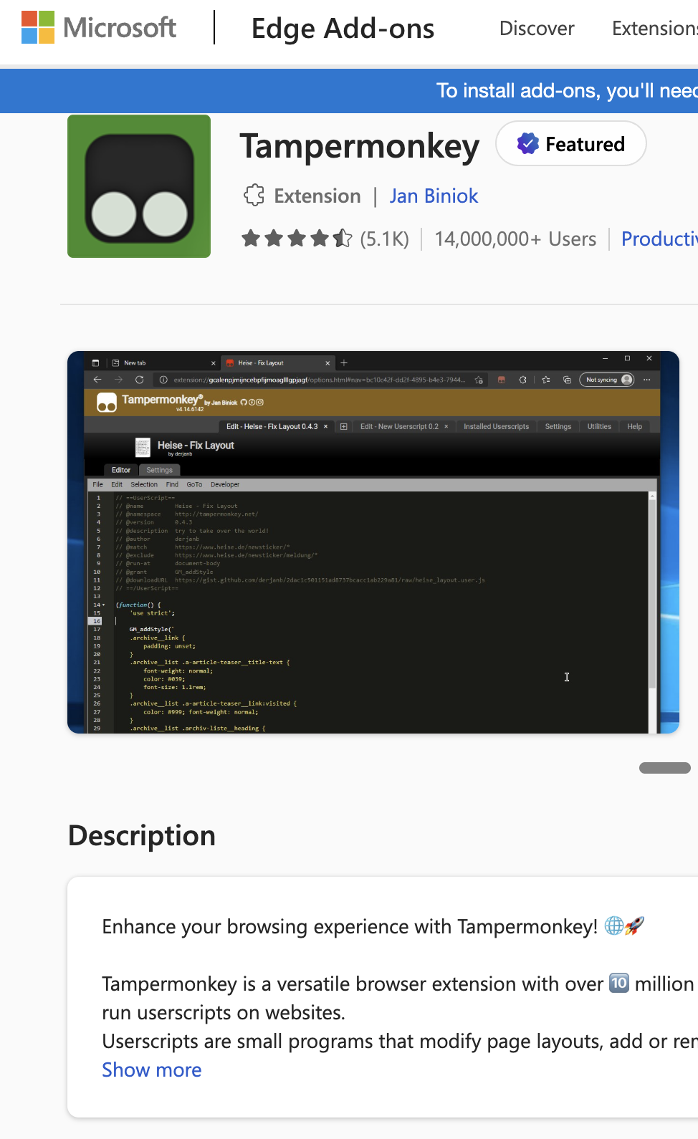
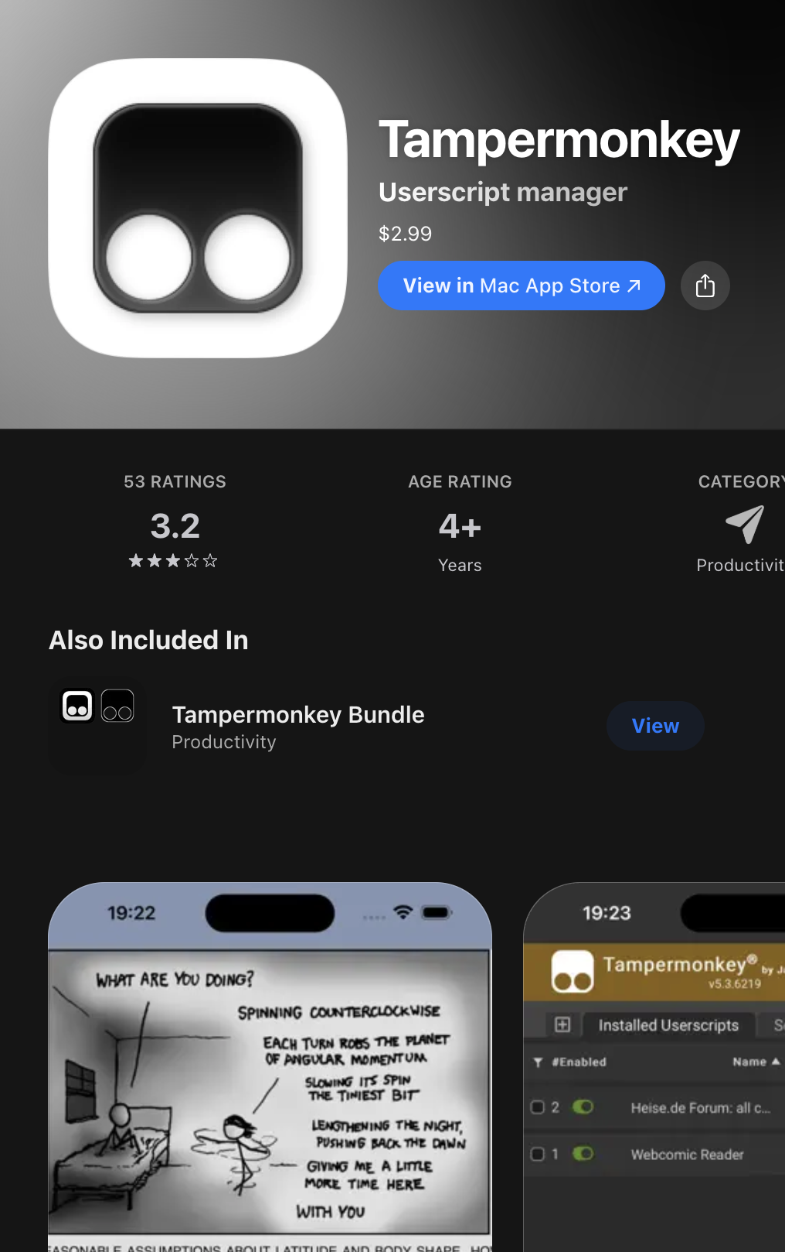
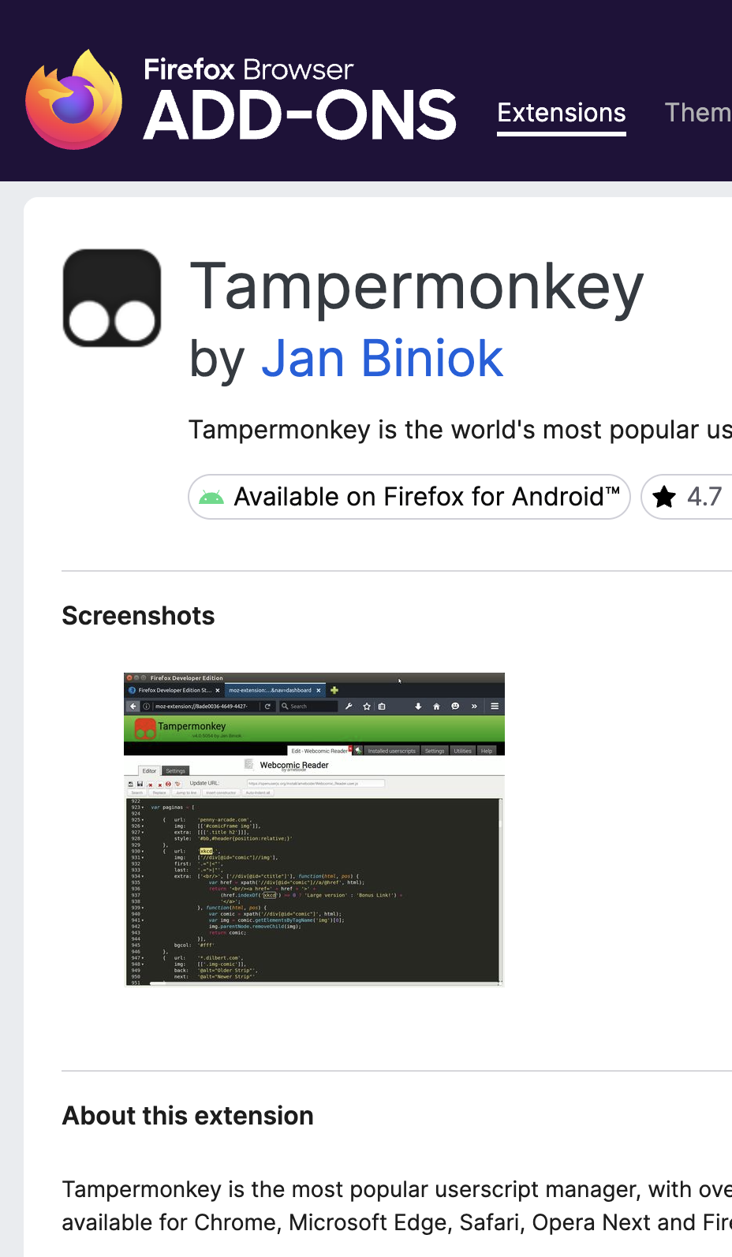
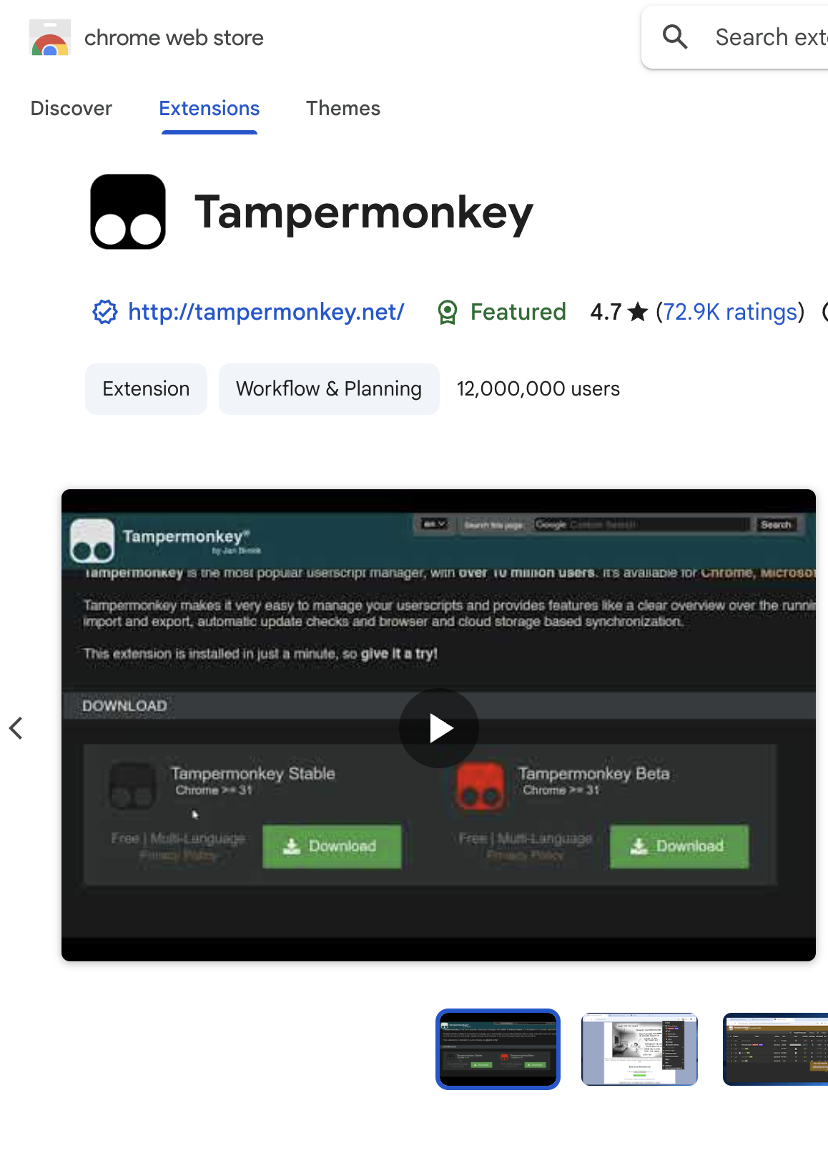

Slide 7
Userscripts

Slide 8
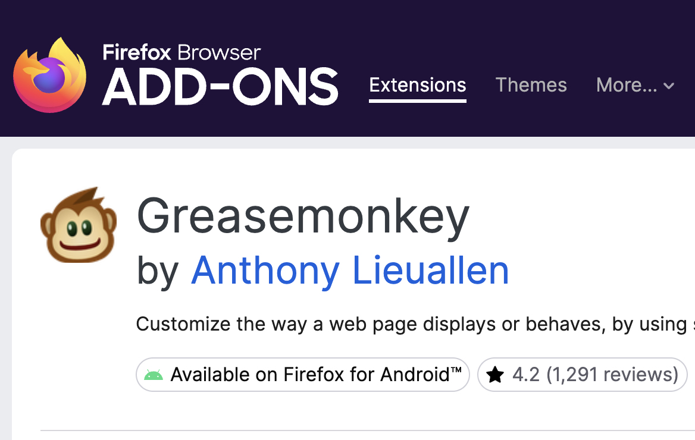
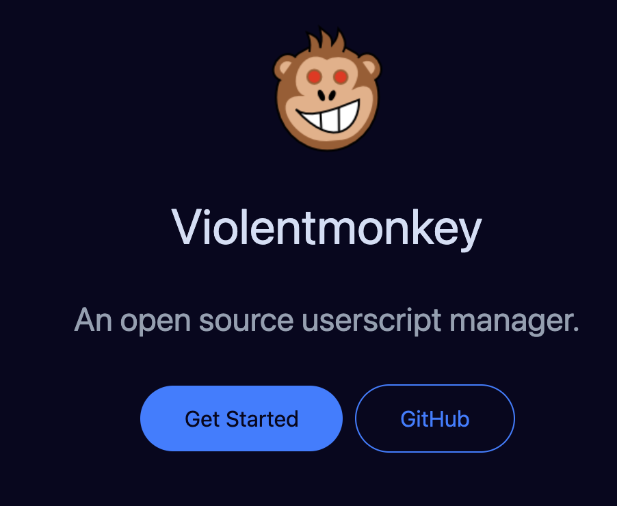



2005
2014
2010

Slide 9
What can a userscript do?
Custom scripts on every single page
Inject CSS!
Inject JavaScript!
Add buttons, new features!
Browser automation!
All of those things you use Playwright or whatever to do in Python, but with the bonus of being much less effort to deal with

Slide 10
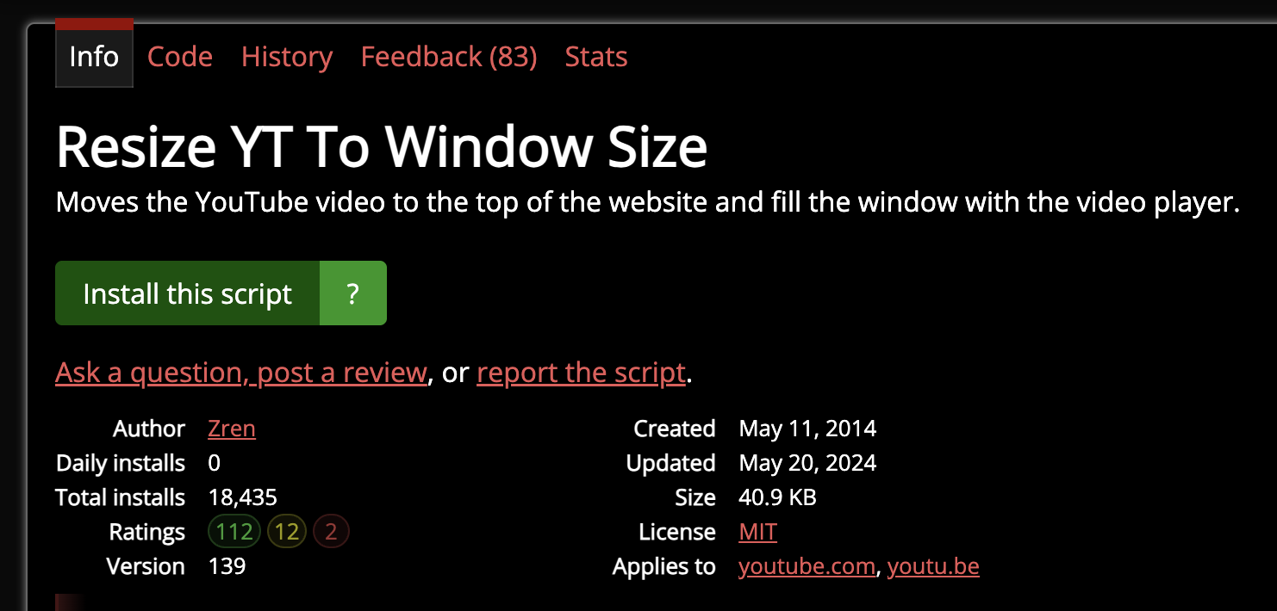
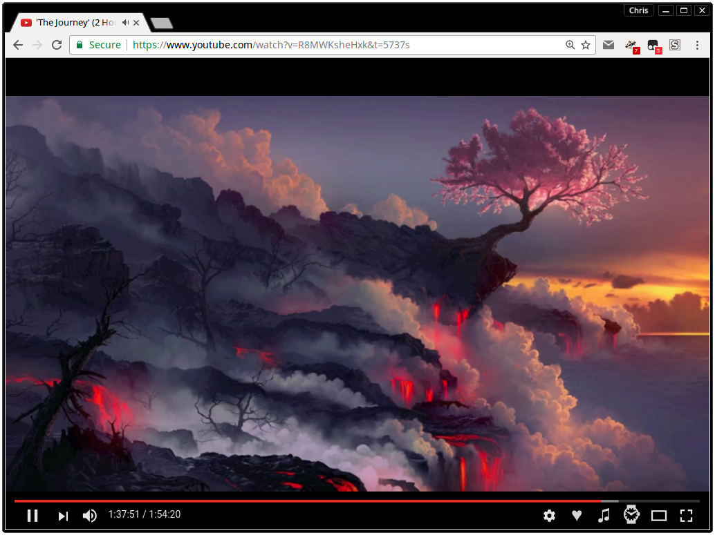

Slide 11
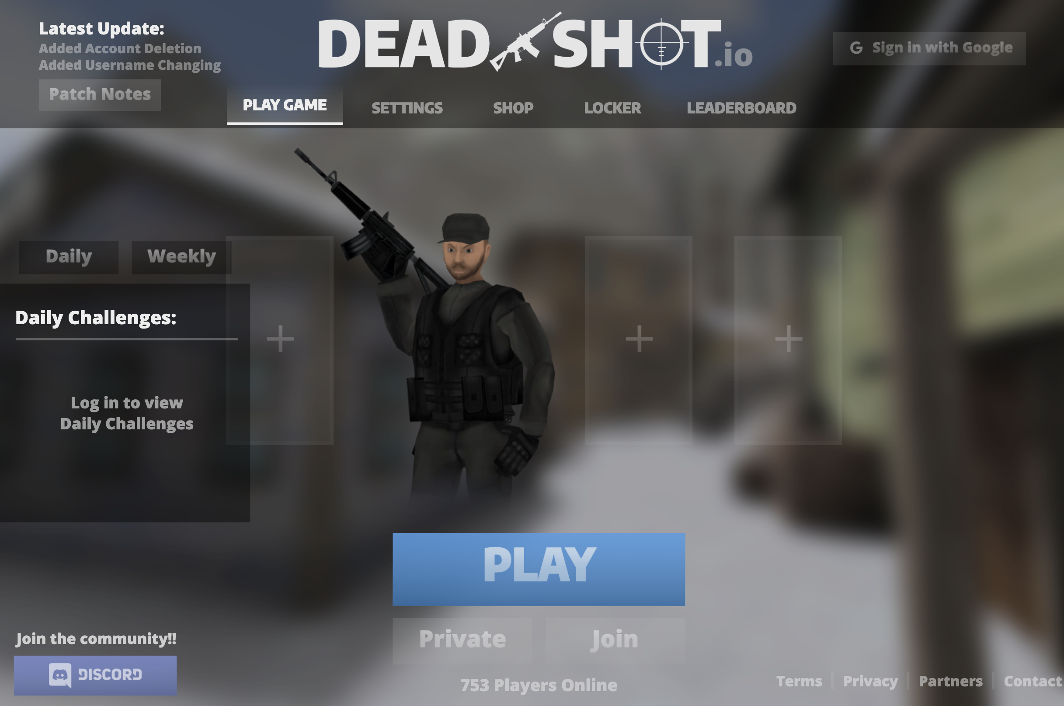
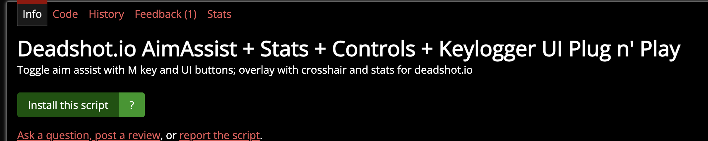

Slide 12
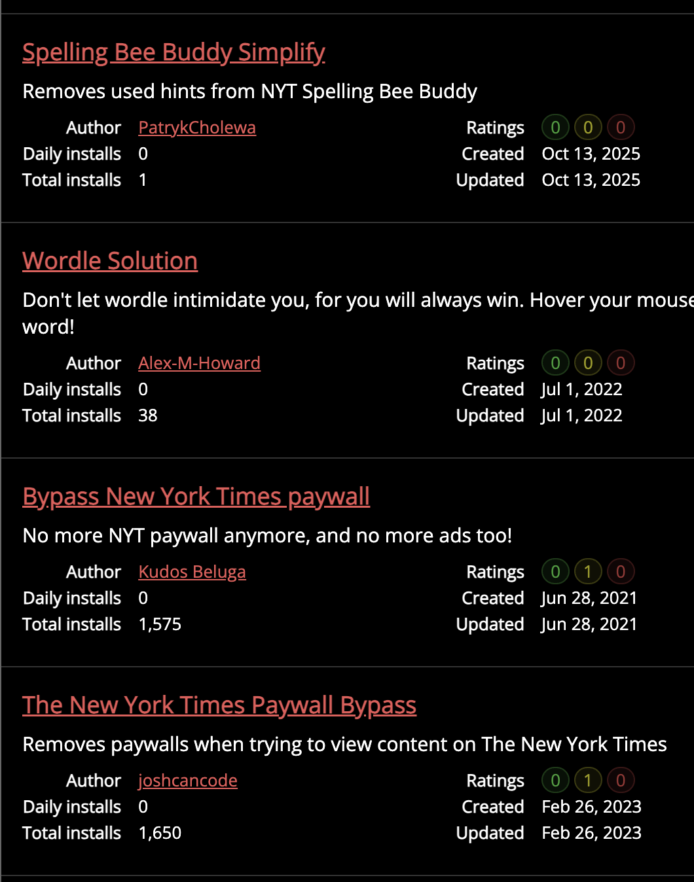
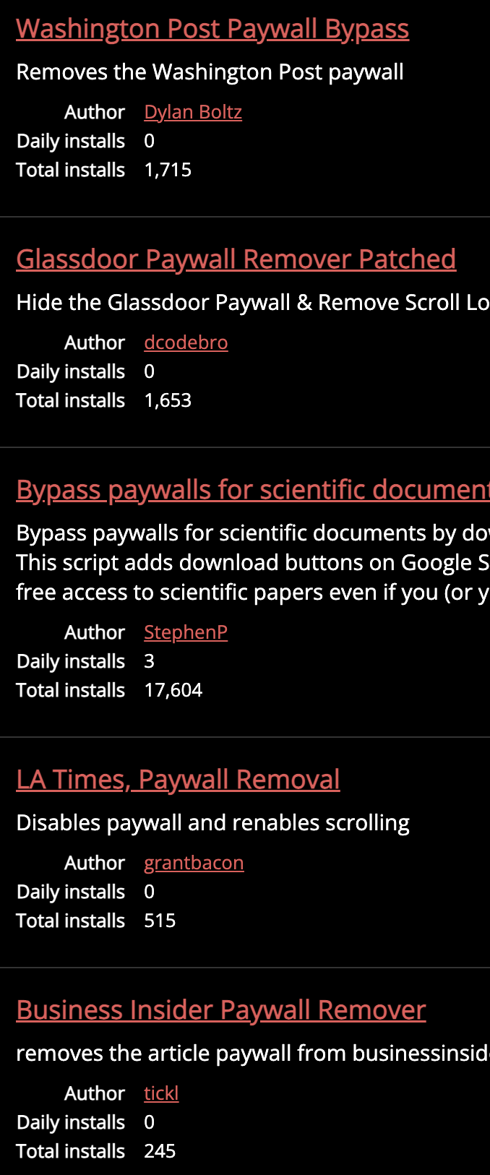
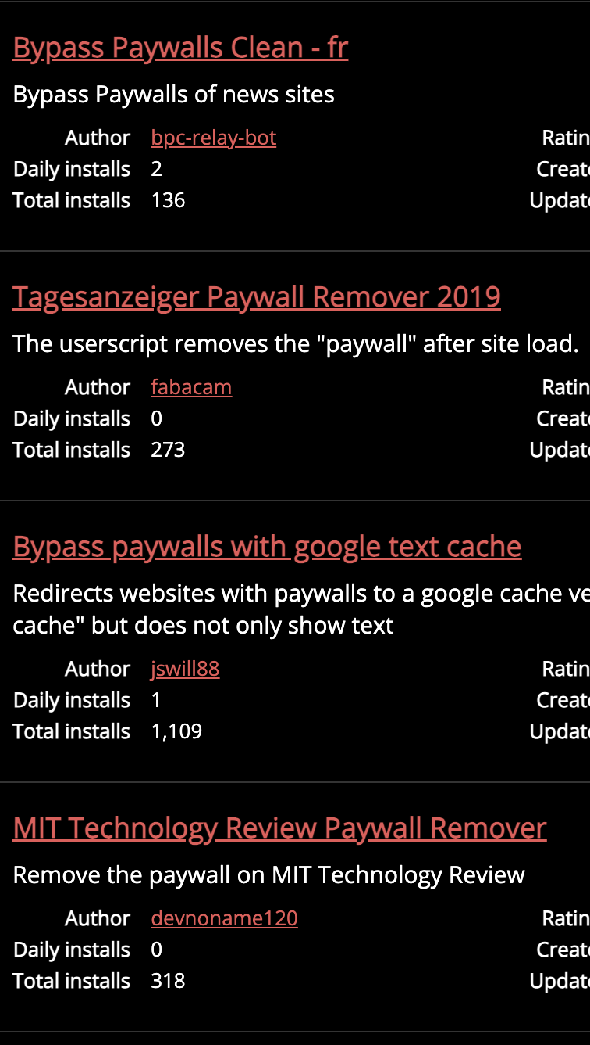
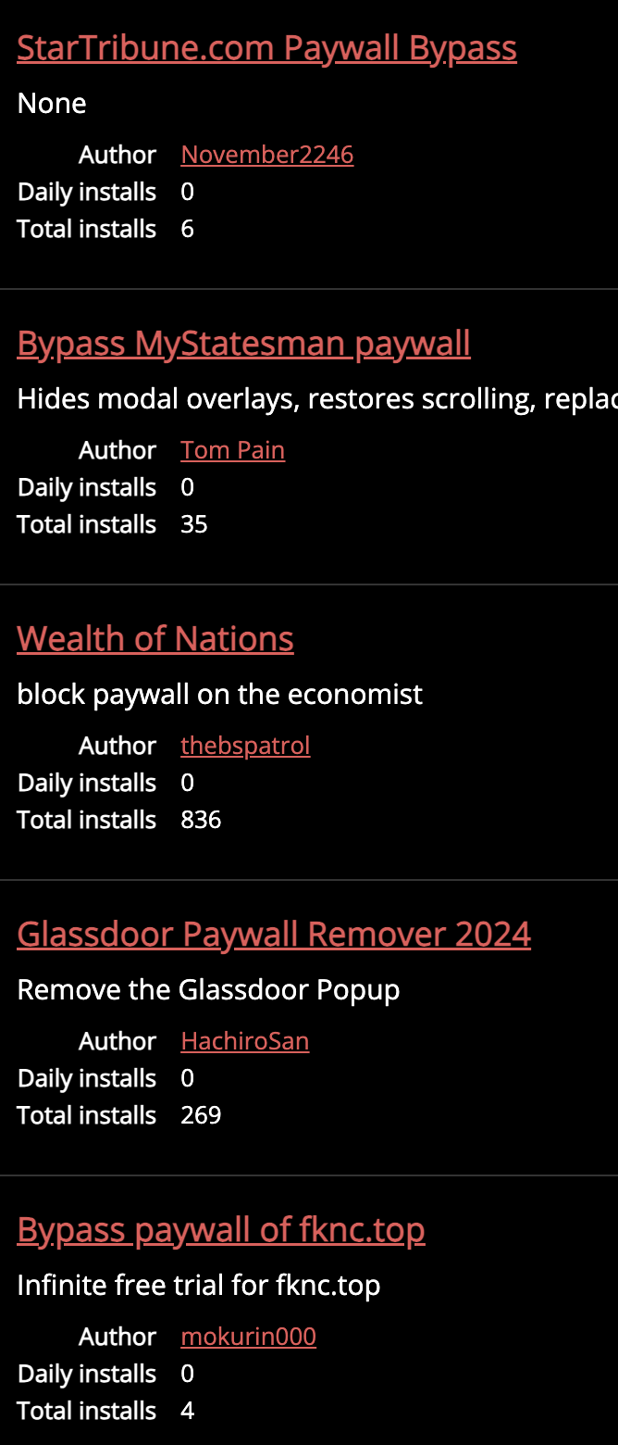

Slide 13
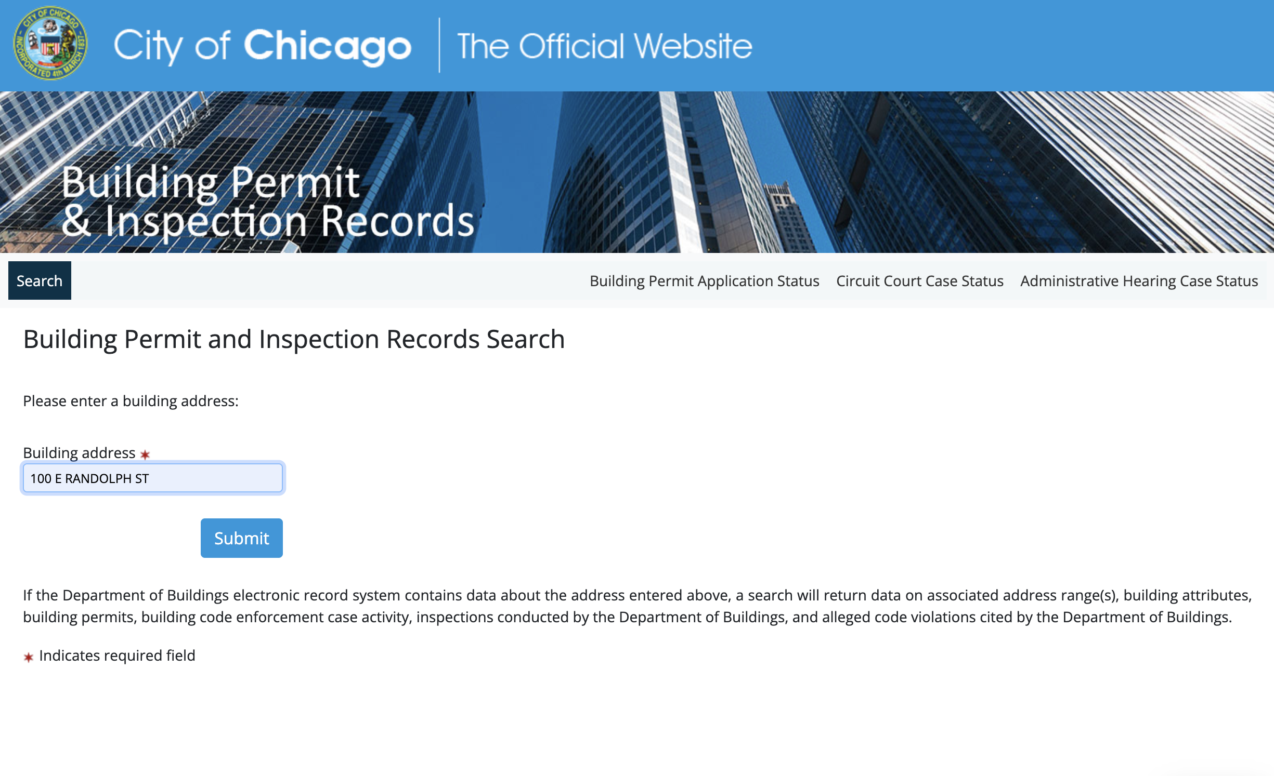

Slide 14
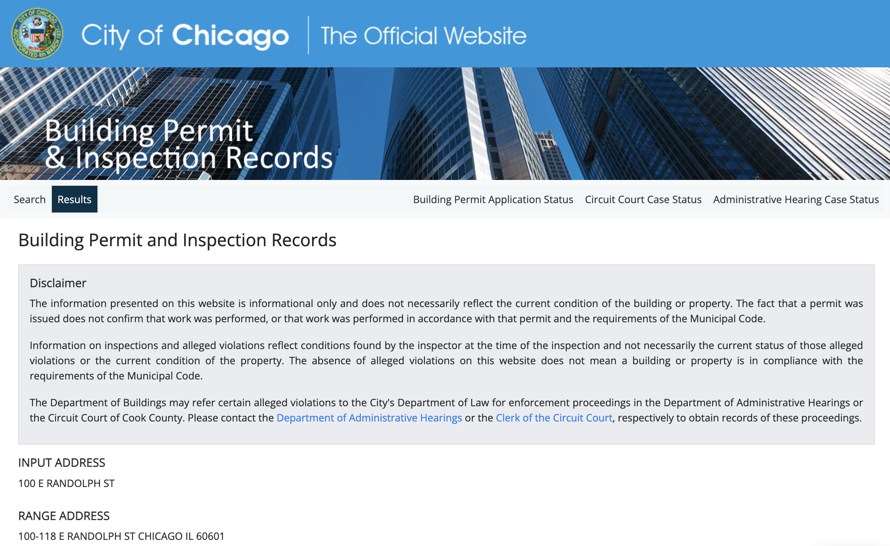
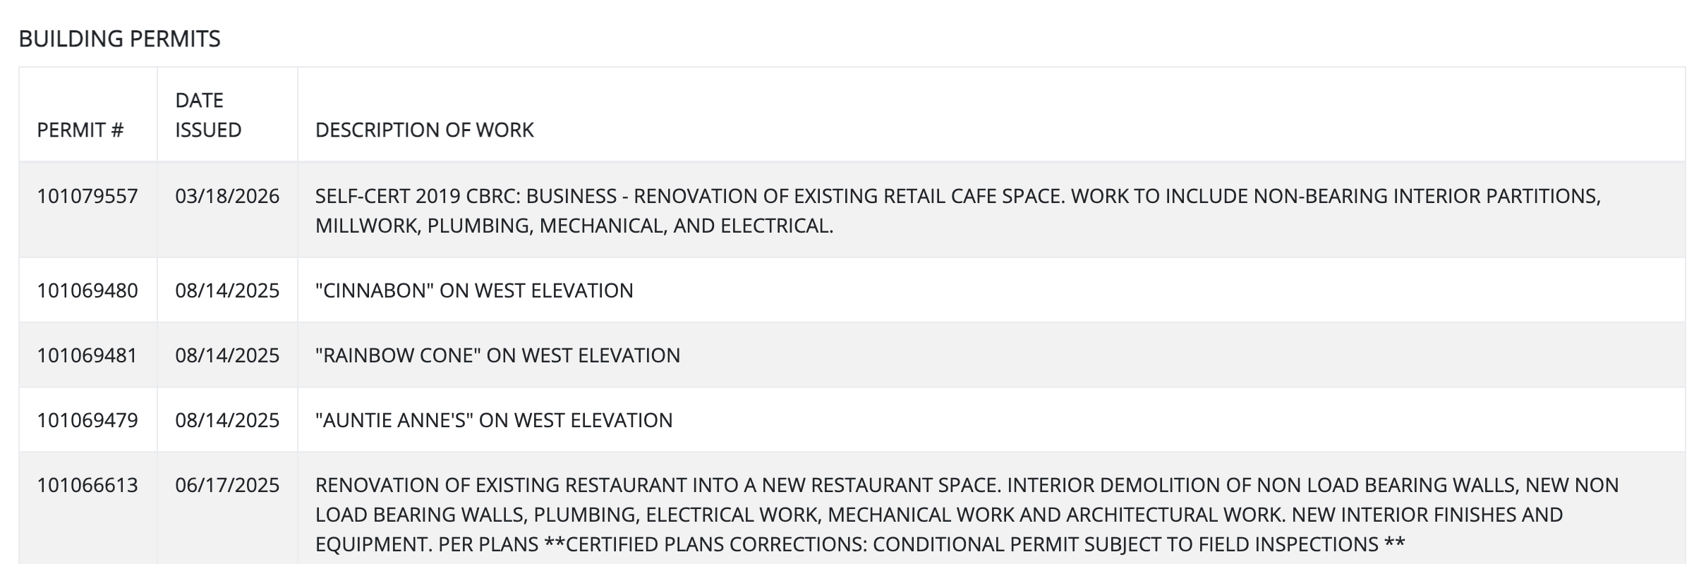
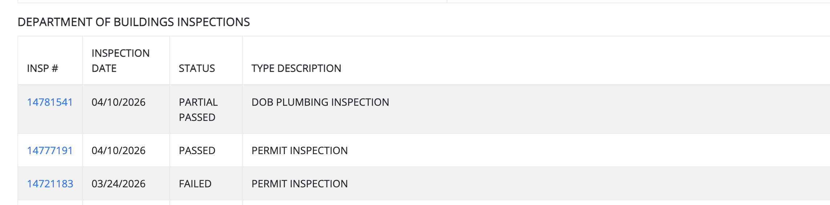
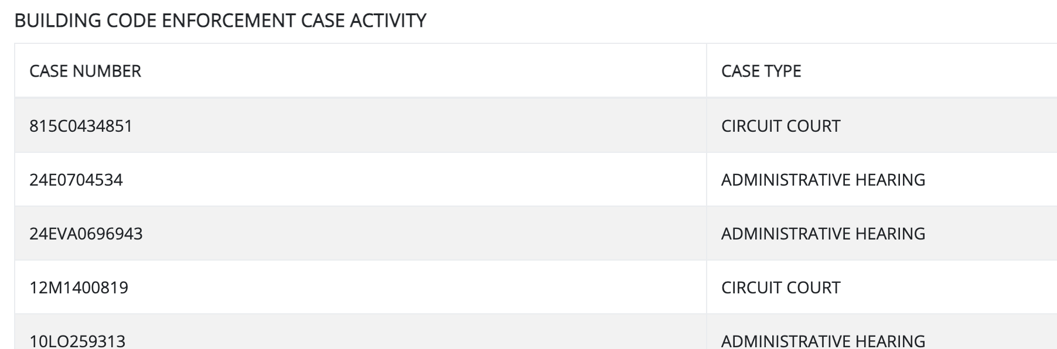
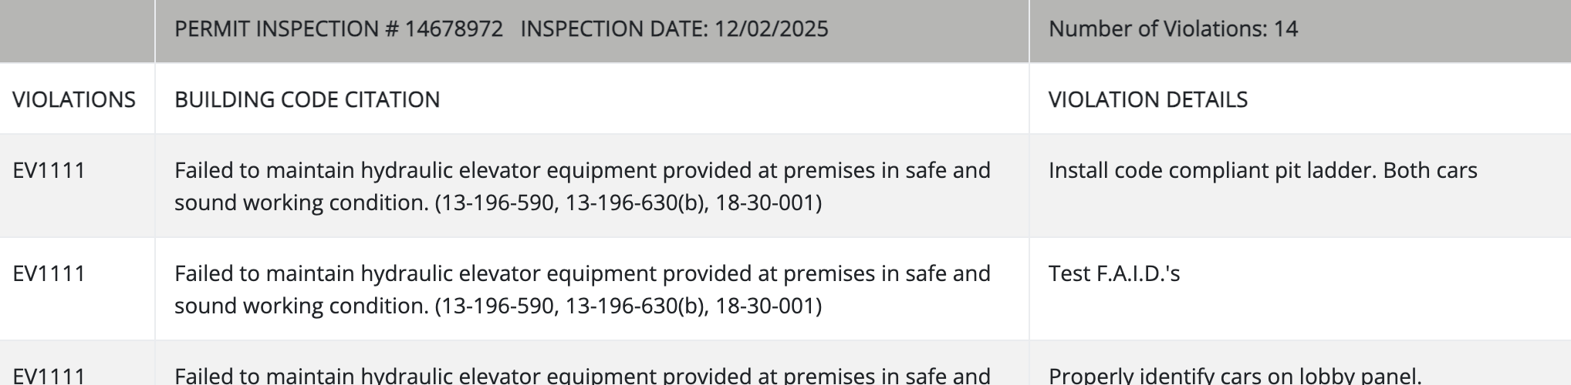

Slide 15
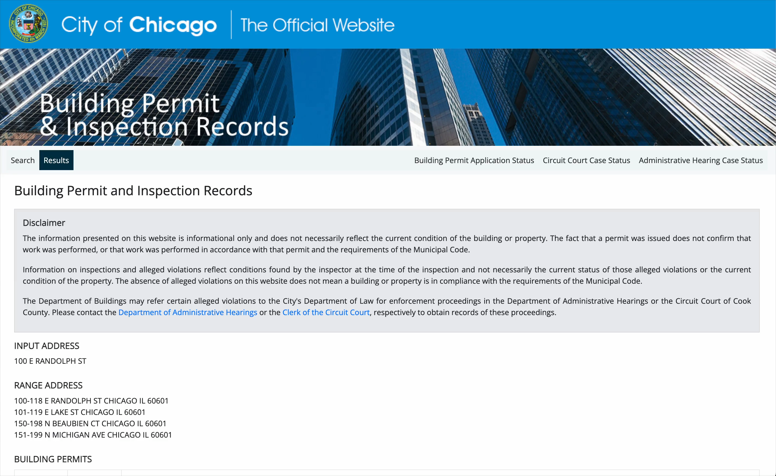

Slide 16
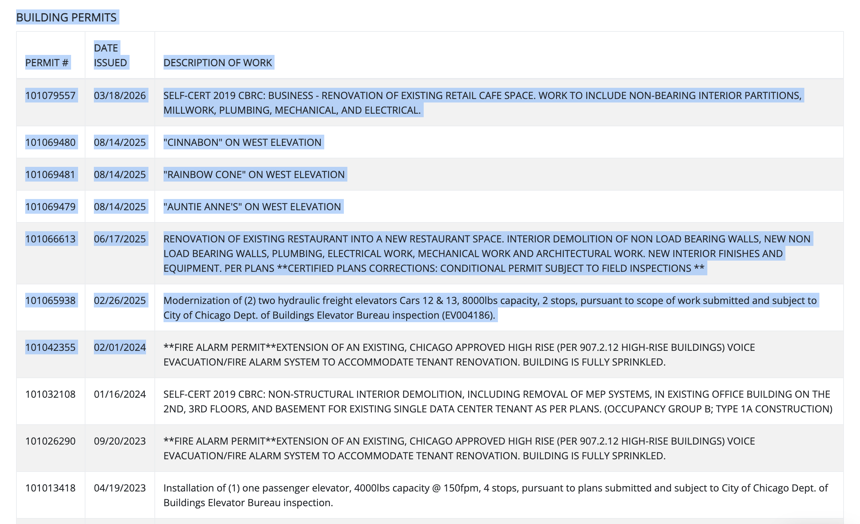
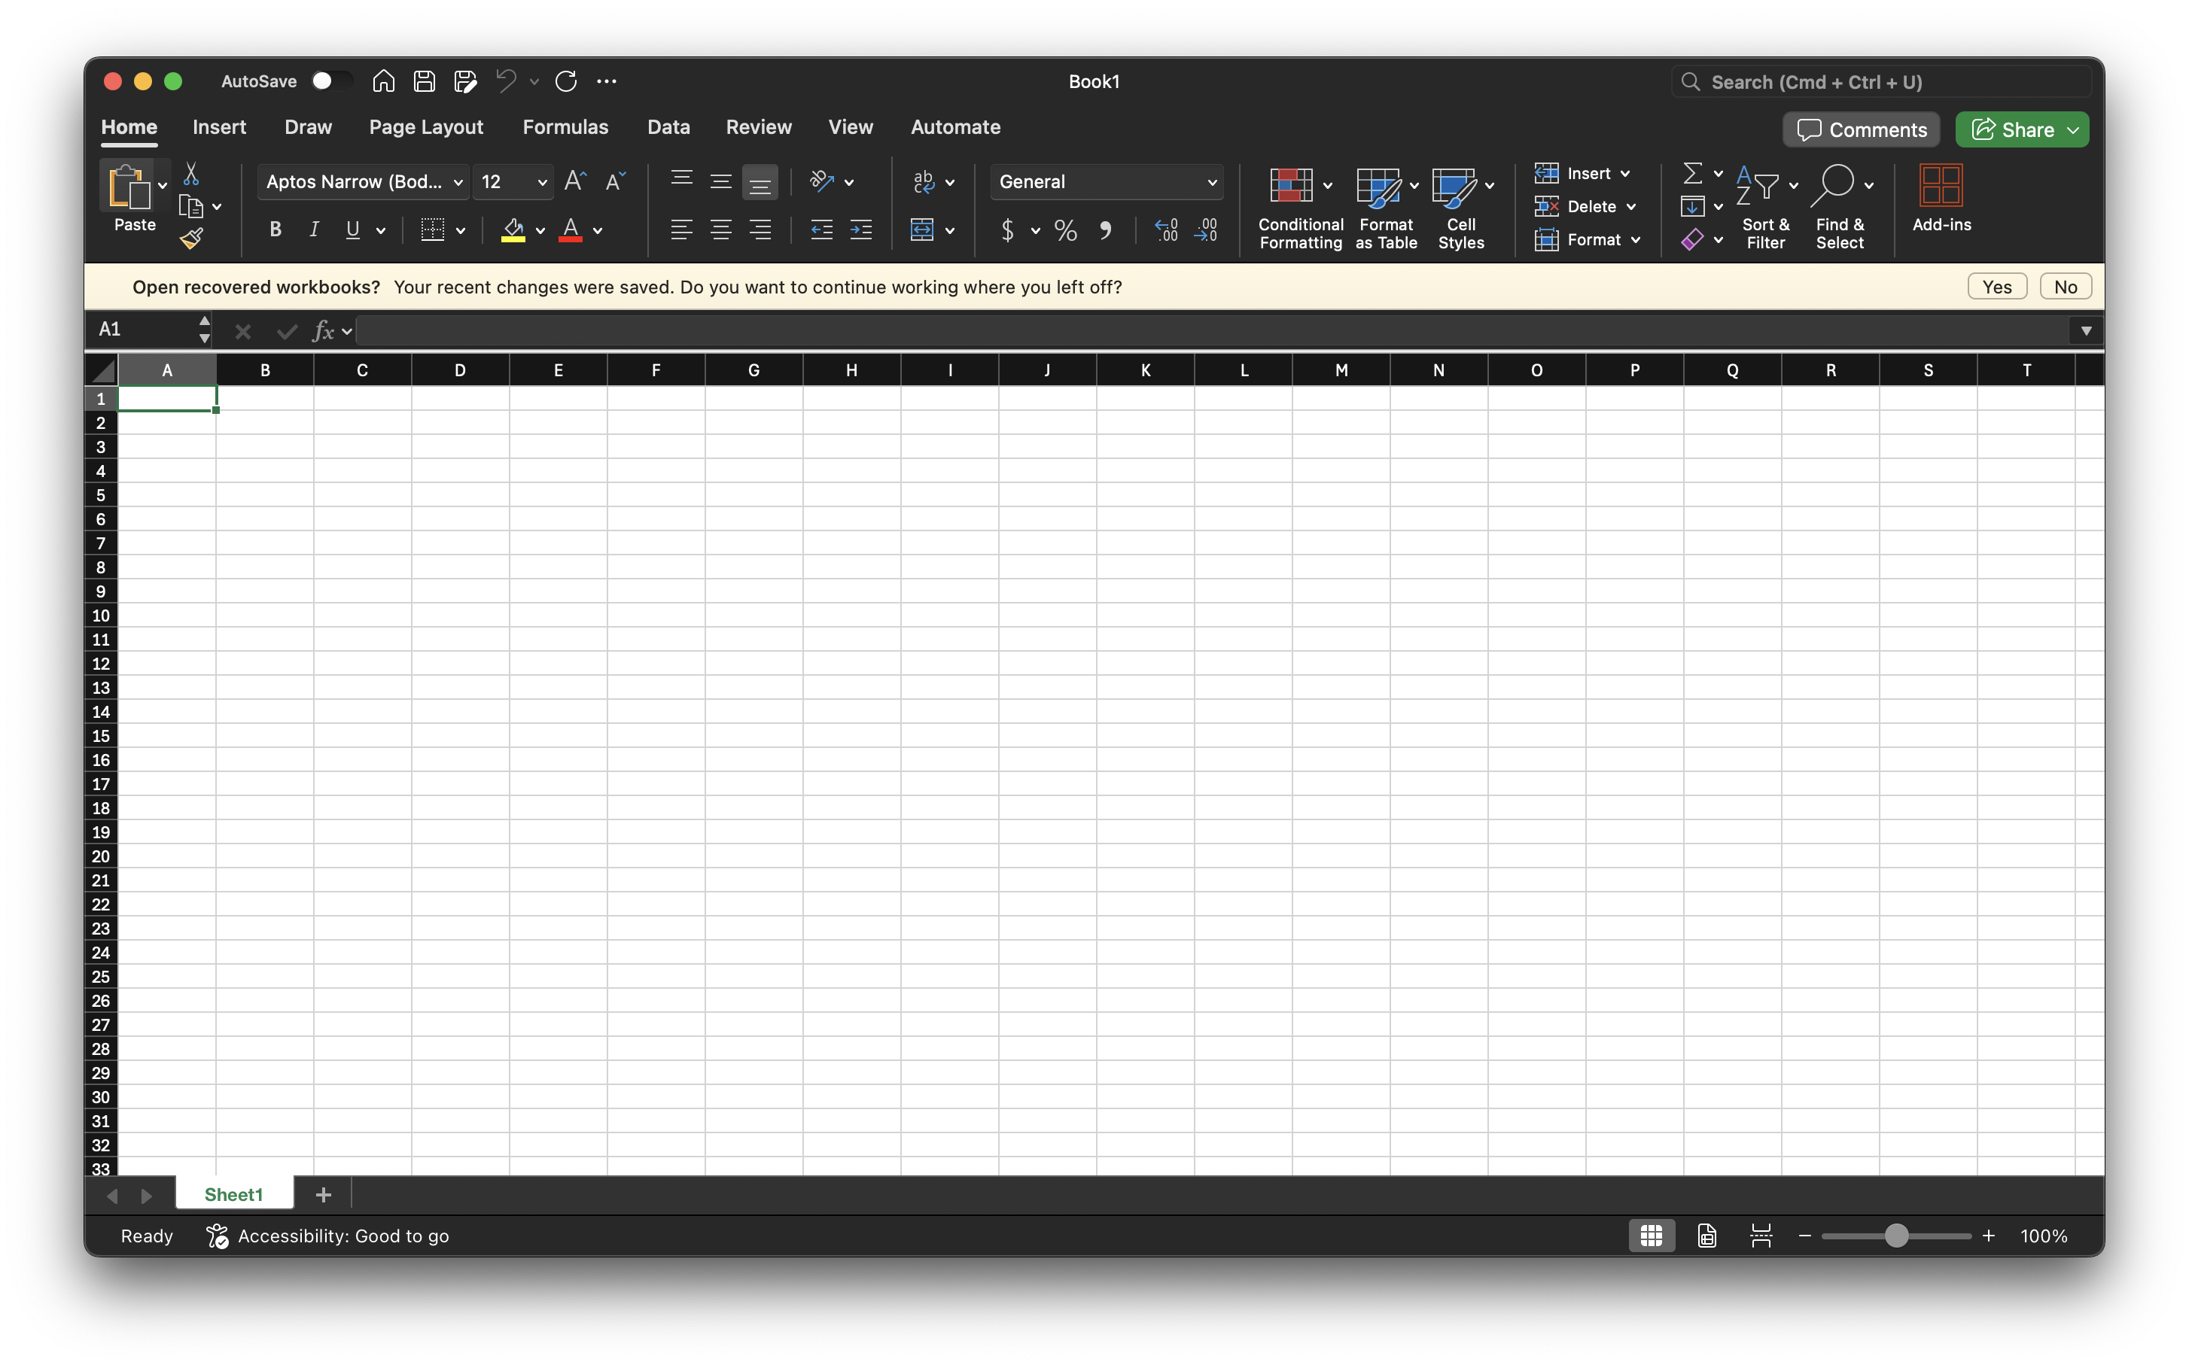


Slide 17
“But that’s too much work!”
Let’s talk about adding buttons and actions to websites

Slide 18
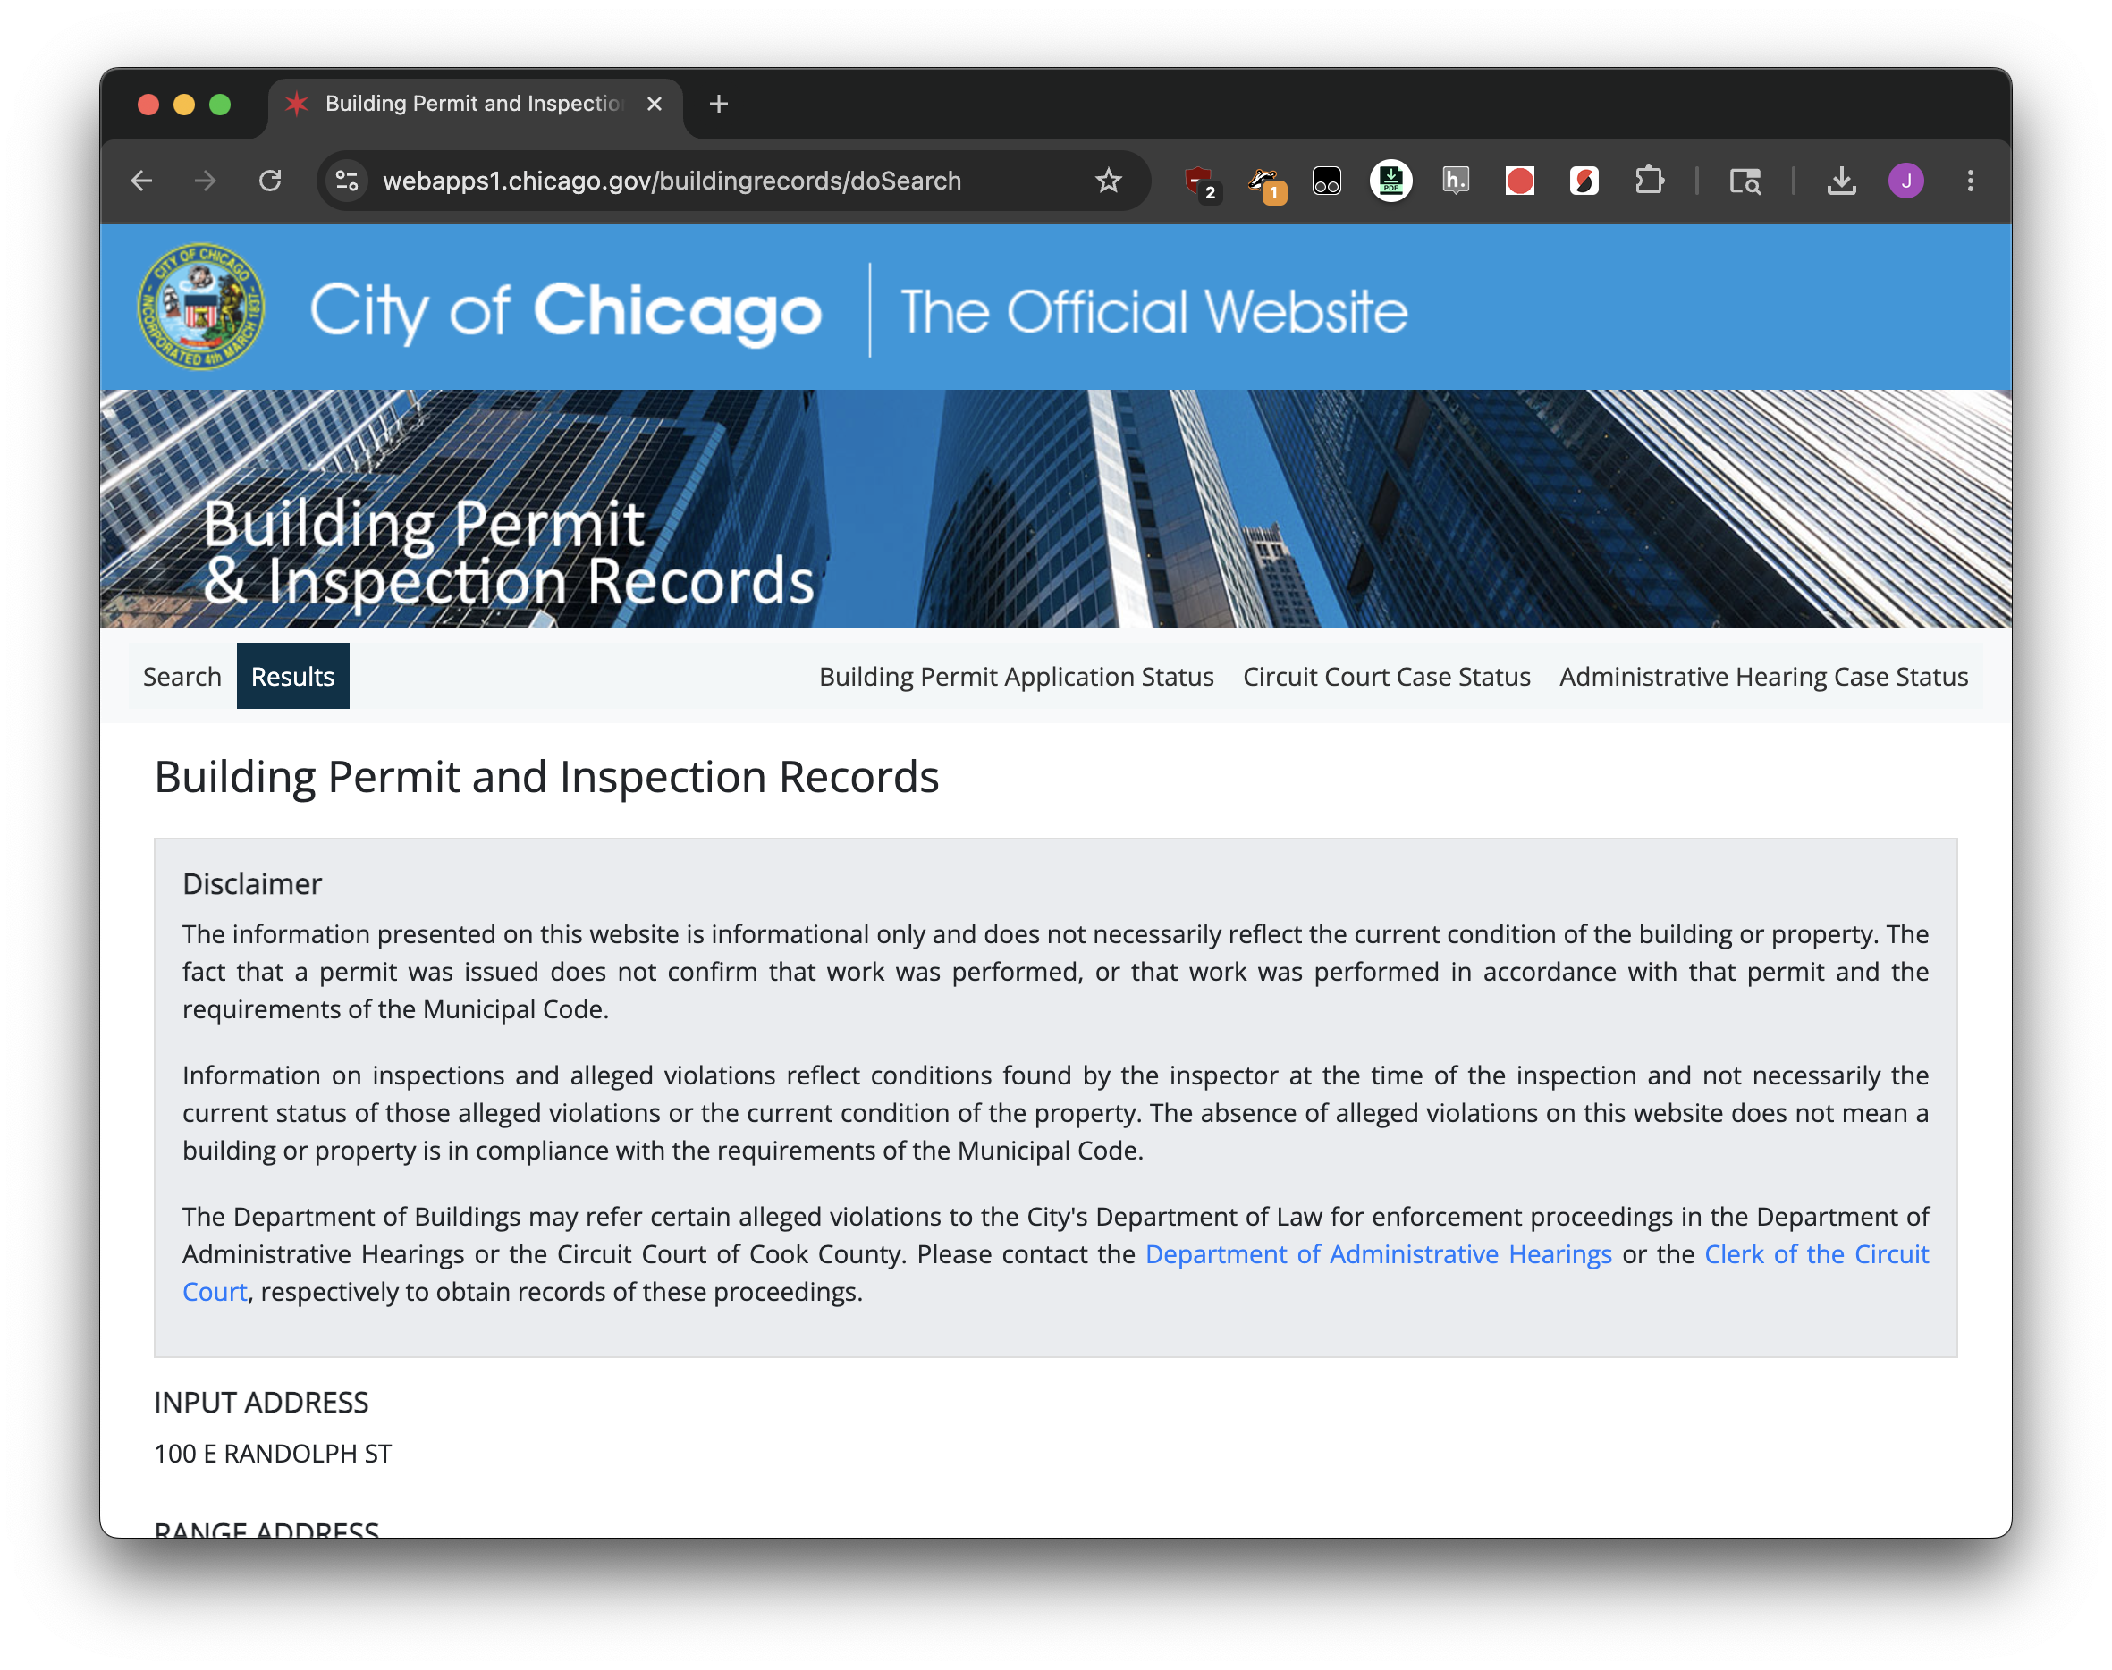

Download all

Slide 19
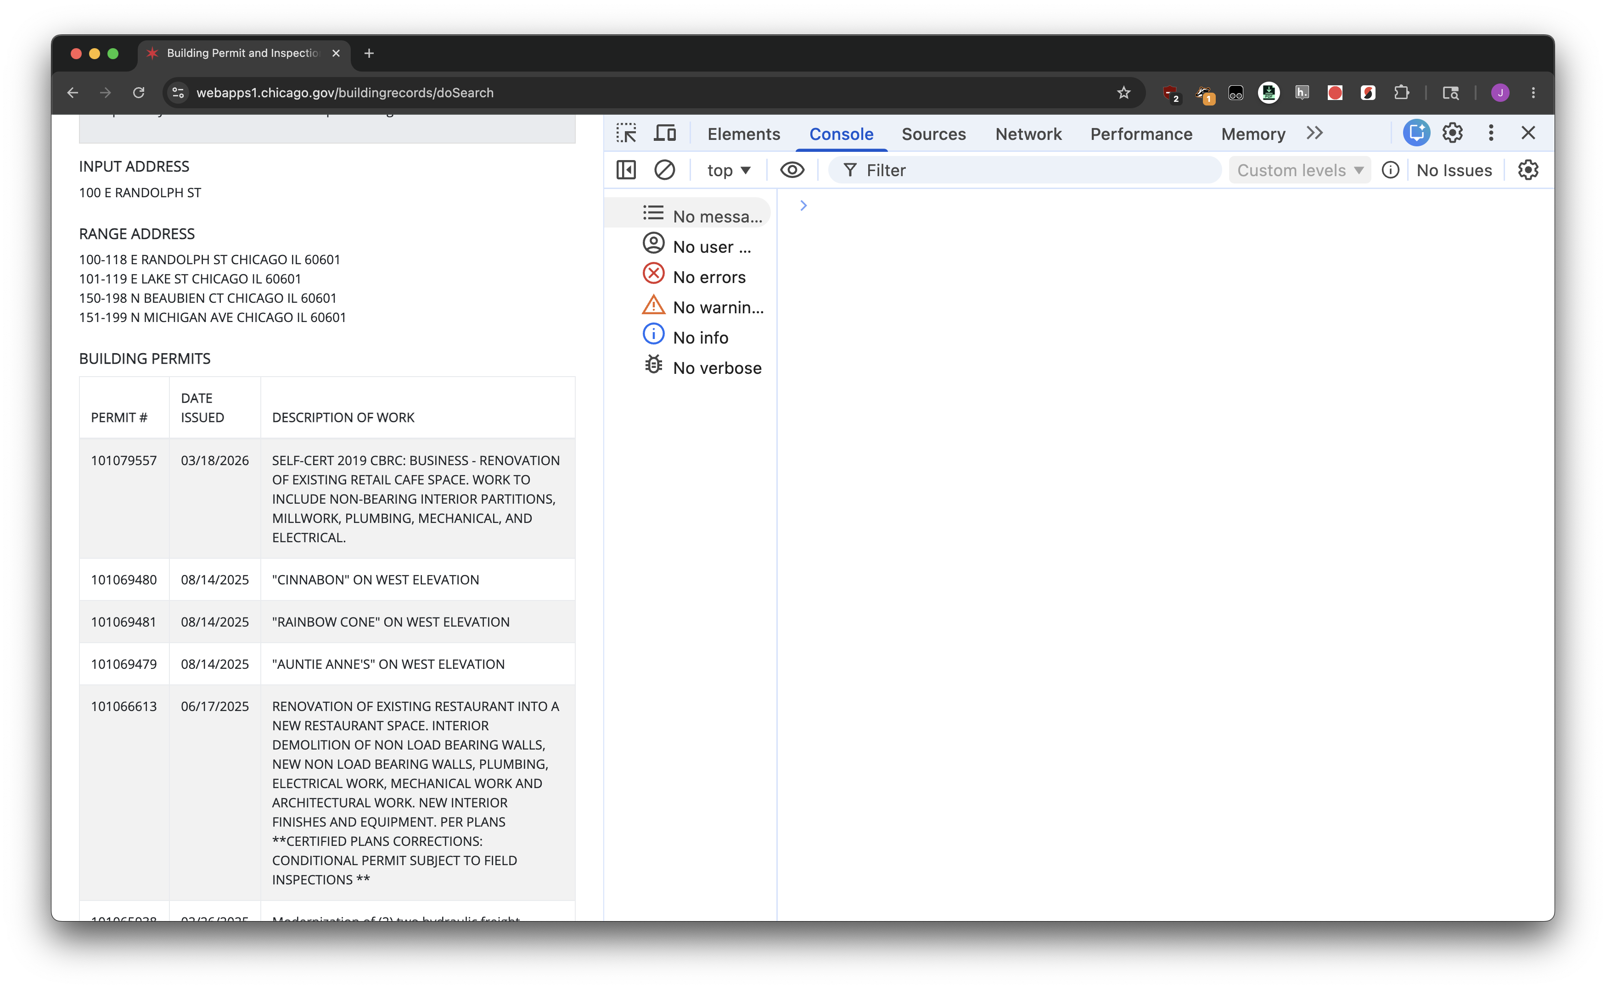
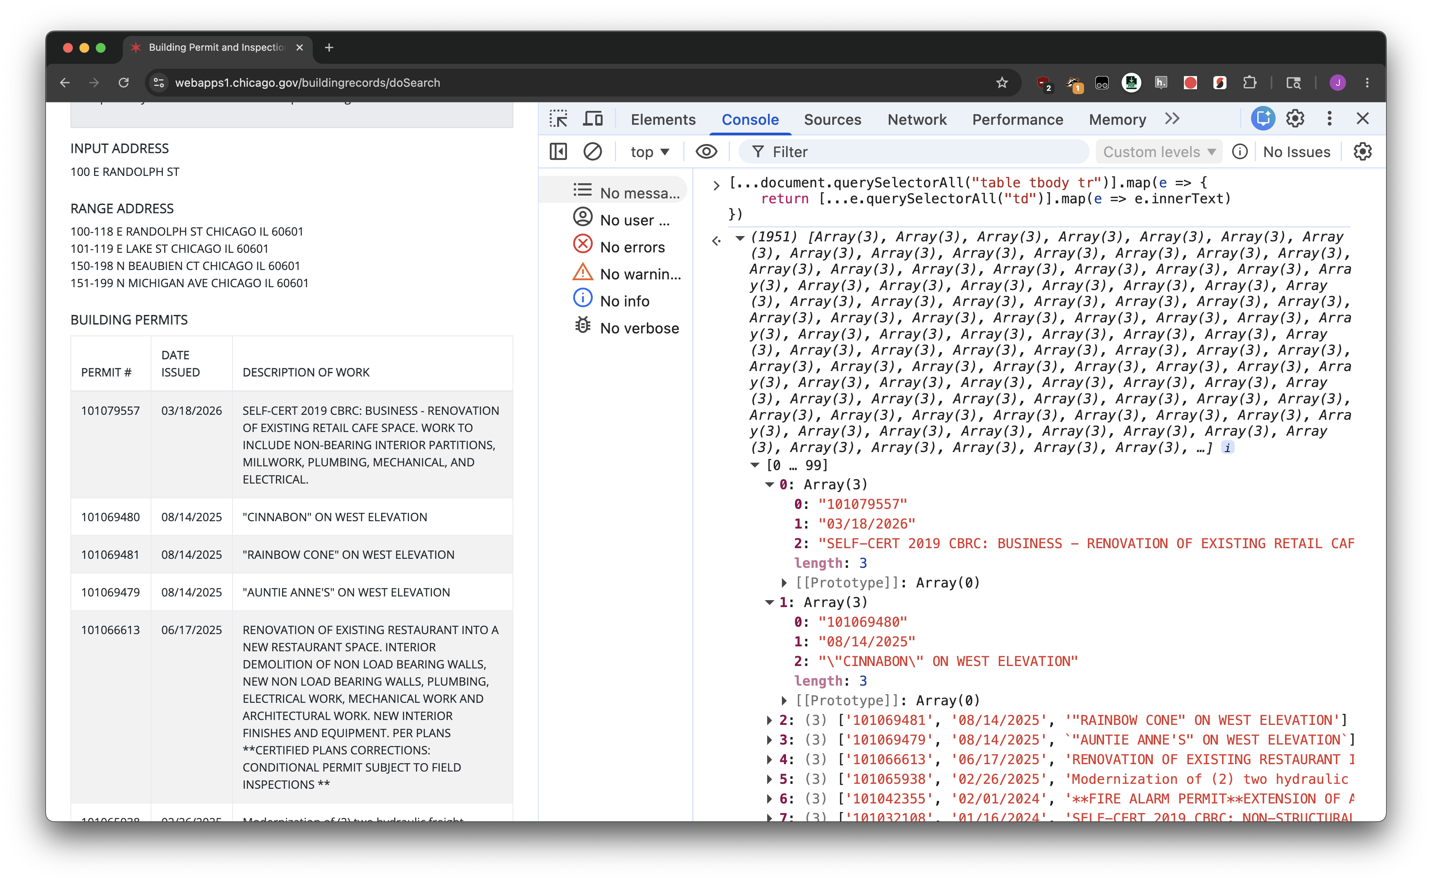

Slide 20
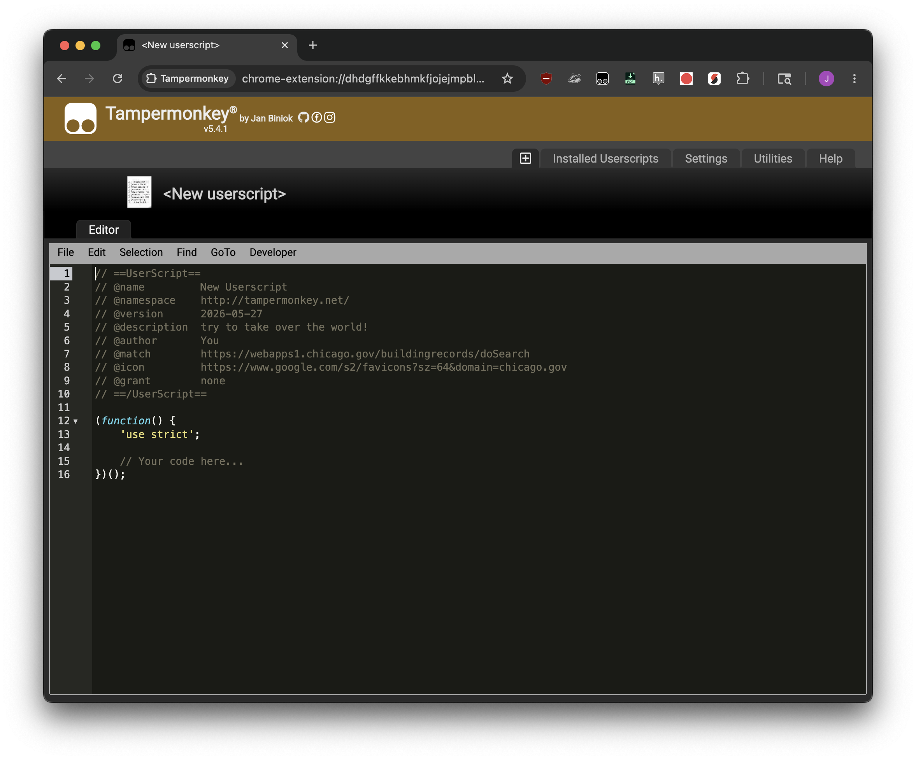

Slide 21
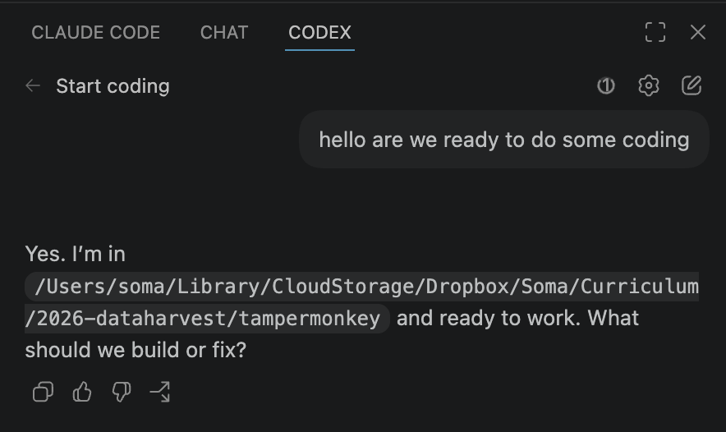

Slide 22
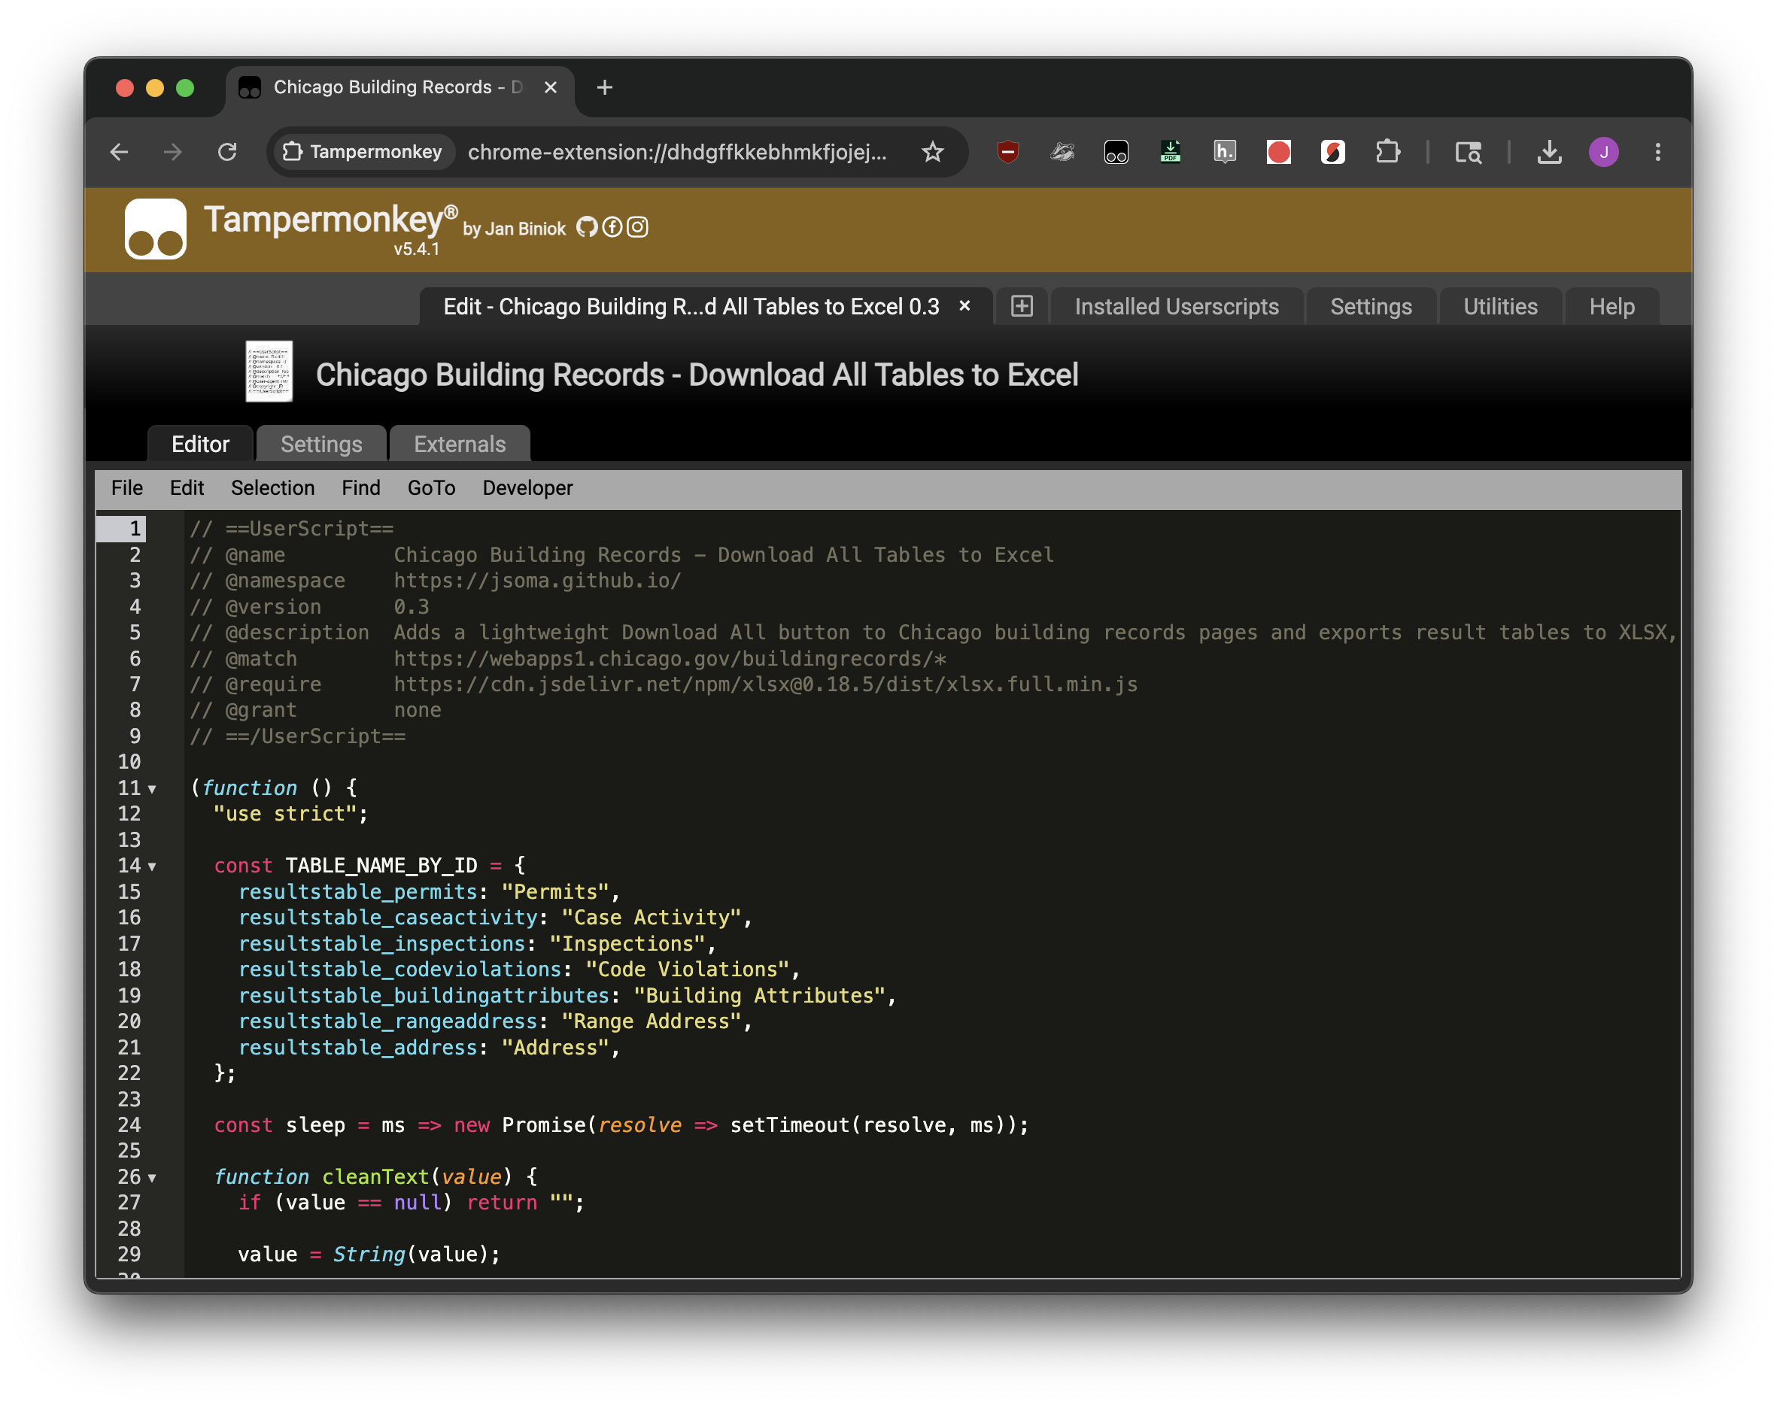

Slide 23
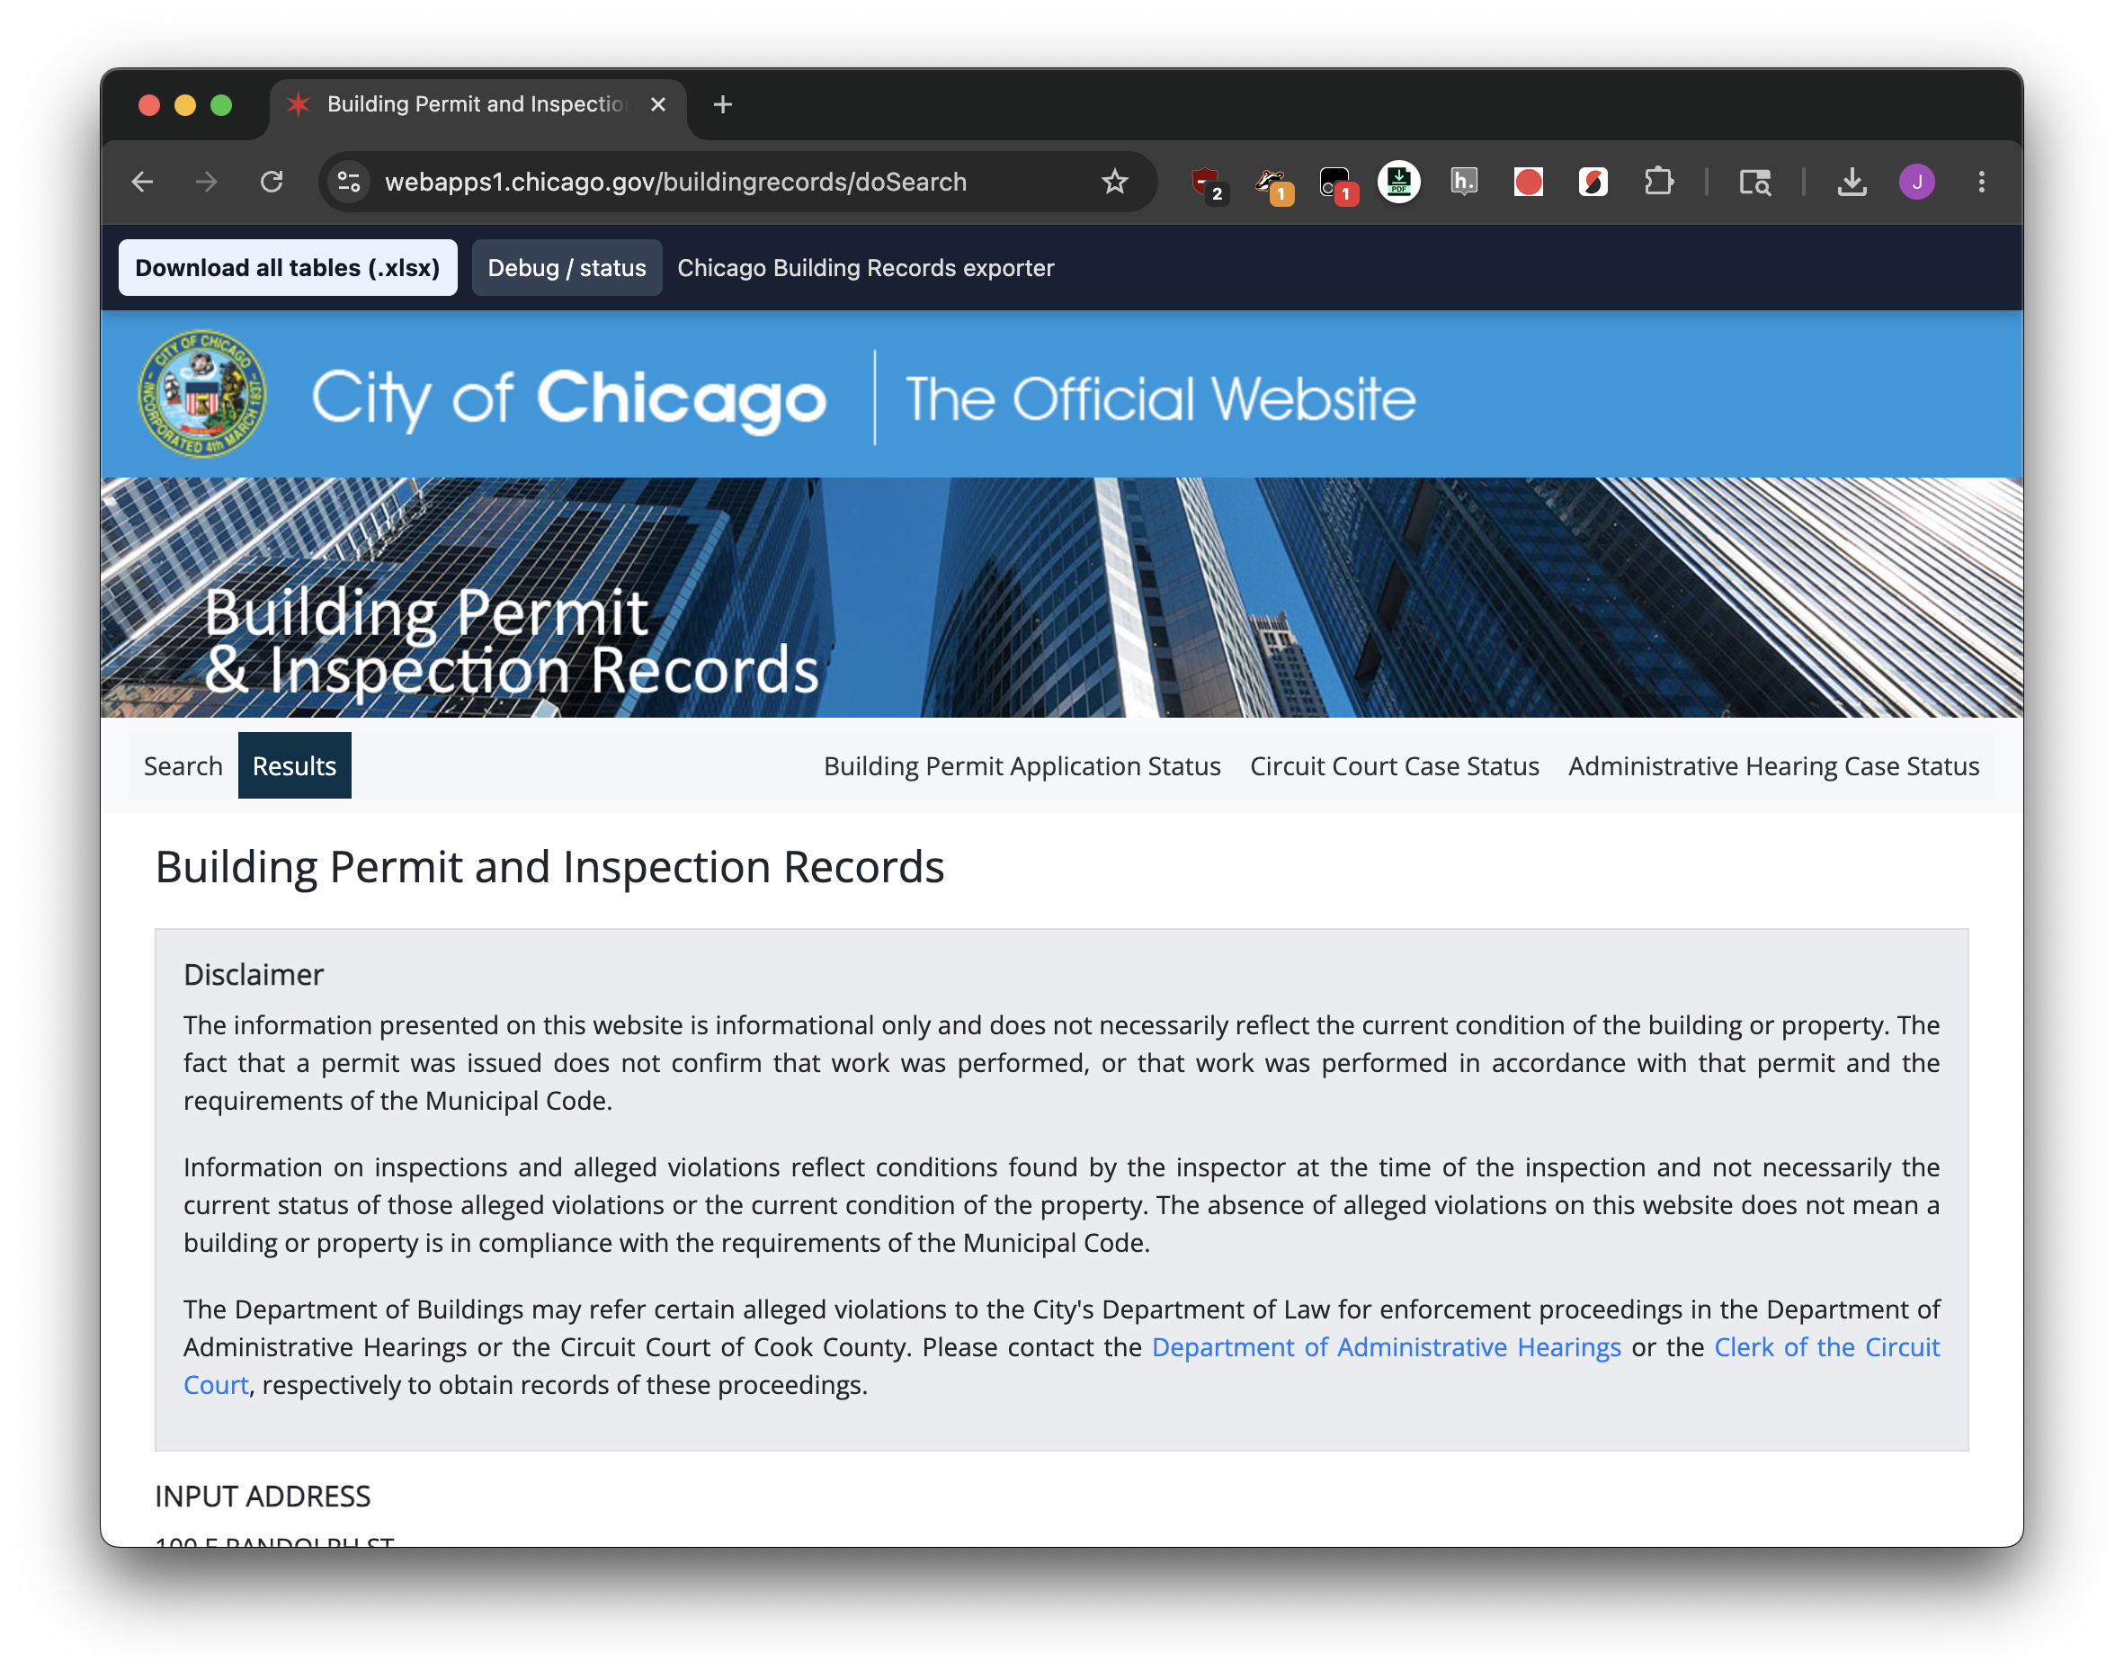


Slide 24
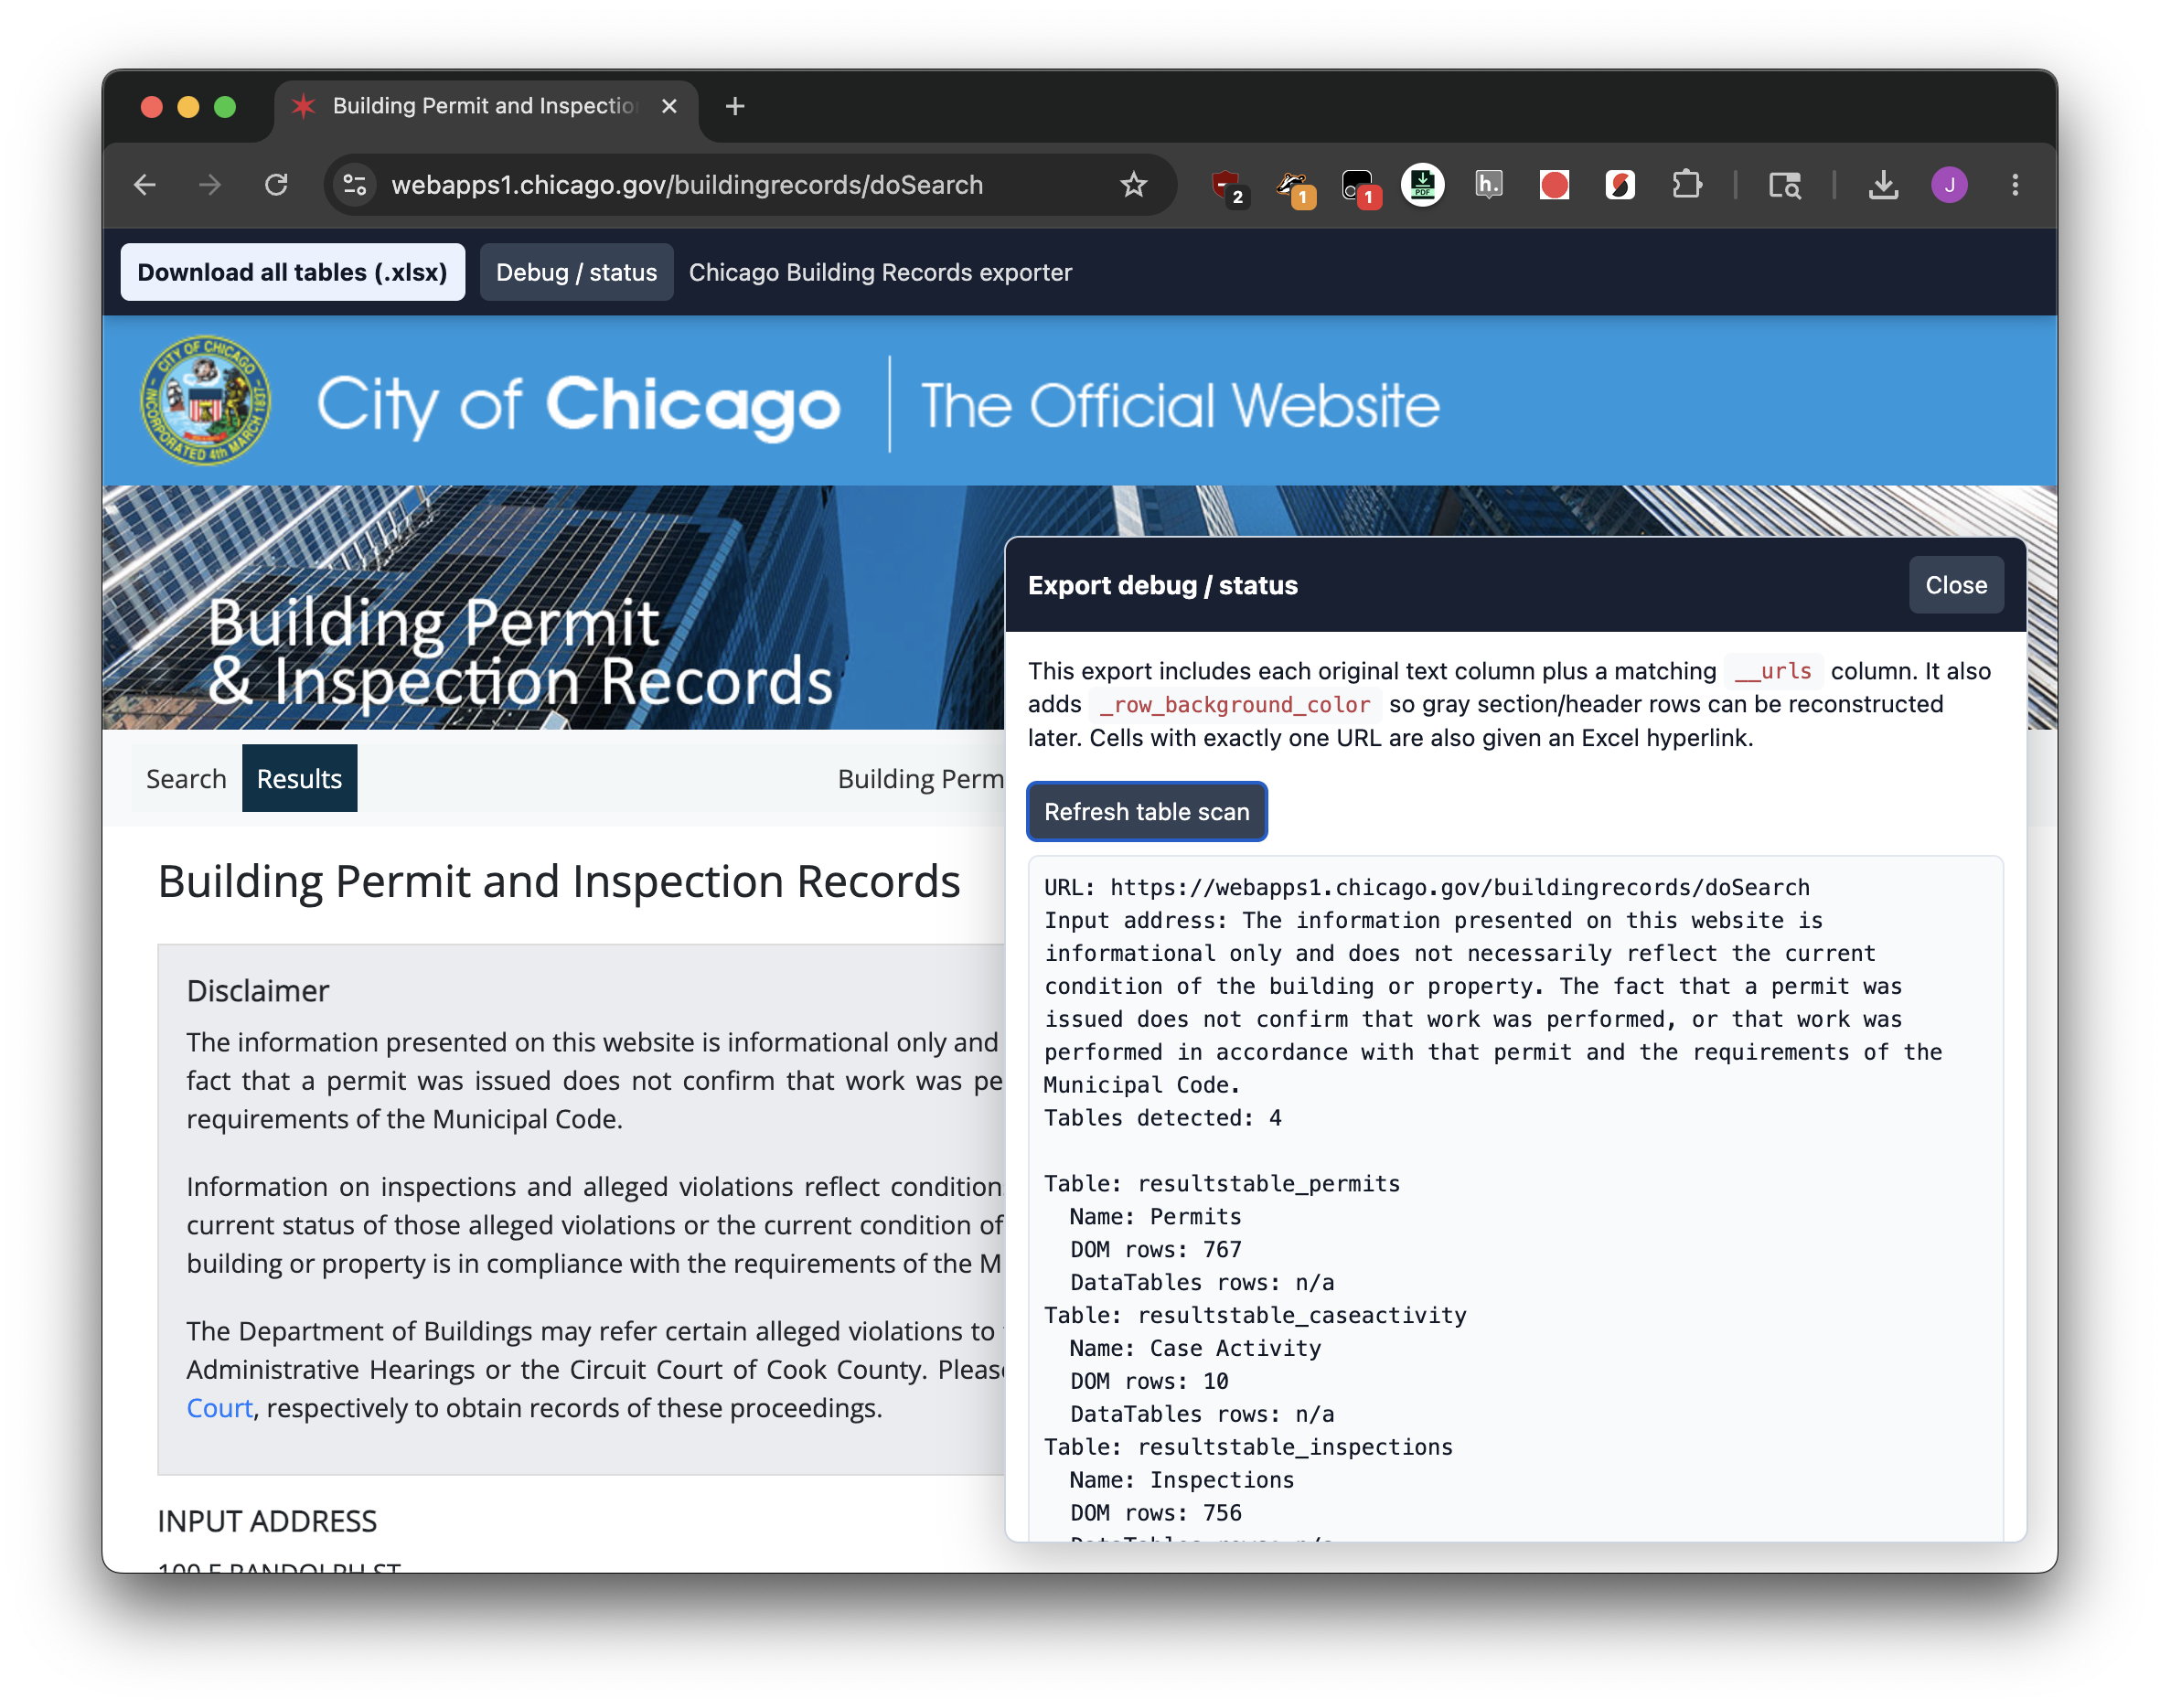

Slide 25
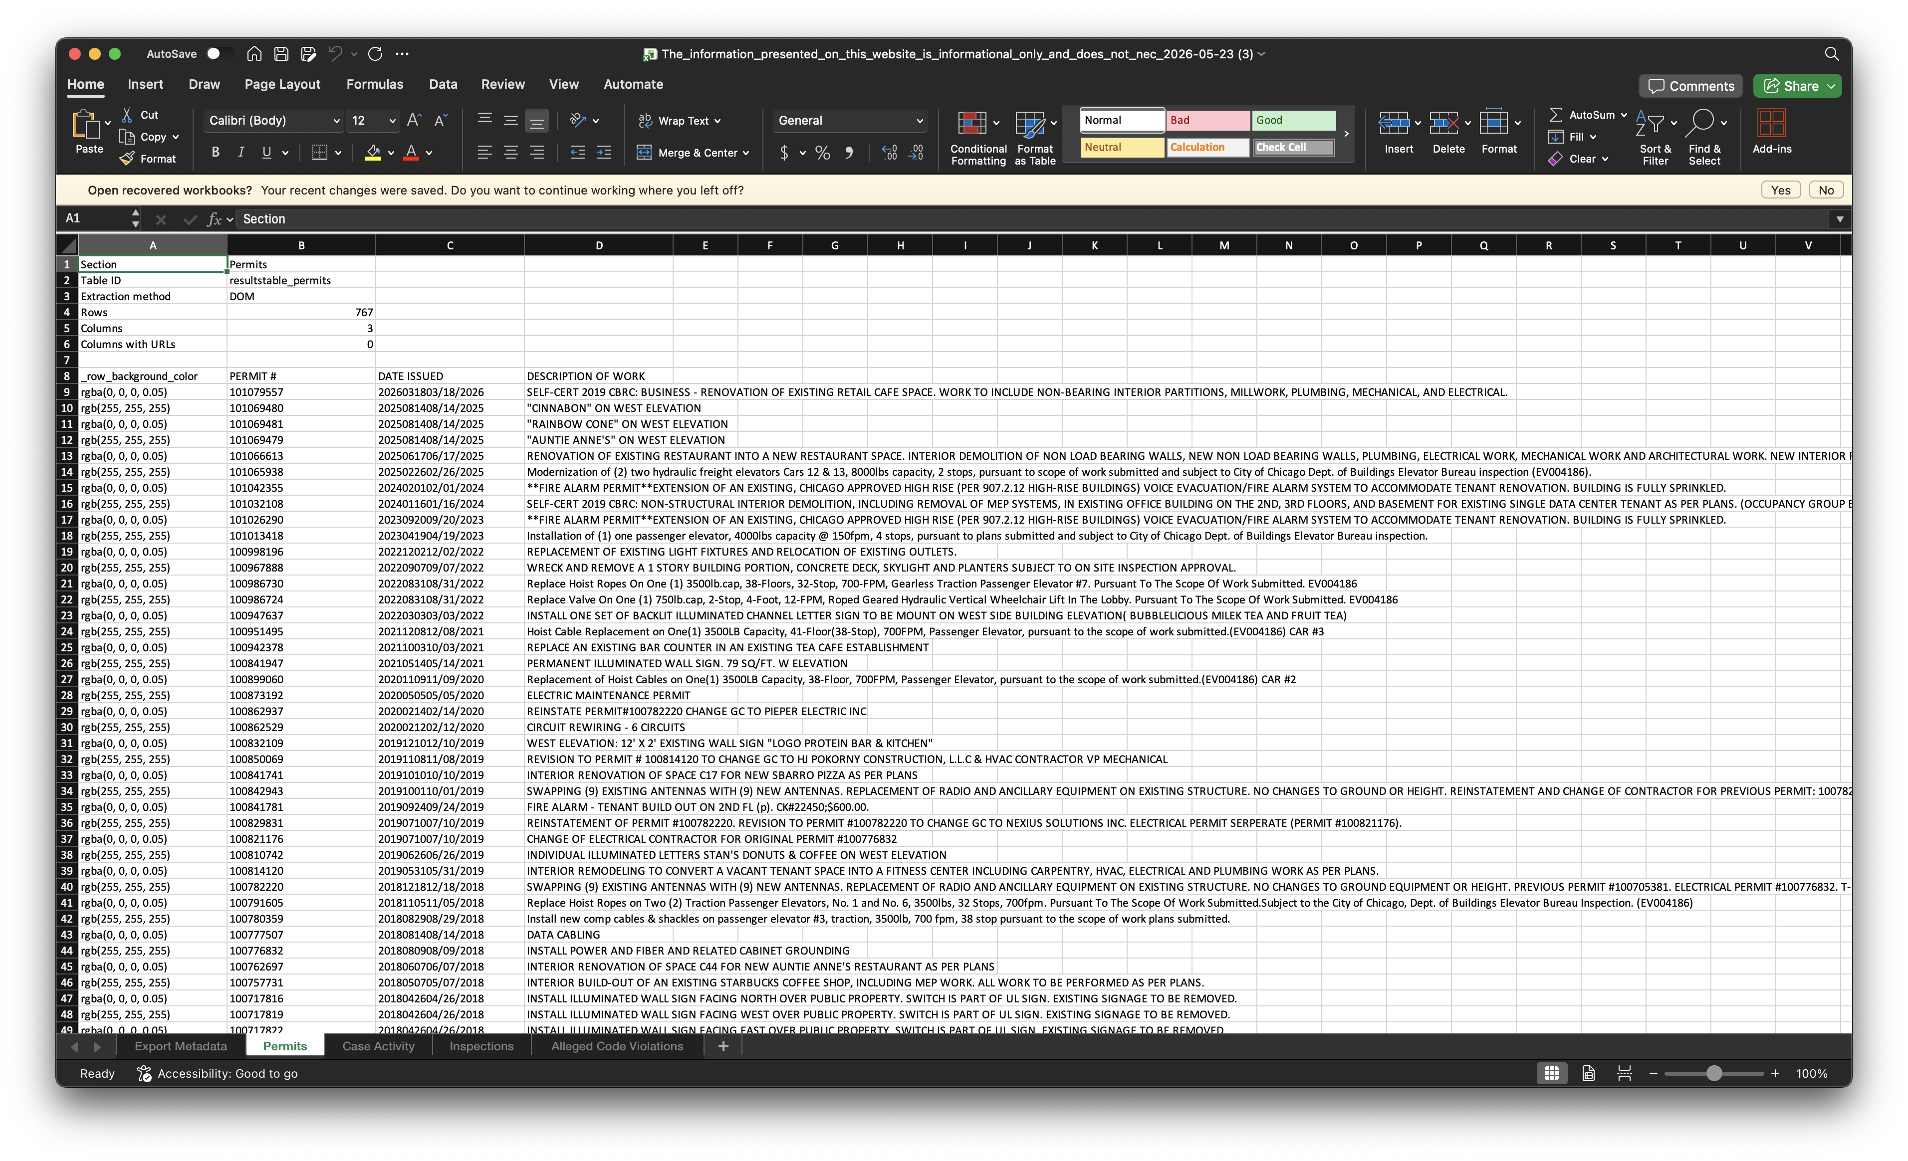
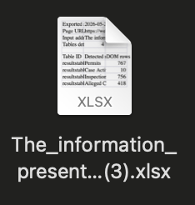

Slide 26
// ==UserScript==
// @name Chicago Building Records - Download All Tables to Excel
// @namespace https://jsoma.github.io/
// @version 0.3
// @description Adds a lightweight Download All button to Chicago building
// @match https://webapps1.chicago.gov/buildingrecords/*
// @require https://cdn.jsdelivr.net/npm/xlsx@0.18.5/dist/xlsx.full.min.js
// @grant none
// ==/UserScript==

Slide 27
“But that’s still too much work!”
Let’s talk about uploading content and having it automate processes for you

Slide 28
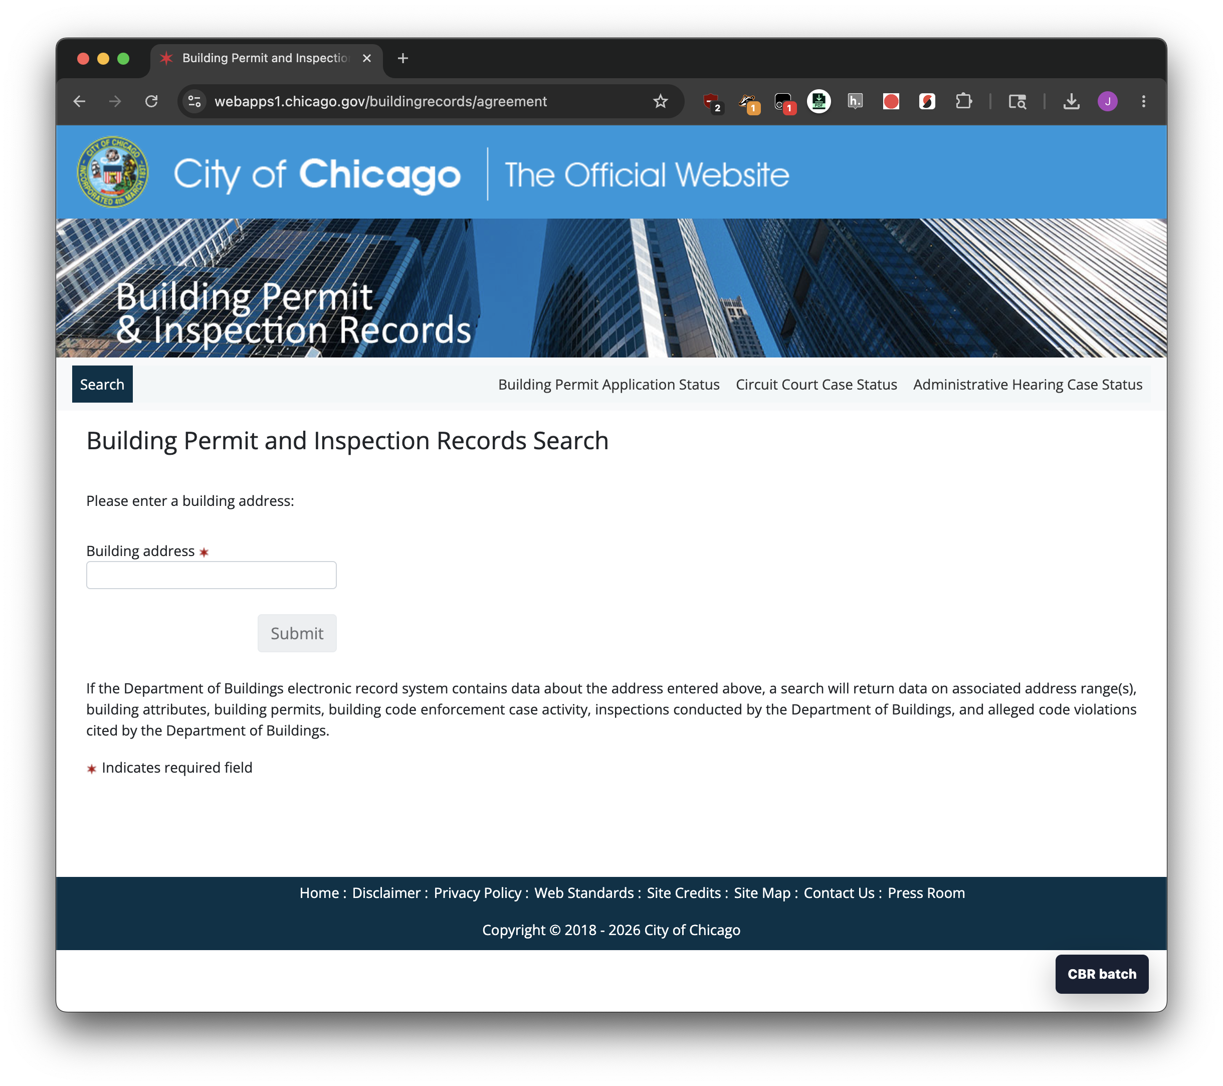
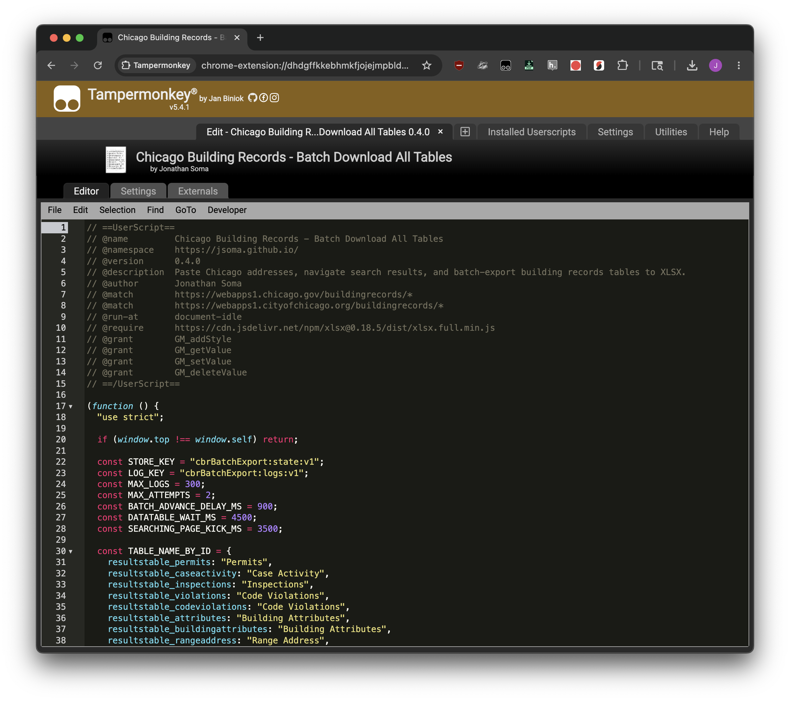


Slide 29
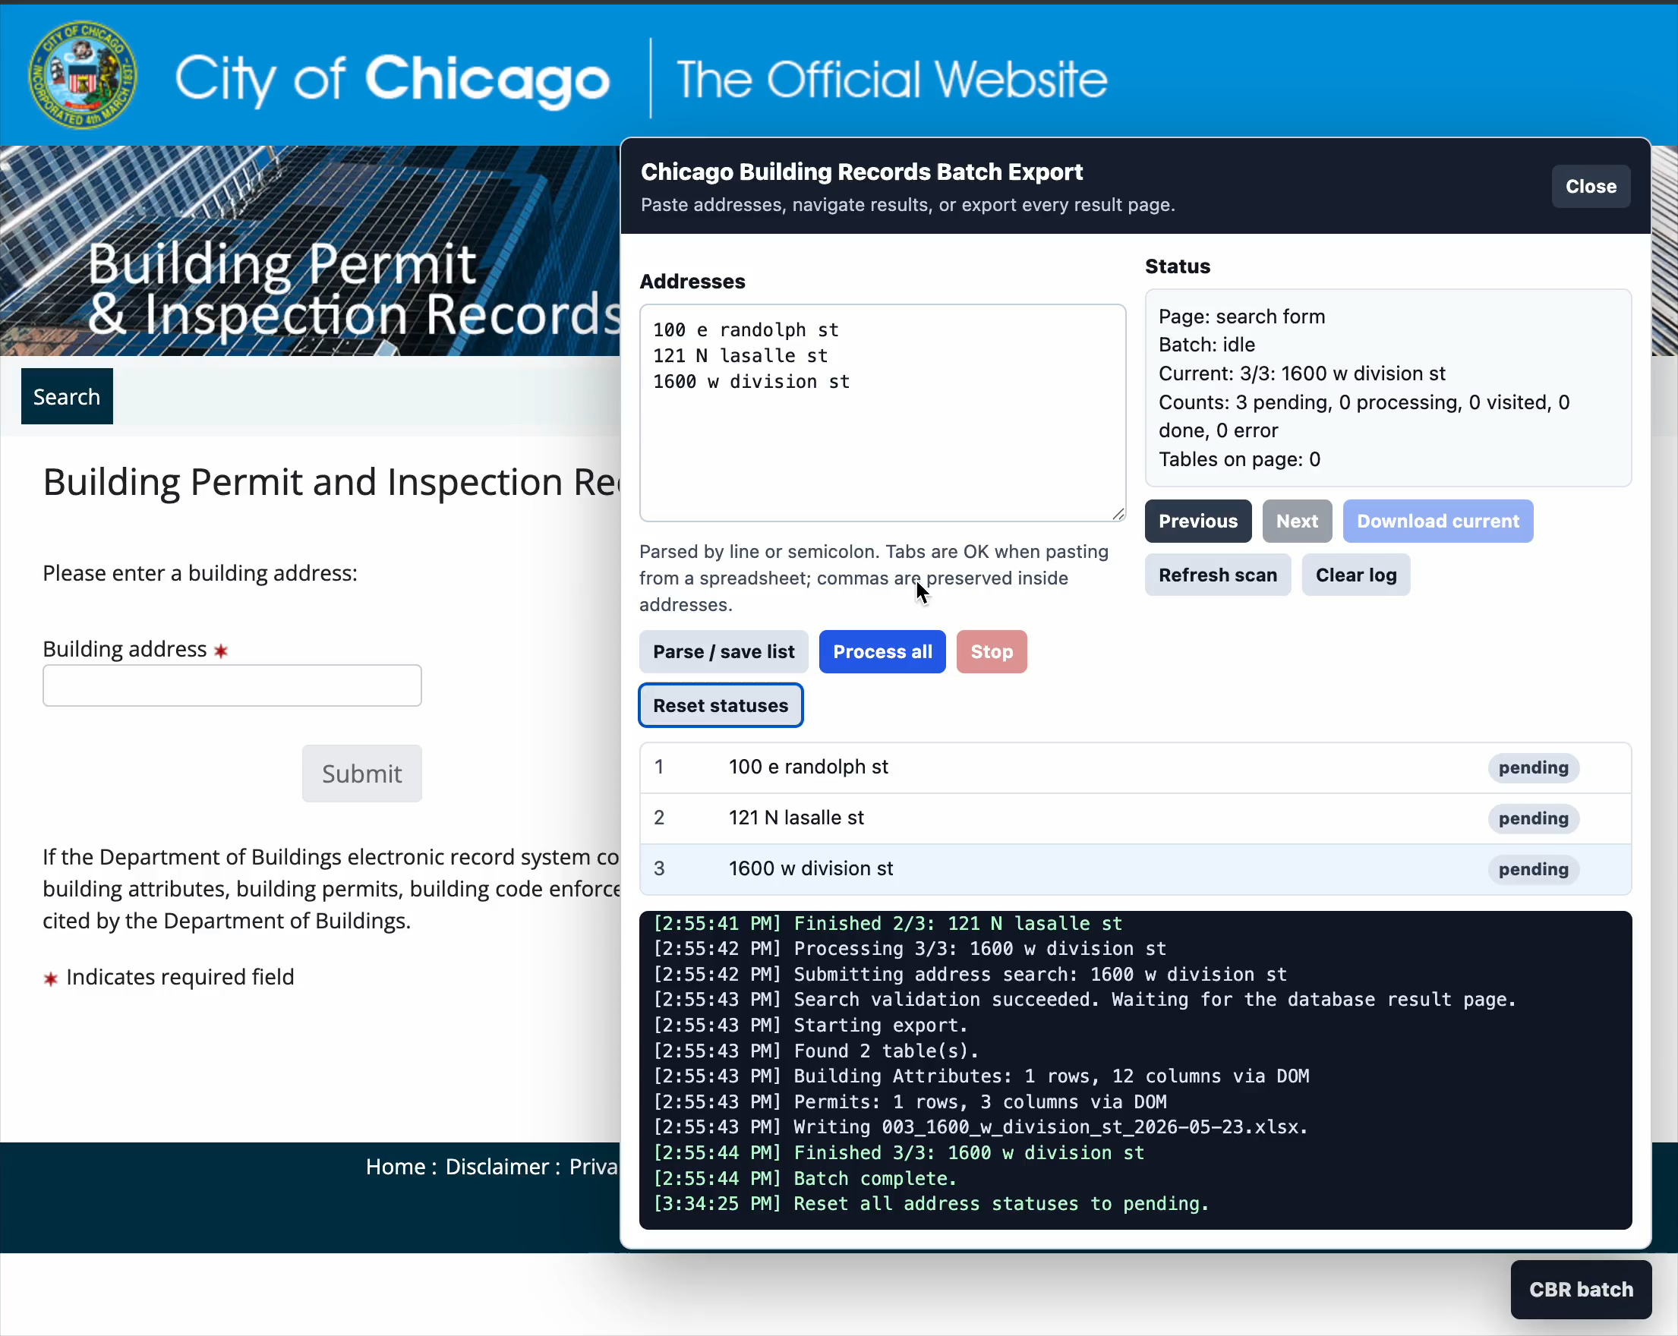
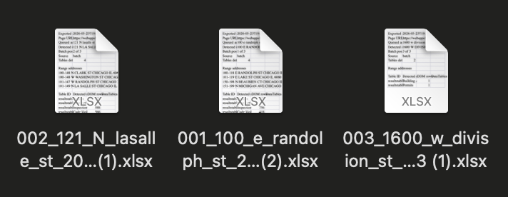

Slide 30
// ==UserScript==
// @name Chicago Building Records - Batch Download All Tables
// @namespace https://jsoma.github.io/
// @version 0.4.0
// @description Paste Chicago addresses, navigate search results, and batch-export building records tables to XLSX.
// @author Jonathan Soma
// @match https://webapps1.chicago.gov/buildingrecords/*
// @match https://webapps1.cityofchicago.org/buildingrecords/*
// @run-at document-idle
// @require https://cdn.jsdelivr.net/npm/xlsx@0.18.5/dist/xlsx.full.min.js
// @grant GM_addStyle
// @grant GM_getValue
// @grant GM_setValue
// @grant GM_deleteValue
// ==/UserScript==

Slide 31
“But that’s still too much work!”
Let’s talk about how to write userscripts without ever lifting a finger

Slide 32
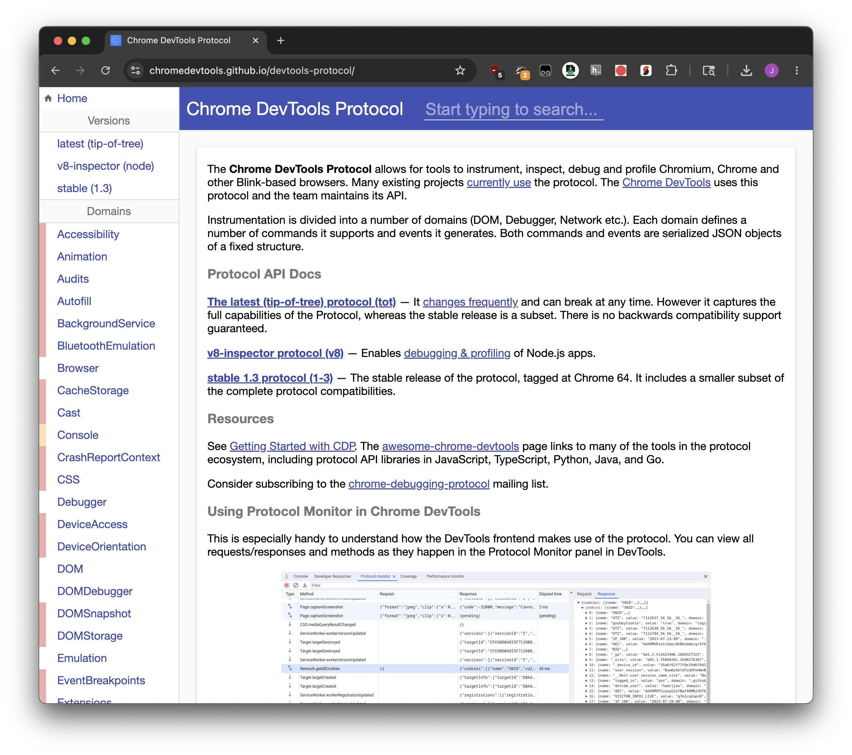
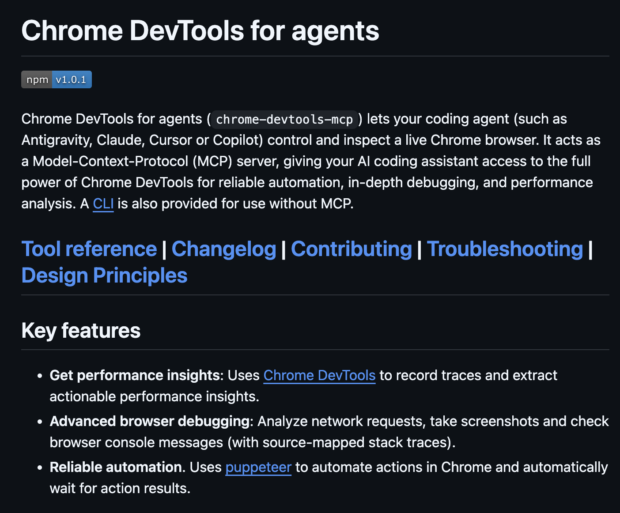





Slide 33
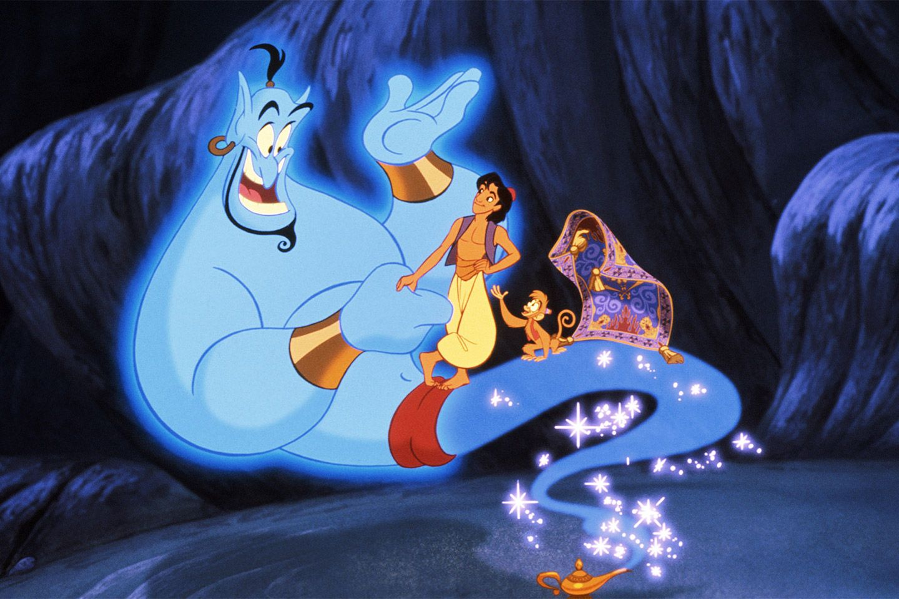



Use Chrome CDP and Tampermonkey
and give me everything I want
:D

Slide 34
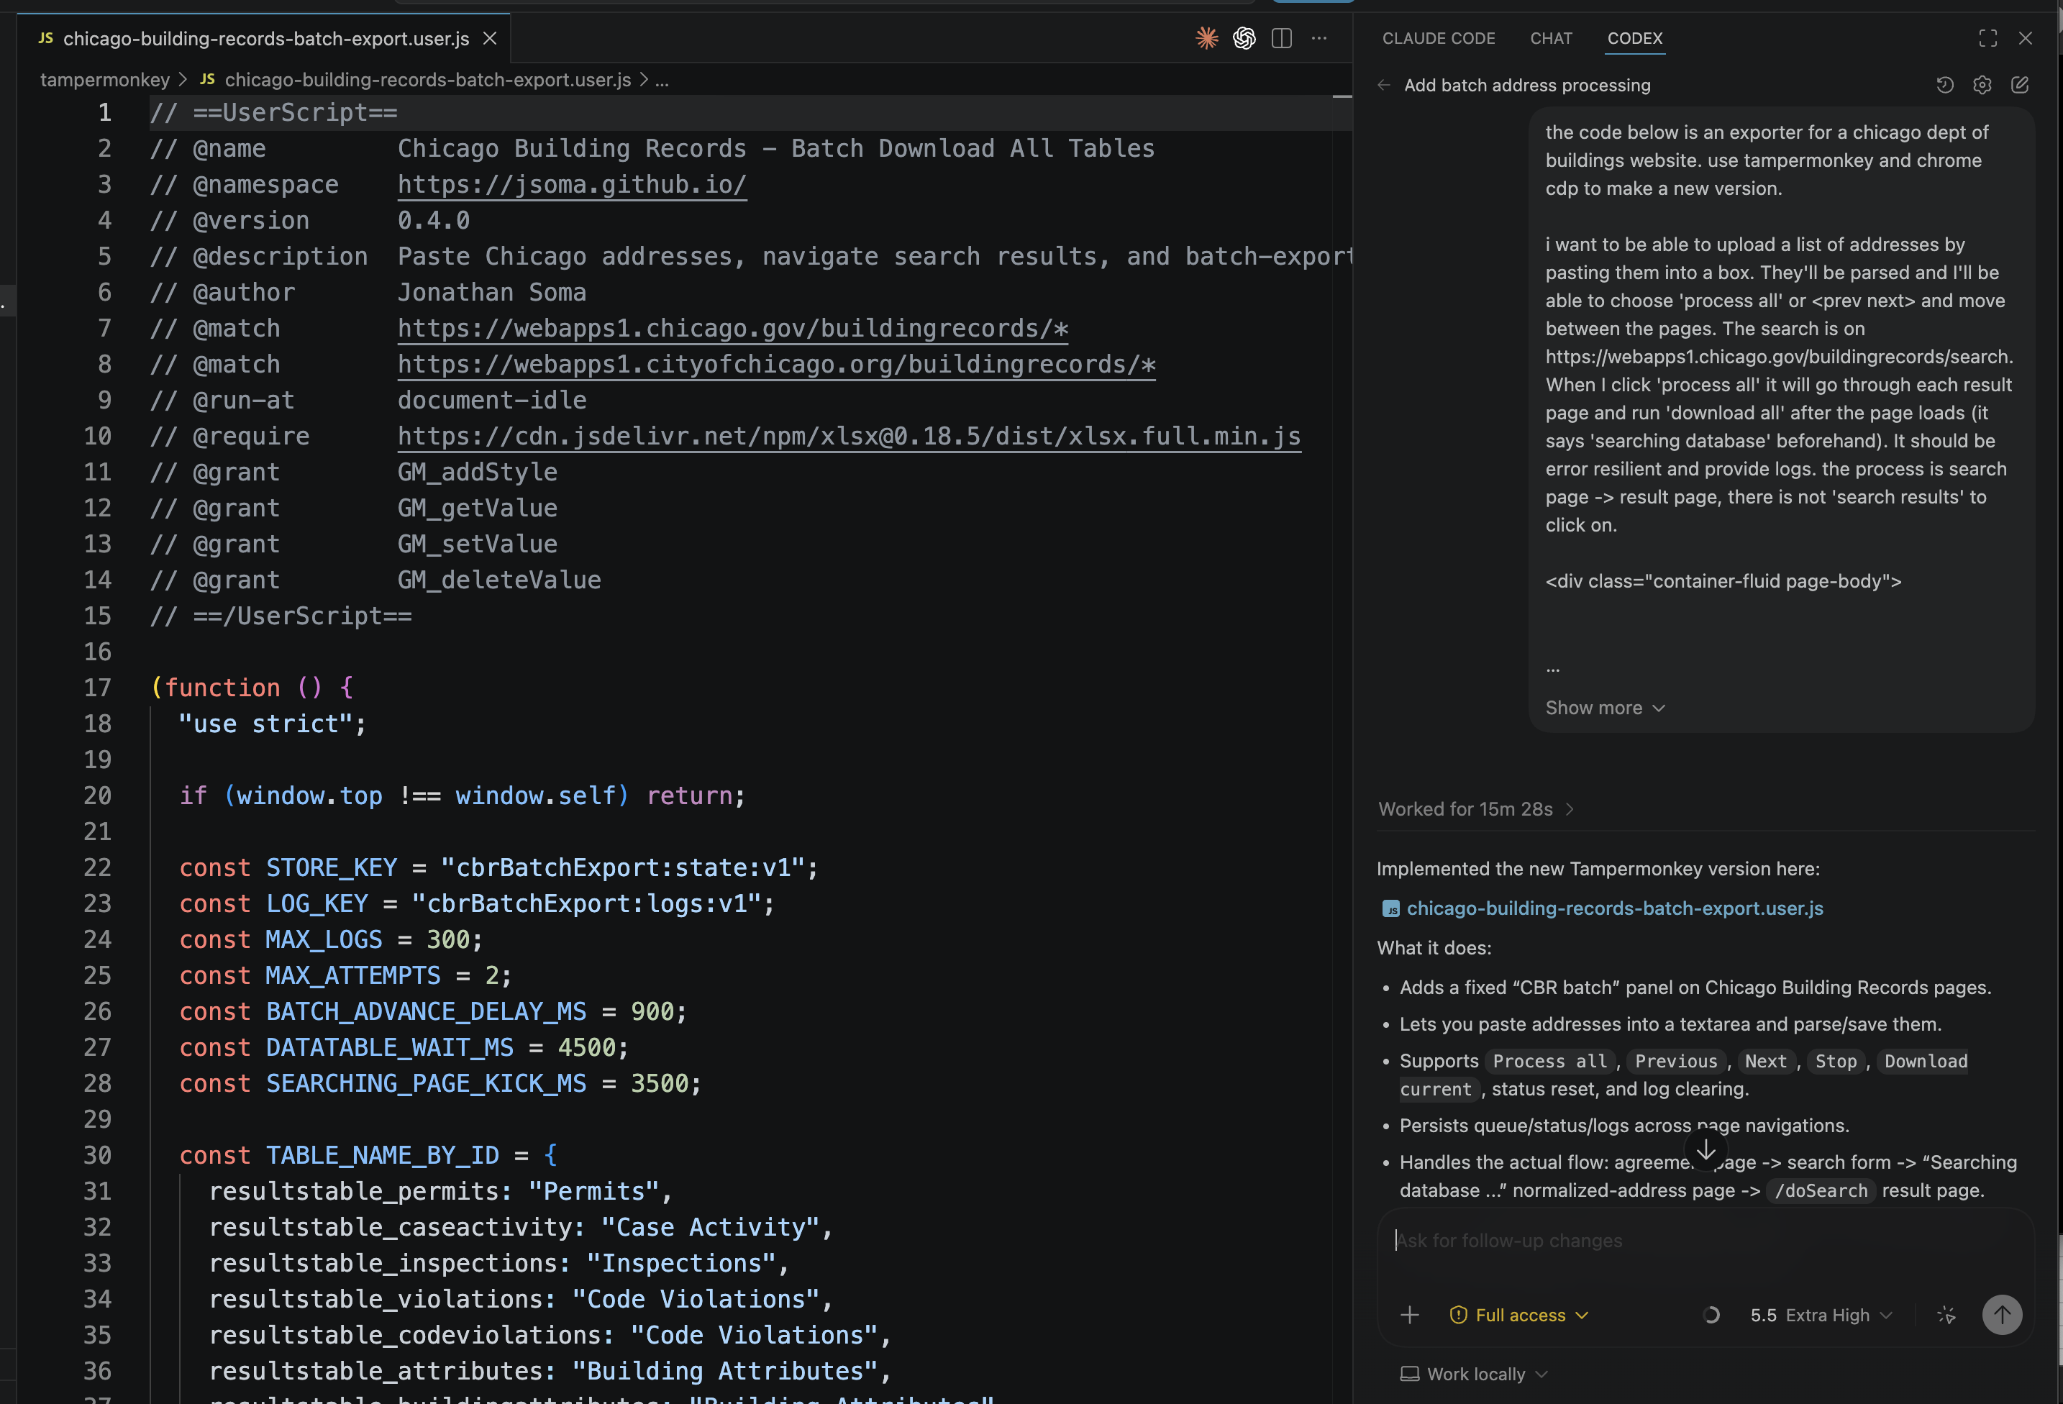


Slide 35
I am so excited!
I’M NOT DONE YET Let’s talk about talking to external services and saving custom variables like API keys

Slide 36
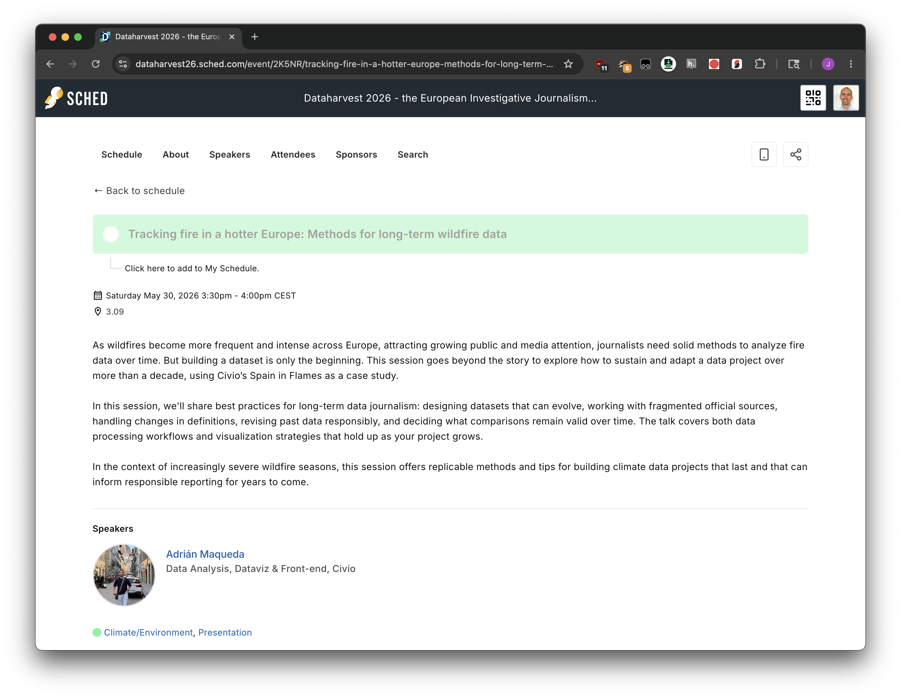

Slide 37
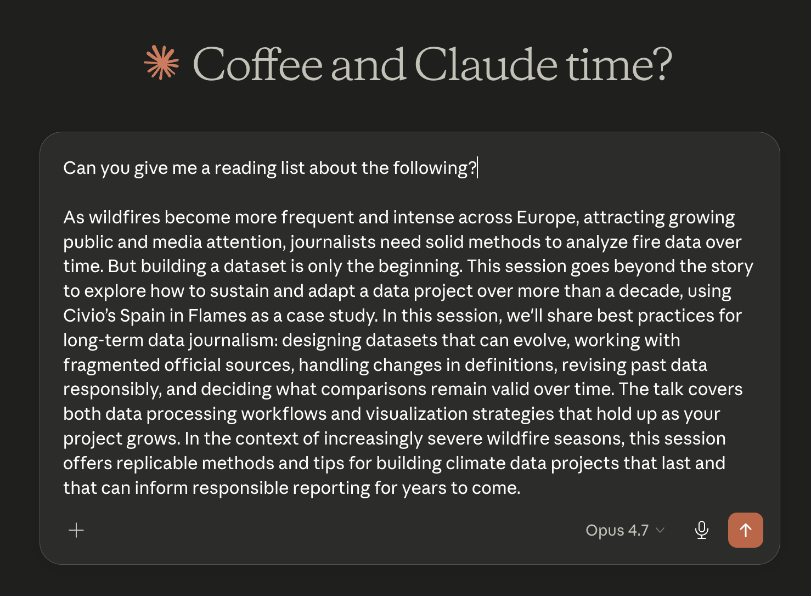

Slide 38
// @run-at document-idle
// @grant GM_addStyle
// @grant GM_xmlhttpRequest
// @grant GM_getValue
// @grant GM_setValue
// @grant GM_deleteValue
// @connect api.openai.com
// @connect openrouter.ai
// @connect api.anthropic.com
// @connect generativelanguage.googleapis.com
// @connect *
// @require https://cdnjs.cloudflare.com/ajax/libs/jspdf/2.5.1/jspdf.umd.min.js
// @require https://cdnjs.cloudflare.com/ajax/libs/jszip/3.10.1/jszip.min.js

Slide 39
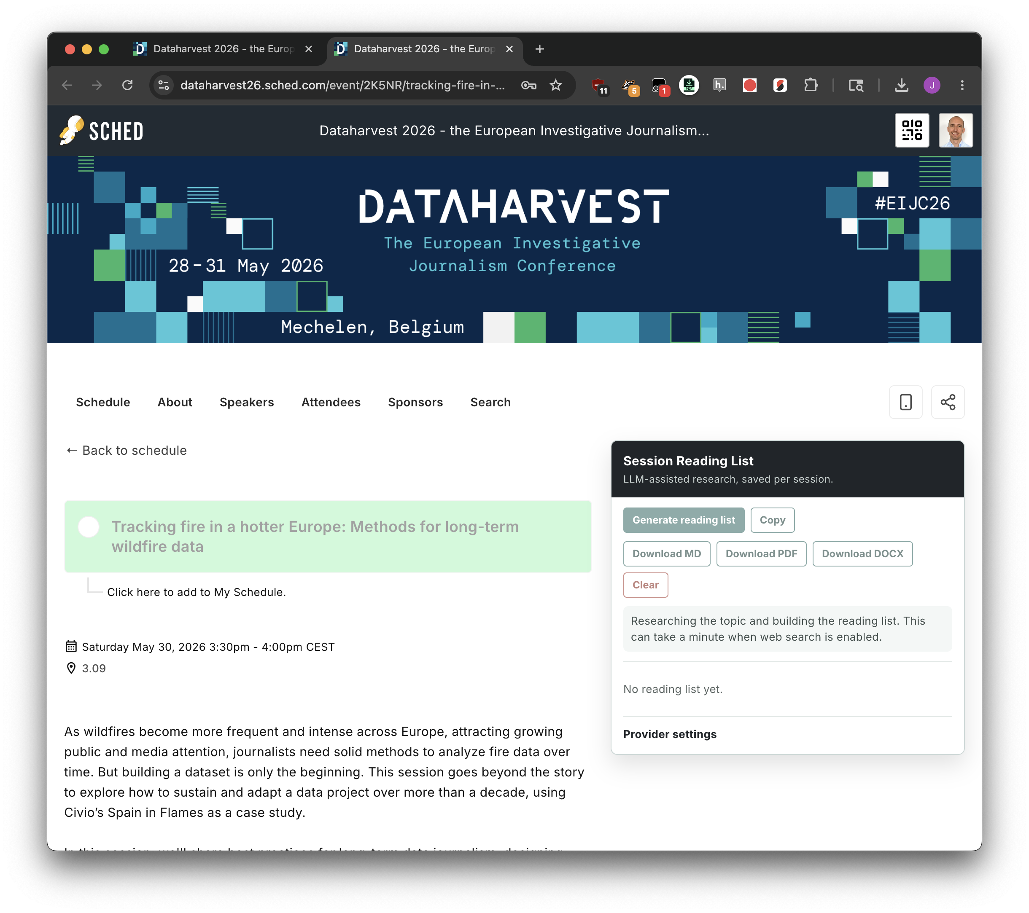















Slide 40



Slide 41







Slide 42



Slide 43
“Wow I can’t believe how incredible this is, it really must have taken you ten hours? Sixty hours?”
Okay I know we all know AI did the work here but maybe you can at least be impressed by my prompting skills

Slide 44
“Now build another one where I can pick a session and it calls out to an LLM provider and does some research on the topic and makes me a SOTA reading list of tech and tutorials and journalism stories on the topic. The button should exist only on the detail page. it should say 'generate reading list' and it should populate into the right-hand side and be downloadable as md or pdf or docx. and if there's a github repo etc mentioned it should try to look at that if possible (i guess that just goes into the prompt?).”

Slide 45
“Now build another one where I can pick a session and it calls out to an LLM provider and does some research on the topic and makes me a SOTA reading list of tech and tutorials and journalism stories on the topic. The button should exist only on the detail page. it should say 'generate reading list' and it should populate into the right-hand side and be downloadable as md or pdf or docx. and if there's a github repo etc mentioned it should try to look at that if possible (i guess that just goes into the prompt?).”

Slide 46
“Okay I get it we’re done here”
I HAVE ONE MORE THING we’ll finish up by really really taking advantage of localStorage and downloads and adding all of the normal features you ever wanted

Slide 47


Slide 48



Slide 49






Slide 50


Slide 51
“I’m convinced!”
But how do you distribute them?

Slide 52

// @match https://app.example.com/*
// @grant none
// @downloadURL https://raw.githubusercontent.com/your-org/your-repo/main/my-team-tool.user.js
// @updateURL https://raw.githubusercontent.com/your-org/your-repo/main/my-team-tool.user.js

Slide 53
Tampermonkey 101
Hack your CMS (and the rest of the web)
Jonathan Soma
js4571@columbia.edu • dangerscarf
Columbia University
bit.ly/dh-tampermonkey

